Slide 1
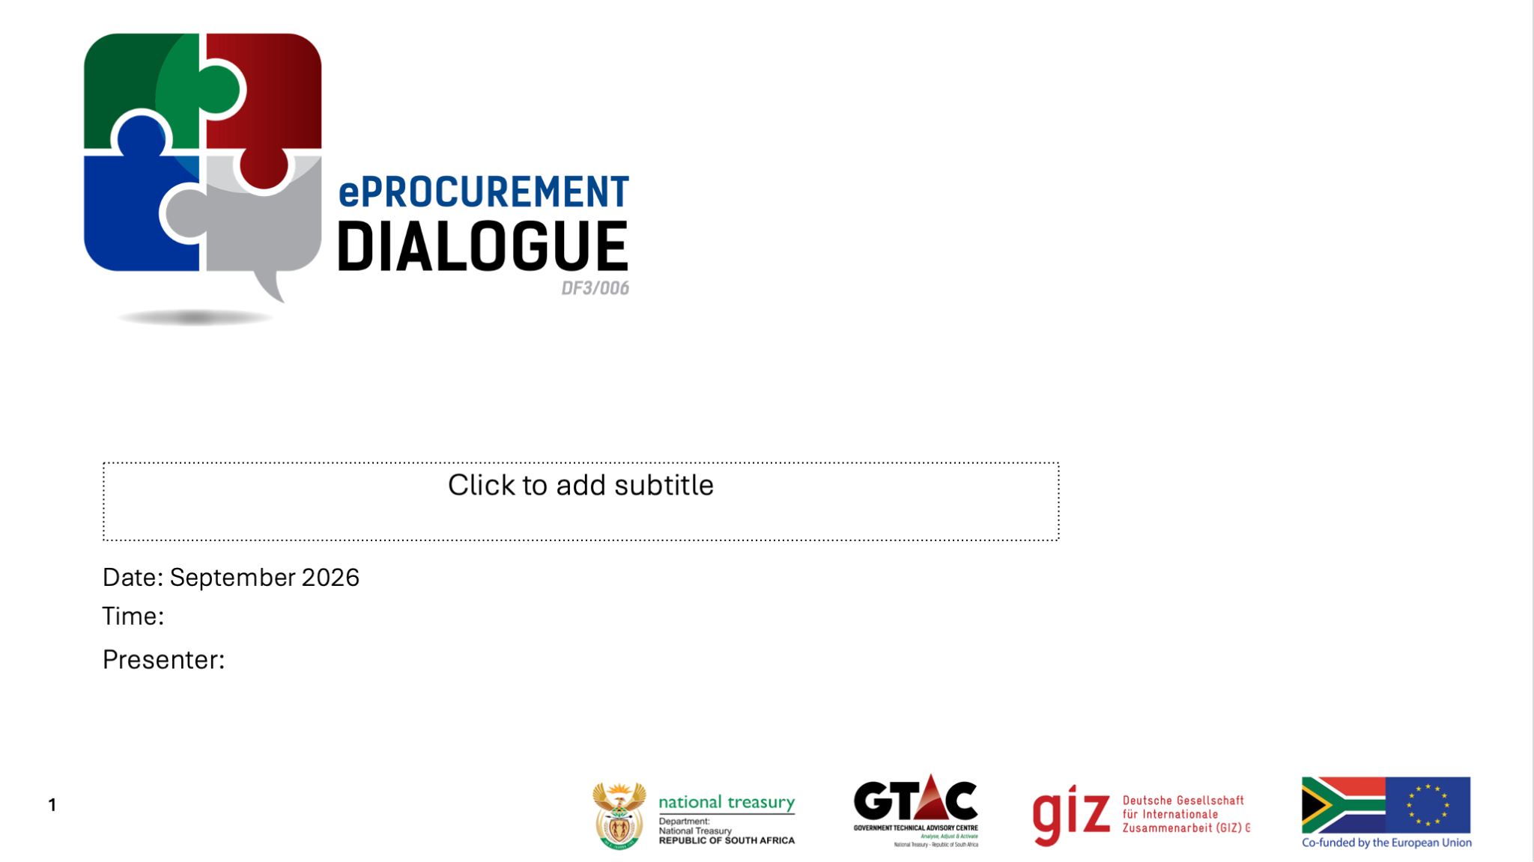
Digitising public procurement well
Transparency, accountability and integrity by design
Limpopo Provincial Dialogue | October 2026
Presenter: Mr Joshua Swart
African Procurement Law Unit | Stellenbosch University Faculty of Law
Notes:
Opening — about 30 seconds
I want to keep this discussion practical and accessible.
The question is not simply whether procurement should become digital. The question is: when we digitise procurement, what should actually become better?
For me, four things should improve: transparency, accountability, integrity and value for money.
I will use one South African case — Inzalo — to show what can go wrong, and then end with a practical checklist that can be taken back into an institution.

Slide 2

1. WHY DIGITISE?
When procurement goes digital, what should get better?
Putting a paper process onto a screen is not, by itself, procurement reform.
1
TRANSPARENCY
2
ACCOUNTABILITY
3
INTEGRITY
4
VALUE FOR MONEY
Can we see what was bought, from whom, for how much, and what changed?
Can we tell who approved what, when, and under whose authority?
Can the system surface conflicts, unusual prices and suspicious patterns?
Can yesterday’s procurement data improve tomorrow’s procurement decision?
INTEGRITY BY DESIGN = make the right behaviour easier to follow and easier to prove.
Anchor: Constitution s 217 — fairness, equity, transparency, competitiveness and cost-effectiveness.
Notes:
Slide 1 — about 1 minute
Before discussing platforms or AI, I would start with outcomes.
A procurement process is not improved merely because forms have moved online.
Digitisation should make four things better: transparency, accountability, integrity and value for money.
That is the basic idea behind integrity by design: the system should make the right behaviour easier to follow and the evidence easier to prove.
This is also why digital procurement should be viewed as a governance issue, not only an ICT project.

Slide 3

2. CASE STUDY
Inzalo:* “data” is not one legal object
The contract failed to define “data”, and the dispute only became visible at exit.
Classify before you contract
THE CONTRACTUAL FAILURE
“The customer reserves the right to all data captured…”
Data class
Minimum contractual treatment
Government source / input data
Government access, control and portable export
But the Master Agreement defined neither “data” nor “captured data”. It separately protected Inzalo’s software as its intellectual property.
Derived / work-product data
Expressly allocate access, use and control
Personal information
POPIA-governed stewardship + access/security rules
Metadata / audit logs
Express allocation, retention and audit access
SCA result
The High Court’s “all data” order was overbroad. The matter was remitted to determine what data, if any, the municipality was entitled to receive.
Supplier software / operational IP
Identify what remains supplier-owned
Backups / configurations
Separate government data from supplier IP; define restore/export rights
Practical rule: EXIT IS PART OF ACQUISITION
*Inzalo Enterprise Management Systems (Pty) Ltd v Chief Albert Luthuli Municipality [2025] ZASCA 85, paras 7–16
Notes:
Slide 2 — about 2 minutes
Inzalo is the case I would use to make the whole discussion concrete.
The municipality depended on an integrated system for core functions including finance, payroll, revenue and other statutory operations.
The contract said that the customer reserved the right to “all data captured”, but it never properly defined what “data” or “captured data” meant. At the same time, the supplier’s software was protected as its intellectual property.
When the contract ended and a replacement supplier needed the information, the uncertainty became operationally serious.
The Supreme Court of Appeal held that the High Court’s broad “all data” order went too far and sent the matter back to determine what data, if any, the municipality was actually entitled to receive.
The practical lesson is on the right-hand side: classify before you contract.
Government data, personal information, audit logs, supplier IP, backups and configurations do not all require the same contractual treatment.
The takeaway is simple: EXIT IS PART OF ACQUISITION.

Slide 4

3. RECORDS & ARCHIVING
The procurement record must survive the platform
A digital record is still evidence. It must remain reliable, retrievable and understandable over time.
1
THE DECISION
2
THE HISTORY
3
THE EVIDENCE
4
THE SURVIVAL
Bids, scoring, reasons, approvals and declarations.
Versions, amendments, variations and timestamps.
Who did what, when, and under whose authority.
Searchable, exportable and usable even if the platform or supplier changes.
IMPLEMENTOR’S TEST: Can an auditor reconstruct the decision years later without the original platform or supplier?
Sources: PFMA Treasury Regulations 17.1 & 17.2; National Archives and Records Service of South Africa electronic-records guidance.
Notes:
Slide 3 — about 1.5 minutes
The second lesson is records.
A digital procurement process still creates public records and evidence.
Years later, an auditor, Treasury official, investigator, court or civil-society organisation may need to understand what was advertised, what bidders submitted, who evaluated it, what changed and why.
So the system must preserve the decision, the history and the evidence — and the record must survive the technology itself.
National Archives guidance for electronic records specifically emphasises matters such as audit trails, version control, contextual information, integrity and reliability.
The practical test is therefore: can an auditor reconstruct the decision years later without the original platform or supplier?

Slide 5
4. DATA BY DESIGN
The system can only aggregate what it captures consistently.
CAPTURE ONCE - STANDARDISED FIELDS
WHAT THIS UNLOCKS
A digital form should collect comparable identifiers and values, not only uploaded PDFs.
1 Price Outliers - compare like-for-like unit prices across entities, suppliers, regions & time - and flag unusual deviations before award.
2 Entity linkages - match a director or BO identifier across supplier entities and awards to surface relationships that deserve scrutiny.
3 Lifecycle patterns - compare initial award, variations, final cost, delays, and payment patterns across similar contracts.
Commodity/ category Unit/quantity
Unit price (ex VAT) Award value / final cost
Supplier Reg no. Director/ BO identifier*
Contract / project ID Award date/ variation
* Use a stable identifier where legally appropriate. Capture does not mean indiscriminate publication; access must remain POPIA-compliant
IMPLEMENTATION RULE: STANDARDISE → STRUCTURE → AGGREGATE
5
Sources: Open Contracting Partnership, Tanzania NeST case study (2026); OCP, Chile beneficial-ownership reform (2025).
Notes:
Slide 4 — about 1.5 minutes
This is where the discussion moves from risk to opportunity.
Structured data only works if government is also using a common language.
So the sequence is: standardise first, structure second, aggregate third.
If one institution records a laptop as “ICT equipment” and another as “notebook computer”, both entries may be digital but they are still difficult to compare.
Common codification standards make it possible to compare like-for-like prices, identify suppliers across the system and follow contract performance over time.
The practical point is also about the form itself. Where possible, capture important information as structured fields — commodity code, unit price, supplier number, director or beneficial-owner identifier, contract value and variations — rather than burying everything inside PDFs.
That is what turns transactions into usable integrity signals.

Slide 6


5. AGGREGATED INSIGHT
Aggregate the spend - then change the procurement decision
Historical transactions become a planning and anti-corruption asset.
1. Cost Better
2. Buy Better
3. See Relationships
Benchmark unit prices and total costs for repeat purchases.
Use historic contracts to improve estimates, identify persistent overruns and test whether a price is an outlier.
Illustrative query:
“Why is Entity A paying materially above the provincial median for the same commodity?”
Aggregate spend by commodity, entity and period.
High-volume categories may justify transversal or framework arrangements; stable demand data can support more accurate multi-year contracting and budgeting.
Ask:
“What are the real budget drivers across the province?”
Measure supplier concentration, repeat awards and common ownership.
Link supplier entities to directors / beneficial owners so apparently separate firms can be checked for shared individuals or other connections.
The signal triggers review - it does not replace due process.
OCP: historic contract data can establish cost benchmarks.
6
DATA DOES NOT REPLACE JUDGEMENT - IT TELLS OFFICIALS WHERE SCRUTINY IS MOST NEEDED. (FLAGS)
Notes:
Slide 5 — about 1.5 minutes
Once the data is standardised and structured, aggregation changes the procurement decision itself.
First, cost better. Historic prices give officials a benchmark and make outliers easier to identify.
Second, buy better. Provincial Treasury can see what the province is buying in high volume and what is really driving expenditure. That can inform transversal or framework contracting, demand aggregation and more accurate multi-year planning.
Third, see relationships. Aggregated supplier information can show concentration, repeat awards and common ownership. Linked to director or beneficial-owner identifiers, it can surface relationships that deserve closer scrutiny.
The important qualification is that data gives us flags, not findings. It tells us where human judgement and investigation should be focused.
So good eProcurement moves integrity earlier — from retrospective audit towards earlier, data-informed scrutiny.

Slide 7
6. CONTRACTING CONTROLS
Eight questions to answer before award
1
CLASSIFICATION
2
RIGHTS & IP
3
STORAGE & ACCESS
4
EVIDENCE
What data classes will the system hold or generate?
Who owns / controls each class, and what remains supplier IP?
Where is data stored / backed up, and who can remotely access it?
Are approvals, versions, logs and timestamps retained and exportable?
5
PORTABILITY
6
INTEROPERABILITY
7
CONTINUITY
8
EXIT
Can government extract usable data in an open / documented format?
Can another system or provider ingest it using documented interfaces?
What backup, restore and disaster-recovery obligations are enforceable?
Who migrates, by when, at what cost, and how is deletion verified?
Build the schedule with:
SCM + business owner + ICT + legal + records manager + internal audit
ONE OWNER ≠ ENOUGH
7
Sources: Inzalo [2025] ZASCA 85; APLU Public Procurement of Cloud Services in South Africa (2026); GIZ AU support proposal (July 2026).
Notes:
Slide 6 — about 2 minutes
I would end the substantive part with this slide because it is the practical checklist.
Before award, ask eight questions.
What information will the system hold?
Who owns or controls each category?
Where is it stored and who can access it?
Will the evidence be retained?
Can government get usable data out?
Can another system actually use that data?
What are the continuity obligations?
And what happens at exit?
These questions do not belong to one official alone.
SCM, the business owner, ICT, legal, records management and internal audit each see a different part of the risk.
If participants remember only one slide, this is the one I would suggest they photograph and take back to their institution.

Slide 8
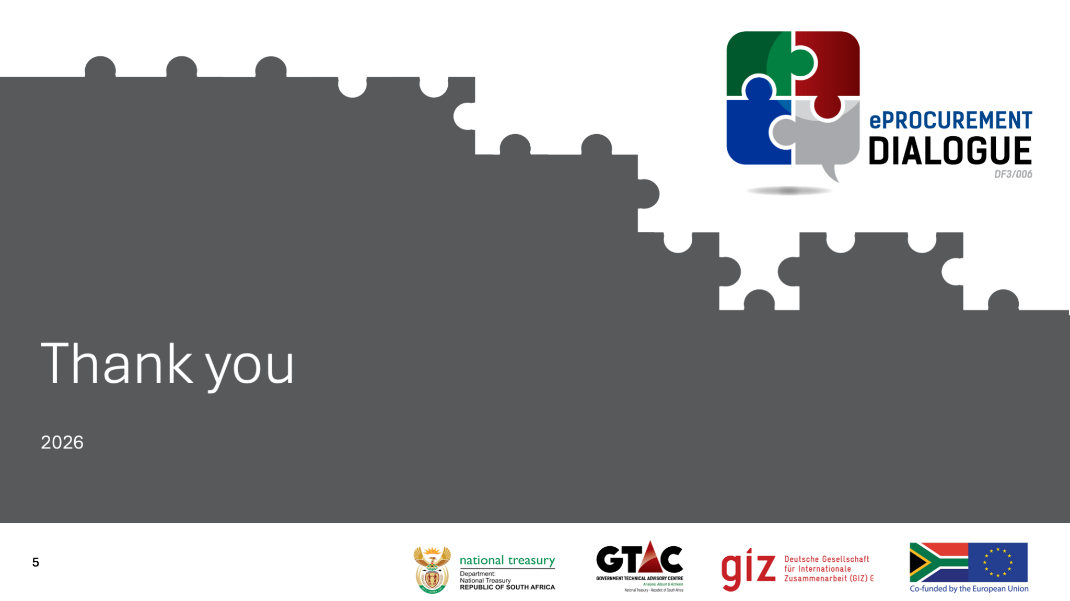
African Procurement Law Unit
Stellenbosch University Faculty of Law
Contact: jswart@africanprocurementlaw.org
Discussion: What would you change first in your institution’s procurement process?
8
Notes:
Close — about 20 seconds
The question I would leave with the room is practical:
If you could improve one part of your institution’s procurement process through better digital design, what would you change first?
That keeps the session as a dialogue rather than a lecture.

