Slide 1
Step 5b
Costing Models
Principles for evaluating and building costing models

Slide 2
Spending Review Methodology
Intro
Introduction & Savings
What to expect, how will we work?
Step 1
Institutional analysis
What is this implementation programme about?
Step 2
Process maps and Logframes
How does the programme work?
Step 3
Indicators protocols
How is it measured and how should it be measured?
Step 4
Expenditure Analysis
What are we spending on the programme?
Step 5
Cost Modelling
What does it actually cost to deliver the programme?
Step 6
Report and Action Planning
What are our key messages? Where can we find savings?

Slide 3
Read the following…
The challenge in modelling lies in the structure of the spreadsheet and which functions should be used to create an efficient and sophisticated model that is easy to use and can accommodate a wide range of eventualities.
Amateur modellers will want to solve the immediate problem. Their focus is on the problem and their challenge is how best to solve it and very often the spreadsheet becomes an impediment.
An experienced modeller is likely to approach the problem from a spread-sheeting perspective. The spreadsheet becomes a tool for representing and exploring reality, thus gaining exciting insights into the nature of the problem.
Adapted from: Grossman , T (2002). Spreadsheet Engineering: A Research Framework

Slide 4
Principles for evaluating and building costing models

Slide 5
Exercise 5.4: What is a good costing model?
Discuss what is meant by the following statements
Building a good costing model is
a blend of both art and science
Jonathan Carter, 2015
Senior Economist with Cornerstone Economic Research
No costing model is right – in the objective sense,
but a costing model can be wrong
Conrad Barberton, 2016
Senior Economist with Cornerstone Economic Research
You are asked to evaluate the PER INSET costing model:
  List the things you like about the model.
  List the weaknesses/shortcomings you can see with the model.

Slide 6
Balancing the art and science of costing
80/20 principle – too much detail is a bad thing!
Transparency – show all assumptions and calculations
Formatting principle – keep it simple and be consistent
Ordering principle – arrange the worksheets logically
Colouring-in principle – use colours to identify cells
KISS principle – keep it (all parts of the model) simple…
Apply these principles from the very beginning
it saves a lot of time!
Principles for building costing models

Slide 7
Balancing Art and Science
KISS
principle
80/20
principle
building a good Costing Model
Colouring-in principle
Transparency principle
Ordering
principle
Formatting principle
Apply these principles from the very beginning
it saves a lot of time!

Slide 8
Balancing the art and science of costing
Always keep in mind that
Building a good costing model is
a blend of both art and science
One is objective and the other subjective
  The science dimension involves data, formulas and math
    The calculations are either right or wrong
  The art dimension involves imagination, assumptions and judgement
    Does the design of the model adequately reflect reality?
    Are the key assumptions reasonable, realistic and informed?
Getting the balance right requires judgement - strengthened by experience

Slide 9
80/20 principle
Too much detail is a bad thing!
  focus on the 20% of cost components which account for 80% of the costs
  focus on getting 80% of the costs by doing 20% of the costing work
How does one avoid too much detail?
  Focus on identifying the key cost drivers -
    the main programme elements and activities
    the key groups of clients or beneficiaries of the service
    the main inputs, activities and outputs of the service
  Avoid trying to work out “How long is a piece of string?”
    simply make an informed assumption or
    identify a plausible range

Slide 10
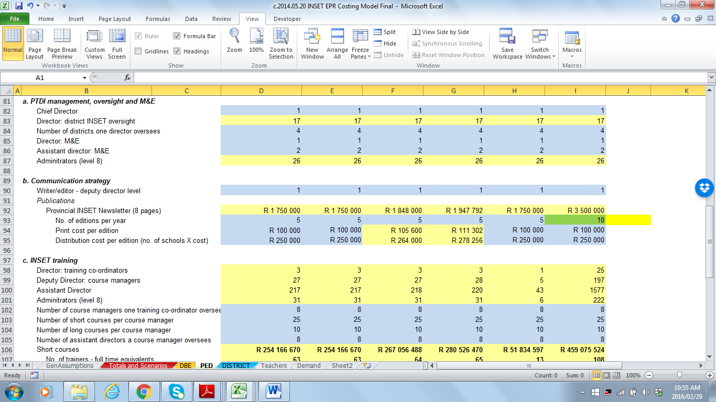
Transparency
Show all assumptions and calculations
  avoid using hidden sheets, hidden cells or hidden formulae
Avoid building assumptions into the formulae
  Wrong if: Administrators (level 8) : 26 = (D82*9)+D83
  Right if: 26 =IF($C$1=$U$14,(D82*9)+D83,D82+D83)
    Can you explain the difference?
Use the notes function to provide explanations

Slide 11
Formatting principle
Keep formatting simple and be consistent
  structure similar sheets the same way
    data sheets, working sheets, results sheets
  avoid blank columns or rows when working with series data
    makes it more difficult to drag or copy & paste formulae
  summary data should be structured in exactly the same way on each sheet - identical cell references
    this facilitates the consolidation / adding-up of information

Slide 12
Ordering principle
Arrange the worksheets logically
  contents and descriptions, result sheets, working sheets, data
  colour the sheet Tabs to distinguish different kinds of sheets

Slide 13
Colouring-in principle
Use colours to identify different types of cells
  information cells –
    descriptions of inputs or assumptions
  number input cells –
    where number assumptions are inputted
  formula cells –
    where the results of formulae are shown
clear / white
light blue
light yellow

Slide 14
KISS principle
Keep it (all parts of the model) simple…
  Show calculations in steps rather than using long formula
  Use sheets to separate different types of data/information
  Use the Group function to make it easier to navigate

Slide 15
Exercise 5.5: Applying the core principles
With reference to the Khanyile Costing:
Open the Khanyile Costing – Example 1:
  Can you explain the key question this costing model is trying to answer?
  Identify and discuss areas where the core principles have not been followed in this model
  What would you do to improve the model?
Open the Khanyile Costing – Example 2:
  Why is this model more useful?

Slide 16
Questions or comments?

