Slide 1
SPENDING REVIEWS
Step 4: Expenditure Analysis
4.5 Interpret

Slide 2
How to do an expenditure analysis?
5 steps:
  Find identify funding sources
  Consolidate & Clean data to show total expenditure
  Group & Allocate expenditure to expenditure buckets aligned to log frame
  Analyse to show trends and findings
  Interpret the key findings supported by evidence
1
2
3
4
5
Find
Consolidate & Clean
Group & Allocate
Analyse
Interpret
Preparation
Analysis

Slide 3
Step 5:
INTERPRET

Slide 4
Find
Consolidate & Clean
Group & Allocate
Analyse
Interpret
STEP 5: INTERPRET
  Finding vs. Observation
  Generating findings:
    Reference points
    “So What” question
  Presenting support evidence:
    Headlines
    Storyboards
By the end of step 5 you will be able to
Generate key findings from your analysis
Present supporting evidence

Slide 5
What is a Finding?

Slide 6
Finding
vs Observation
A finding is a conclusion reached after an examination or investigation
An observation is just that, a statement stating what you see
A finding is reached from drawing meaning from multiple observations
Useful tools for generating a finding
  Reference point
  The “so what” question

Slide 7
Finding
A finding is a conclusion reached after an examination or investigation
A finding is not:
  Raw data
  The answer from your analysis
  Basic information
  A description
A finding:
  Sparks action
  Stands the test of logic
  Informs decision making

Slide 8
Understand findings - tips
Findings are there - be creative and hunt them down
I know there is one in there somewhere?
Is the fact that there are 1,569 people out there a finding?
Raw data or results are not findings
Notes:
Responsibility Centre at high level
Point of service delivery often at lowest level of responsibility code

Slide 9
Understand findings - tips
Basic information is not a finding
Basic information can be helpful
7´0
If I plot expenditure and enrolment, that may be a finding
6´5
6´0
Expenditure
5´5
5´0
50
60
70
80
90
100
110
120
130
140
School Size
(No. students)
Notes:
Responsibility Centre at high level
Point of service delivery often at lowest level of responsibility code

Slide 10
Understand findings – tips
Description is not a finding
Describe the data patterns
7´0
Expenditure in 25% of the schools is below a certain threshold
6´5
6´0
Expenditure
5´5
5´0
50
60
70
80
90
100
110
120
130
140
School Size
(No. students)
Notes:
Responsibility Centre at high level
Point of service delivery often at lowest level of responsibility code

Slide 11
Understand findings - tips
Findings should spark action
Use the “so what” test
7´0
6´5
6´0
Expenditure
5´5
5´0
25% of the schools can afford access
75% needs subsidy
50
60
70
80
90
100
110
120
130
140
SO WHAT?
Notes:
Responsibility Centre at high level
Point of service delivery often at lowest level of responsibility code

Slide 12
Understand storytelling - tips
Be careful about conclusions
Test your logic
7´0
6´5
I see a big opportunity if we influence people´s height!
6´0
Height
5´5
5´0
50
60
70
80
90
100
110
120
130
140
Weight
Notes:
Responsibility Centre at high level
Point of service delivery often at lowest level of responsibility code

Slide 13
Understand storytelling - tips
The absence of data is a finding e.g. revenue received at hospitals is not recorded in BAS
Point it out
Notes:
Responsibility Centre at high level
Point of service delivery often at lowest level of responsibility code

Slide 14
How to generate Findings

Slide 15
Understand findings – reference points
A reference point is used to give meaning to your analysis or observations
A reference point could be:
  Your expectations
  An internal or external benchmark
  History
  A target or goal
A reference point should also relate to the purpose of your spending review e.g.,
  Find savings
  Test whether the programme is worth having
  Improve value for money on the programme
Notes:
Responsibility Centre at high level
Point of service delivery often at lowest level of responsibility code

Slide 16
Understand findings – reference points
Potential reference points for different analytical techniques
Applicable analytical technique
Possible reference points
Summation using pivot tables
Your expectation
Historical spend
Trend analysis
Use Year on Year Growth Rate Formula
Use Compound Annual Growth Rate Formula
Inflation rates
Growth rates from other locations
Implications for future expenditure
Growth projections
Use of simple growth formula
Order and rank analysis
Use of sort functions
Use of rank functions
Policy priorities
Customer needs
Your expectations
Share and pareto analysis
Use of percentage functions
Use of sort, percentage, sum, and conditional formatting
Policy priorities
Expectations
Other locations or similar programmes
Unit Cost analysis
Benchmarking
Market rates, programme expansion
Potential savings
Regression analysis
X-Y scatter graph
Expectations
Design assumptions
Notes:
Responsibility Centre at high level
Point of service delivery often at lowest level of responsibility code

Slide 17
Example 1 – Please go to www.menti.com and use code 42 10 75 7
What key finding can you draw from the chart below:
      Hint
      Think total savings
Average Expenditure per meal for high capacity urban hospitals (Rands)
Number of meals served per year | 10 million | 15 million

Slide 18
Example 1 - Answer
What key finding can you draw from the chart below:
      Sample answer
      R15 million can be saved by insourcing catering in high capacity urban hospitals
Average Expenditure per meal for high capacity urban hospitals (Rands)
Number of meals served per year | 10 million | 15 million

Slide 19
Example 2 - Please go to www.menti.com and use code 42 10 75 7
What key finding can you draw from the chart below:
      Hint
      Think of direct programme costs vs. programme overheads
      Think policy choices around programme implementation
Distribution of expenditure on TB programmes by expenditure buckets

Slide 20
Example 2
What key finding can you draw from the chart below:
      Sample answer
      Programme expenditure is efficient as over 80% of the expenditure is on direct programme costs
      Our policy of delivering services via NPIs is been poorly implemented
Distribution of expenditure on TB programmes by expenditure buckets
Programme overheads
Direct programme costs

Slide 21
Example 3 - Please go to www.menti.com and use code 42 10 75 7
What key finding can you draw from the chart below:
      Hint
      Think inflation – general inflation or medical inflation
      Or think growth in patient numbers
Year on Year Growth on Expenditure on TB Programmes

Slide 22
Decision tree
Is there potential duplication with other programmes?
Is the most cost-effective mix of personnel used to produce outputs?
Are we buying goods and services at the best prices?
Is the service still relevant to the needs of beneficiaries?
Who should deliver these services?
How best to deliver the service?
Is government delivering the services efficiently and cost-effectively?
Are we implementing the programme at the right pace?
Are we using the right and affordable technology to deliver?
Is the programme consistently overspending or underspending?

Slide 23
How to present Findings

Slide 24
Storytelling
A good report tells a story that helps the user
  Follow what was done
  Get to grips with what really matters
  Highlight what must happen next
Useful tools in structuring your report include
  Headlines
  Storyboards
It doesn’t simply playback the results of the analysis

Slide 25
Understand storytelling – headlines
Headlines - collection of statements that tell the story of
  What was done
  What is important
  What must happen next
Writer focuses on presenting evidence to support / expand headlines
Examples
  This project evaluated expenditure on TB Programmes
  Growth in expenditure was found to be high
  However, some locations can learn from other locations on how best to control costs
Notes:
Responsibility Centre at high level
Point of service delivery often at lowest level of responsibility code

Slide 26
Understand storytelling – storyboards
Story boards expand on each headline by including sketches of supporting evidence
1. Expenditure has grown at 10% p.a
2. The bulk of the expenditure is attributed to Head Office
Distribution of expenditure across multiple locations
3. Many locations operating below benchmark
4. These locations must be prioritised for further investigations
Show results of benchmarking
The investigations should focus on:
1.
2.
3
Notes:
Responsibility Centre at high level
Point of service delivery often at lowest level of responsibility code

Slide 27
Interactive summary workbook
RECALL: Key end-product of expenditure analysis is excel workbook containing
Homepage with hyperlinks
raw data
cleaned and categorised raw data
intermediate analysis
output tables
Dashboard
  Homepage with hyperlinks
  Summarise your analysis
Dashboard
  Facilitate discussion of multiple scenarios

Slide 28
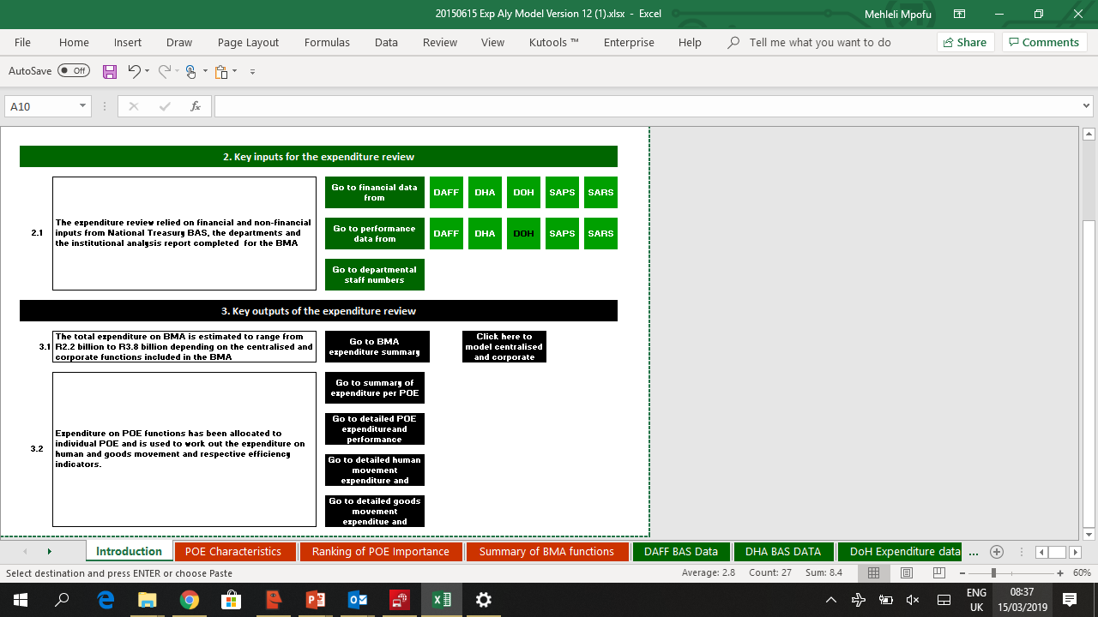
Homepage with hyperlinks
Leading statements highlight the key findings
Hyperlinks allow the user to go to the relevant worksheets
28

Slide 29
Creating hyperlinks
Guidelines on how to insert hyperlinks can be found on:
https://www.excel-easy.com/examples/hyperlinks.html

Slide 30
Creating dashboards
Super users interested in creating dashboards can watch a video on:
https://www.youtube.com/watch?v=FyggutiBKvU&index=4&t=0s&list=PLUUvQSOBw-4bl5rDsemWra5nGTxdFUd9R

Slide 31
Tutorial instructions

Slide 32
Day 1 - Tutorial
Instructions
Use the BAS provincial data provided
  Work in your groups
  Be prepared to discuss in next session
Do the first 2 steps of your Spending Review
  Find
  Consolidate & clean
  Group and allocate
      Questions
What is the total expenditure on your topic?
What is the expenditure per year?
What are the data limitations of BAS ?
      Time
Tutorial (1 hour) and homework

Slide 33
Day 2 and Day 3 - Tutorial
Instructions
Use the BAS datasets that you have cleaned, grouped and allocated
  Work individually
  Be prepared to discuss tomorrow morning
Do the 4th step of your SR in BAS:
  Analyse
If necessary, repeat steps 4.1 to 4.4 using Persal and Logis Datasets
      Questions
      Expenditure on programme in last 3 years
      Trend analysis
      Growth projection
      Share analysis
      Unit Costs
      Pareto analysis
      Time
Tutorial (1 hour) and homework

Slide 34
Day 4 – Tutorial Finalising your Expenditure analysis
Milestone 1
Milestone 2
Milestone 3
  Determine the expenditure baseline for the implementation programme
  Understand expenditure patters on the implementation programme
  Explain the flow of fund and analyse the expenditure in terms of departments, locations, expenditure buckets, the relationship between inputs and outputs, and management policies and practices
  Compare expenditure to performance and administrative information
  Identify cost drivers and opportunities for improvement
  Identify cost drivers and opportunities for improvement
Discuss how each of the following will be done, assign roles and responsibilities, and agree timelines

Slide 35
CONCLUSION

Slide 36




After doing Step 5: Interpret- You should be able to -
Differentiate between a finding and a simple observation
Use reference points to generate good findings
Build an interactive excel work-book to share the results of the expenditure analysis step
Use headlines and storyboards to plan how to present your findings?
Key value of step 5:
Identify priority areas for savings
Provide key inputs to use in the costing step of the spending review process

