Slide 1
SPENDING REVIEWS
Step 4: Expenditure Analysis
4.4.3 Procurement Spend Analysis

Slide 2
Procurement EXPENDITURE ANALYSIS

Slide 3
Procurement Spend Analysis
A spend analysis can be done at an enterprise level….
How much does each department buy?
What does each department buy?
What are they buying patterns per commodity?
Who in the department does the actual buying?
How do they actually buy?
Buyer
Perspective
Who are the suppliers to each department?
How much do we spend on each supplier?
What do we buy from these suppliers?
How do we buy from these suppliers?
How much of our spend goes to BEE /Rural / Township based suppliers?
What is our spend on local (EC based) suppliers?
What items or services (commodities) are
being purchased?
Which are the high spend commodities?
Which departments are buying these commodities?
How many suppliers do we use for
these commodities?
Commodity
Perspective
The Organisation’s / Entity’s total spend is……….
Supplier
Perspective
End User
Perspective
Who are the end users in the department?
What is their role in the buying process?
Which end users account for the bulk of the spend?
What is their usage / demand pattern?
What are their perceptions of the effectiveness and efficiency of their buyers?

Slide 4
Procurement Spend Analysis
….or at a commodity level to generate deep insights to inform future sourcing strategies and…..
Starting Point
Desired Level of Understanding
Potential Outcome of Preliminary Analysis
Useable Information
Office Supplies
Copiers R 293,300
  Canon R 22,000
  Xerox R 98,000
  Sharp R 60,100
  Mita R 7,200
  Kodak R 6,000
Fax Machines R 85,300
  Mita R 60,500
  Canon R 18,700
  Pitney Bowes R 6,100
High Volume
Kodak 2085 R 6,000
Mita 8590 R 7,200
Sharp SF4085 R 5,100
Color
Xerox DC230 R 20,000
Xerox DC265 R 15,000
Canon CLC7005 R 2,000
Low Volume
Canon 6050 R 120,000
Sharp SF2030 R 55,000
Xerox 5350 R 63,000
(To maintain client confidentiality, such comparisons are always provided in disguised fashion)

Slide 5
Procurement Spend Analysis
…understanding Total Cost of Ownership (which considers all costs, not just purchase price) is critically important to the understanding of the category
Purchase
Price
Acquisition
Installation
Maintenance
Disposal

Slide 6
Spend Analysis
Total Cost of Ownership (“TCO”) can also reveal significant improvement opportunities
TYPICAL TCO ELEMENTS
Transaction Costs
Purchase Price
Operational Costs
Requisition, including approval
Supplier selection
Purchase order creation and transfer to supplier
Purchase order follow-up
Goods/services receipt
Goods dispatch to user
Supplier payment
Price of goods/services
Transportation costs
Disposal cost
Inspection/quality control
Downtime and bad product due to procured material/service
Disposal
Obsolescence
Inventory storage costs
Cost of failure
R&D
Supplier management
Products/services with high TCOs are immediate candidates
for the strategic sourcing process

Slide 7
Procurement Spend Analysis
A good spend analysis must also identify opportunities to achieve savings
Price Opportunities
Reduced Prices
Price
Volume rebates
Supplier Rationalisation
Payment term discounts
Reduced Inventory Carrying Costs
Cost of capital
Storage costs
Commodity Savings
Usage Opportunities
Reduced Lifecycle Costs
Maintenance costs
Operating, energy, and other costs
Disposal costs
Reduction in Consumption/
Volume
Elimination
Substitution
Change in mix
Cost Avoidance
Cyclic price fluctuations
Sudden, unanticipated supply/demand changes
Transactional & Admin Opportunities
Reduced Procurement- Related Operating Expense
Cost of processing purchase orders
Cost of processing accounts payable
Cost of receipt/warehousing
Process efficiencies

Slide 8
HOW TO COMPLETE A PROCUREMENT SPEND ANALYSIS
5 steps:
  Find identify funding sources
  Consolidate & Clean data to show total expenditure
  Group & Allocate expenditure to expenditure buckets aligned to log frame
  Analyse to show trends and findings
  Interpret the key findings supported by evidence
1
2
3
4
5
Find
Consolidate & Clean
Group & Allocate
Analyse
Interpret
Preparation
Analysis

Slide 9
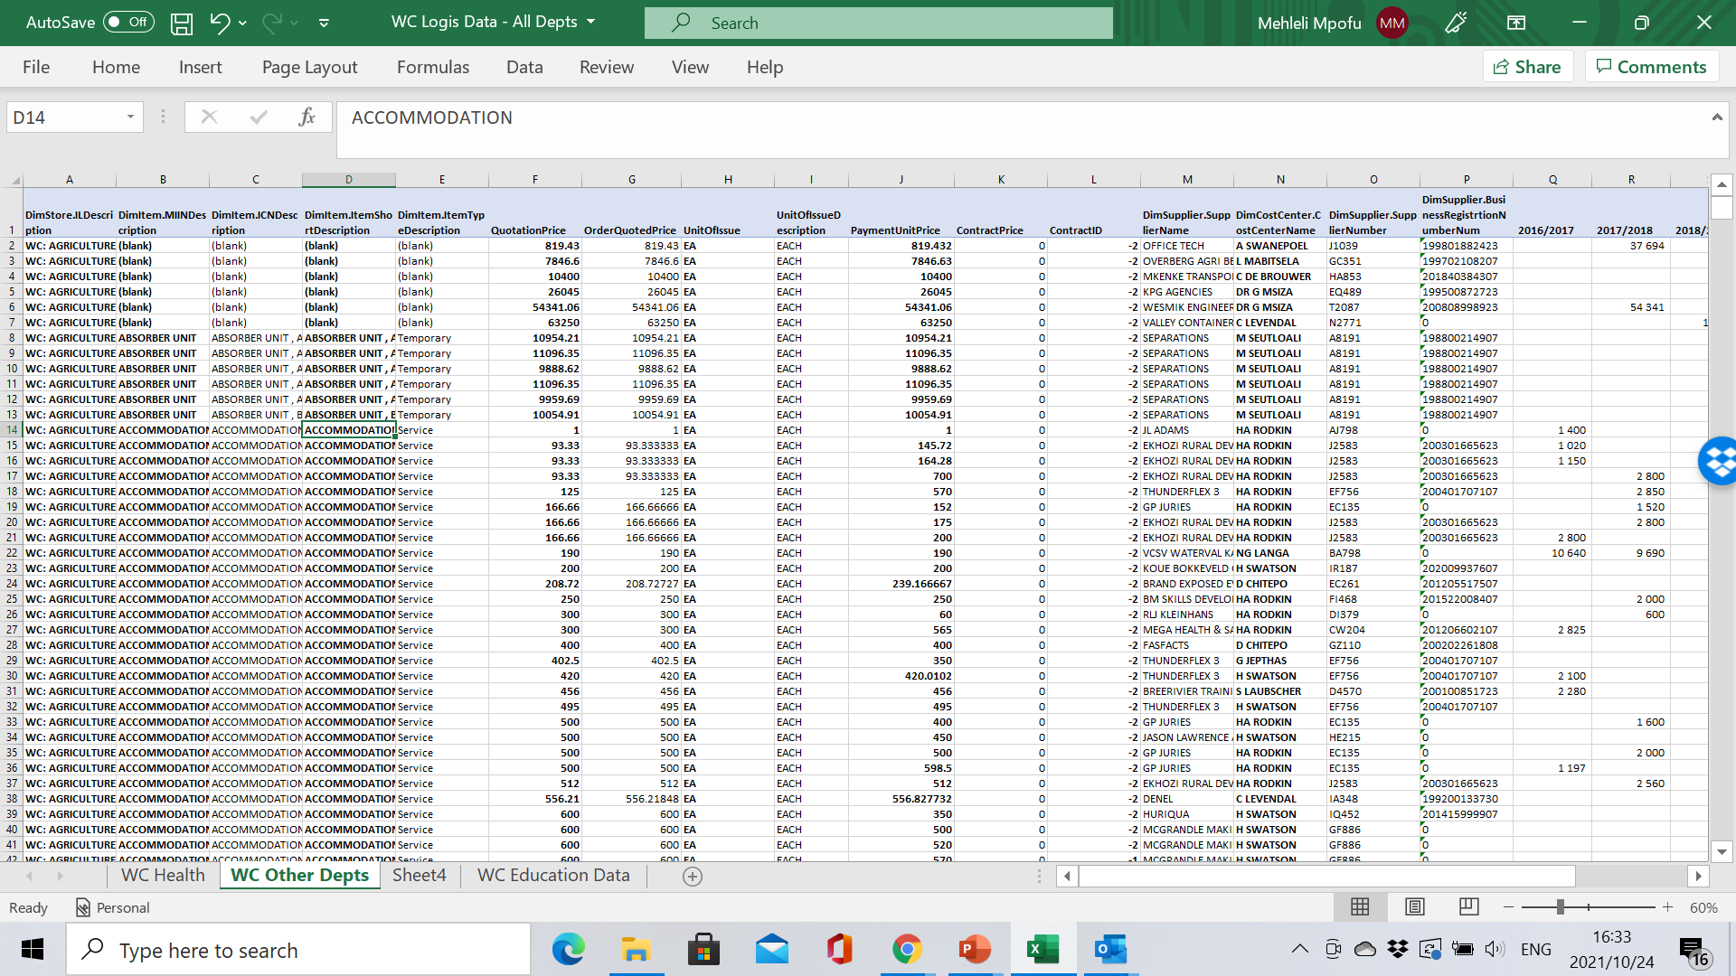
Look and feel of Logis data
Similar to BAS data a consolidated data set for 1 financial year consists of Thousands of rows
Columns must be prioritized to limit file size

Slide 10
Key fields of interest in LOGIS
Information | Relevant LOGIS Field
Supplier name | DimSupplier.SupplierName DimSupplier.SupplierNumber | DimSupplier.BusinessRegistrtionNumberNum ContractID
Item identifiers | DimItem.MIINDescription DimItem.ICNDescription | DimItem.ItemShortDescription DimItem.ItemTypeDescription
Price and cost information | QuotationPrice OrderQuotedPrice UnitOfIssue | UnitOfIssueDescription PaymentUnitPrice ContractPrice
Buyer and end user details | DimStore.ILDescription | DimCostCenter.CostCenterName
Spend Amounts | Financial Years and Grand Total

Slide 11
The logis analysis can tell you……..
The number of suppliers and buyers for the top commodity groups as well as …..
Expenditure Category | Commodity group | Total (R 000) | No. of stores | No of suppliers | No of Depts | Ave No. of Suppliers per Dept.
Security services | Outsourced security services and contractors | 717,315.42 | 94 | 120 | 10 | 12
Property payments | Property payments | 675,884.79 | 156 | 1,169 | 13 | 90
Communication | Other communication services, equipment or accessories | 565,233.02 | 137 | 118 | 13 | 9
Travel and subsistence | Domestic Travel: Accommodation | 453,104.43 | 145 | 518 | 13 | 40
Contractors: Other | General personnel and labourers | 392,485.11 | 33 | 96 | 6 | 16
Entertainment, events, and venues | Venues and facilities | 332,609.42 | 56 | 495 | 13 | 38
Fleet services | Finance leases | 315,945.85 | 13 | 4 | 13 | 0
Fleet services | Fuel, oil, and lubricants | 311,378.49 | 104 | 110 | 10 | 11
Contractors: Other | Non-infrastructure maintenance | 297,186.65 | 70 | 464 | 9 | 52
Computer services | SITA services | 293,235.51 | 22 | 30 | 13 | 2
Consultants: Bus. and advisory services | Consultants: Financial management | 226,910.26 | 15 | 29 | 7 | 4
Other expenses | Printing and publication services | 208,829.44 | 117 | 186 | 13 | 14
Consultants: Business and advisory services | Consultants: Audit related | 197,480.30 | 14 | 42 | 13 | 3
Other staff costs | Training and development | 118,793.05 | 56 | 307 | 13 | 24

Slide 12
The logis analysis will also allow you to identify……
The number of suppliers and buyers per purchased items within each commodity groups
Expenditure Category | New item lowest level | Sum of Spend Amount (R 000) | % total | No. of stores | No of suppliers | No of Depts
Core service delivery items | National Health Laboratory Services | 736,069 | 27% | 99 | 4 | 2
Core service delivery items | School stationary | 333,718 | 12% | 2 | 12 | 1
Core service delivery items | Prescribed textbooks | 254,331 | 9% | 2 | 67 | 1
Core service delivery items | Surgical supplies | 191,278 | 7% | 74 | 352 | 1
Core service delivery items | Non-specified school furniture and equipment | 171,164 | 6% | 2 | 54 | 1
Core service delivery items | Assistive device | 167,102 | 6% | 84 | 177 | 1
Core service delivery items | Blood Products and Plaletes | 136,829 | 5% | 64 | 5 | 1
Core service delivery items | School nutrition | 119,308 | 4% | 1 | 44 | 1
Core service delivery items | Medical and chemical waste removal | 62,869 | 2% | 9 | 4 | 1
Core service delivery items | Surgical consumables | 53,670 | 2% | 45 | 222 | 1
Core service delivery items | Medical supplies | 52,607 | 2% | 65 | 137 | 1
Core service delivery items | Other | 48,449 | 2% | 27 | 25 | 1
Core service delivery items | Seeds and seedlings | 30,979 | 1% | 8 | 48 | 1
Core service delivery items | Animal medicine | 28,441 | 1% | 9 | 20 | 1
Core service delivery items | Fertilizer | 26,965 | 1% | 8 | 26 | 1
Core service delivery items | Agricultural services | 25,603 | 1% | 10 | 40 | 1
Core service delivery items | Health nutrition | 25,318 | 1% | 4 | 5 | 1
Core service delivery items | Medical services | 24,619 | 1% | 13 | 27 | 1
This helps identify potential opportunities for supplier rationalisation to improve transaction costs and maybe get better pricing

Slide 13
The logis analysis will also allow you to identify……
Variation in unit costs for specific items groups (1 of 2)
This helps identify potential opportunities to issue pricing guidelines / price lists for standard items
Purchasing Events / Unique Logis Entries

Slide 14
The logis analysis will also allow you to identify……
Variation in unit costs for specific items groups (2 of 2)
This helps identify potential opportunities to issue pricing guidelines / price lists for standard items
Purchasing Events / Unique Logis Entries

Slide 15
Also make use of contract information
Besides Logis, examining the existing contracts can also generate insights into the unique requirements of each business unit / department
Purpose of Agreement
Terms of Agreement
CONTRACT
hhhhhhhhhhhhhhhhhhhhhhhhhhhhhhhhhhhhhhhhhhhhhhhhhhhhhhhhhhhhhhhhhhhhhhhhhhhhhhhhhhhhhhhhhhhhhhhhhhhhhhhhhhhhhhhhhhhhhhhhhhhhhhhhhhhhhh
Services to Be Performed
Locations Serviced
Pricing
Rebates
Termination Clauses
Points to Remember:
No two contracts have the same look or structure
Stakeholders may claim “non-disclosure” clauses…these can be overcome

Slide 16
Also make use of contract information
Sometimes different business units / buyers have variations in pricing for different contracts; look for variations in pricing for the same products
Price Per 10 Lb. Pkg, 2nd Day Delivery
Unit A Unit B Unit C Unit D Benchmark

Slide 17

Purpose of Exercise
To identify the commodities purchased within the security expenditure category
For the top commodities within the category, identify the:
  Spend by the department
  Spend by the actual buyers in each department
  Spend by suppliers in each department
  Number of suppliers used by each department
Step 1: Find and copy expenditure on security from master dataset to a new worksheet:
  Use Ctrl+F to find the rows containing relevant security expenditure
  Use the filter on the DimItem.ICNDescription field to select the relevant rows
  Use Ctrl+C and Ctrl+V to copy and paste the relevant rows to a new worksheet
  Place DimItem.ICNDescription field in rows and Financial year and Grand Total fields in the value section
  Sort values in 2020/21 column largest to smallest
  Show values in 2020/21 as a % of Column total
Spend Analysis Demo 1
Analysis of the Provinces Spend on Security
Notes:
Video… 2 / 3 expenditure…

Slide 18
Step 3: Amend the Pivot as appropriate to solve the following challenge for the top security commodity
Spend Analysis Demo 1 (Cont’d)
Analysis of the Provinces Spend on Security
Challenge | Pivot Table set up
Identify the spend items within the top security commodity | Place DimItem.ICNDescription in the filter Place DimItem.ItemShortDescription in row section Using the filter next to DimItem.ICNDescription select « Security » only
Identify spend by departments | Place DimItem.ICNDescription in the filter and select « security » Place DimStore.ILDescription in the row section
Identify spend by the actual buyers in each department | Place DimItem.ICNDescription in the filter and select « security » Place DimStore.ILDescription in the row section Add DimCostCenter.CostCenterName to the row section
Identify spend by suppliers in each department | Place DimItem.ICNDescription in the filter and select « security » Place DimStore.ILDescription in the row section Add DimSupplier.SupplierName to the row section
Identify the number of suppliers by each department
Notes:
Video… 2 / 3 expenditure…

Slide 19
Getting Started
Open the file “4c. WC Logis Data Analysis Exercises - Without Answer”
Breakaway challenge
Apply spend analysis concepts for accommodation i.e.,
Identify the commodities purchased within the accommodation expenditure category
For the top commodities within the accommodation category, identify the:
  Spend by the department
  Spend by the actual buyers in each department
  Spend by suppliers in each department
  Number of suppliers used by each department
  General Guidelines
  Step 1: Find and copy expenditure on security from master dataset to a new worksheet:
  Step 2: Build a pivot table to inspect the security data to identify top commodities
  Step 3: Amend the Pivot as appropriate to solve the challenge
Spend Analysis Breakaway Exercise
Analysis of the Province’s Spend on Accommodation
Notes:
Video… 2 / 3 expenditure…

