Slide 1
SPENDING REVIEWS
LEVEL 3
Step 4: Expenditure Analysis

Slide 2
How to do an expenditure analysis?
5 steps:
  Find identify funding sources
  Consolidate & Clean data to show total expenditure
  Group & Allocate expenditure to expenditure buckets aligned to log frame
  Analyse to show trends and findings
  Interpret the key findings supported by evidence
1
2
3
4
5
Find
Consolidate & Clean
Group & Allocate
Analyse
Interpret
Preparation
Analysis

Slide 3
STEP 4:
ANALYSE

Slide 4
introduction

Slide 5
Find
Consolidate & Clean
Group & Allocate
Analyse
Interpret
STEP 4: ANALYSE
  Generate key insights using
  Total expenditure per time period
  Trend analysis
  Growth projections
  Ranking
  Share analysis
  Pareto
  Unit costs
  Benchmarking
  Regression analysis
By the end of step 4 you will be able to derive key insights into expenditure

Slide 6
Key takeaway
  Good analysis is the result of asking the right questions and using the right analytical techniques to answer the questions

Slide 7
Analysis starts with good questions
Question of interest
Applicable analytical technique
What is the total expenditure per time period?
In aggregate or expenditure item or bucket?
Summation using pivot tables
Is expenditure on the programme decreasing or increasing?
Trend analysis
Use Year on Year Growth Rate Formula
Use Compound Annual Growth Rate Formula
At what rate is expenditure decreasing or increasing?
What could future expenditure on the programme be?
Growth projections
Use of simple growth formula
Descriptive
On what or where is the most and the least money spent on?
Ranking
Use of sort functions
Use of rank functions
What share of the total expenditure is spent on various expenditure buckets?
What is the implementation programme’s cost structure?
Share and pareto analysis
Use of percentage functions
Use of sort, percentage, sum, and conditional formatting
Is the variation in expenditure across locations justifiable?
Unit cost analysis
Benchmarking
Probing
Is the expenditure on the implementation programme too high or too low?
What is the relationship between expenditure and performance?
What are the key drivers of expenditure on the programme?
Regression analysis
X-Y scatter graph

Slide 8
Descriptive QUESTIONS AND ASSOCIATED analysis

Slide 9
Trend analysis = collecting and displaying information in order to spot a pattern
Why we do it?
To identify the trajectory of expenditure
  Is it increasing or decreasing?
  What rate is it increasing or decreasing?
To have a basis to predict future expenditure
How to do it?
Present data in chronological order – using a pivot table
      Use the year on year growth formula – g = Y_{n} / Y_{n-1} - 1
      Use Compound Annual Growth Rate (CAGR) formula
        CAGR = (Y_{n} / Y₁)^^{(1/(N-1))} - 1
      Caution
      Always use CAGR to work out the average annual growth across multiple years
        Caters for compounding effects
        Correctly averages out positive and negative year on year growth rate.
Trend analysis

Slide 10
Growth projection
A growth projection is a simple prediction of future expenditure
Why we do it?
      To understand what future expenditure could be
How to do it?
      Use simple growth formula (i.e., Y_{N}⁼Y_{n-1}* (1+g%)) (NB: N > 1)
      The forecast formula in excel
      Caution
      Where more accurate information about future growth is available one should use that .e.g., An agreed to wage or price increase

Slide 11
Identifying what or where the most/least money is spent
Why we do it?
      To identify expenditure buckets or locations where expenditure differs significantly from other locations or categories
      To identify expenditure buckets or locations to prioritise
      To identify where we can learn from
How to do it?
      Sort expenditure either in ascending or descending order
      Plot out an x-y scatter graph to see the spread expenditure per location
      Work out each data-point as a percentage of the average
      Caution
      This analysis is best done using unit costs
Outlier or rank analysis

Slide 12
Expressing the proportionality of different components
Why we do it?
      To understand a programme’s cost structure
      To identify the expenditure buckets or locations to prioritise
How to do it?
      Workout expenditure per bucket or location as a percentage of the total expenditure
Share analysis

Slide 13
80% of the problems (expenditure) are caused by 20% of the issues (expenditure buckets or locations)
Why we do it?
      To identify the expenditure buckets or locations to prioritise
How to do it?
      Sort the expenditure per expenditure bucket or location in ascending award
      Workout expenditure per bucket or location as a percentage of the total expenditure
      Count the number of expenditure bucket or locations that resultant in a cumulative sum >=80%
Pareto analysis
(80/20 rule)

Slide 14
SPENDING REVIEWS
Excel in Excel
Statistical Functions

Slide 15
Today we will walk you through how to:
Conduct the following analysis within your master pivot table:
  Rank
  Share analysis
  Pareto analysis
  Compute historical growth rates
  Rank
Conduct the following analysis outside of your pivot table:
  PercentRank
  AverageIF
  Mean
  Median
  Mode
  Min
  Max
Discuss cases when we need to use these functions

Slide 16
Why we use these functions?
Compare expenditure levels or performance across a number of locations or expenditure components
  Identify top spenders or top performers
  Order spenders according to level of spend or performance
  Assess if particular implementation approach (e.g., insourcing vs. outsourcing has better outcomes)
To have an interactive discussion about your analysis and expenditure on your programme

Slide 17
These tips will help you complete tables 1 to 5 of your expenditure analysis step.
  Table 1: Aggregated expenditure on the implementation programme over the last 5 years
  Table 2: Breakdown of aggregated expenditure by organisational unit / programme / location
  Table 3: Breakdown of aggregated expenditure by expenditure component (i.e., item level)
  Table 4: Breakdown of on key expenditure components by organisational unit / programme / location
  Table 5: Variation in profile of expenditure across organisational unit / programme / locations
  Table 6: Variation in unit costs across organisational units / programme / location (this should be done for aggregated expenditure and the key expenditure components)
  Further analysis will be informed by what is shown in the above tables. However, consideration should be given to:
  Table 7: Variation in the ratios between inputs to outputs; inputs to inputs; inputs/outputs to beneficiaries
  Table 8: Expenditure by suppliers
  Table 9: Variation in unit prices

Slide 18
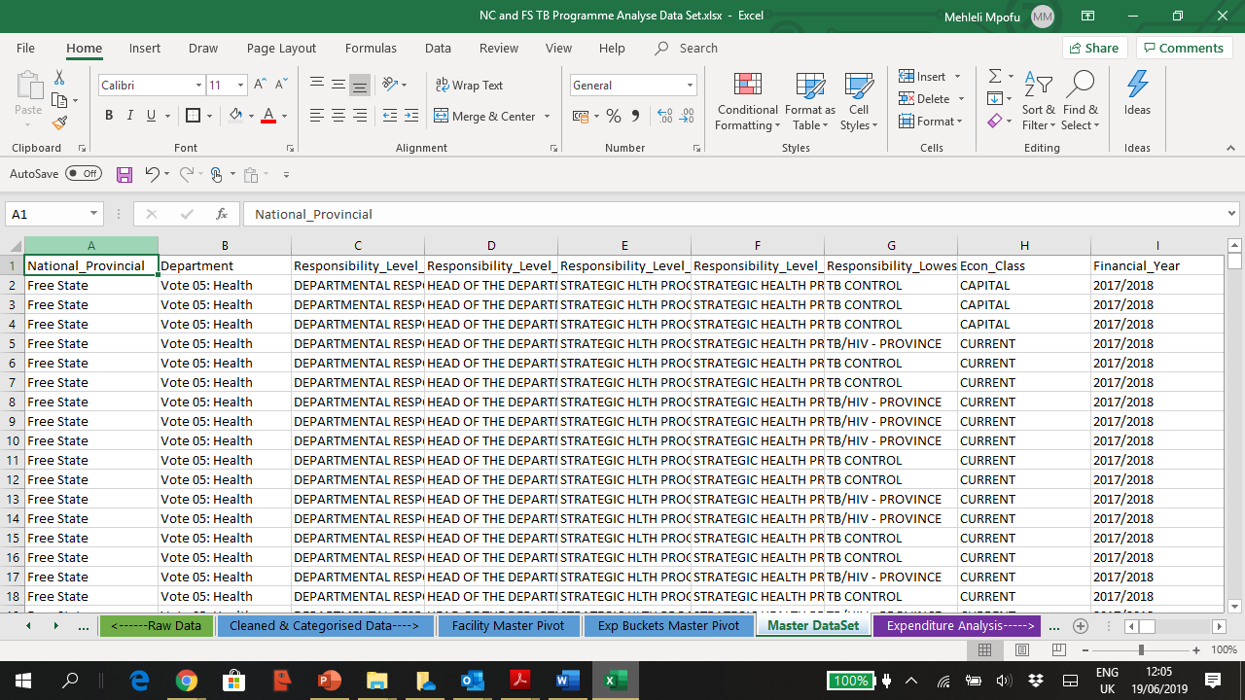

Checking minimum requirements

Slide 19
Checking minimum requirements
Excel Steps
    Checking if data range contains the minimum number of financial years:
    Use the Ctrl+Home keys to go to cell A1
    Highlight row 1’s by placing mouse on Row 1 Number Heading and press left click.
    Use the Ctrl+Shift+L keys to insert filters on highlighted Row 1
    Use the Right Arrow key to move to the financial year column
    Click filter dropdown arrow to see the number of years included in the column
    Checking if data range is pivotable
    Use the Ctrl+Home keys to return to cell A1
    Press Ctrl+Right Arrow repeatedly to go to the last used cell in row 1
    Use the right arrow key to see if there are still cells with data after the last used column
    If the blank cells in row 1 is a missing header for a column with data, add a title appropriate for the data in the column
    If the blank cell is part of column with data, delete the data by using the following toolbar selections:
      Home > Delete > Delete Sheet Column
    Checking if data range contains operating locations and expenditure buckets
    the minimum number of financial years:
    Use the Ctrl+Home keys to go to cell A1
    Highlight row 1’s by placing mouse on Row 1 Number Heading and press left click.
    Use the Ctrl+Shift+L keys to insert filters on highlighted Row 1
    Use the Right Arrow key to move to the facility name, facility type and expenditure bucket columns
    Click filter dropdown arrow to inspect what is contained in these columns

Slide 20
Instructions
Open “WC Master Data set” Data Set
Background
Data represents WC’s expenditure on TB Programmes at hospitals, clinics, community health centres, and on programme administration and management
Before you start, check minimum requirements …
Check that dataset contains expenditure for at least 3 years?
    Apply a filter on the financial year column to see how many years’ data is contained
Is the expenditure data in a pivotable table?
    Ensure dataset is in one complete table: Row 1 should have no blank cells. Column A should have no blank cells
Does your dataset contain facility level data?
    Given your knowledge of the implementation programme, locate the column that contains the facility names and facility type. Apply a filter to test if it’s a complete and clean list
Does it show expenditure by expenditure buckets?
    In row A, locate the column that contains expenditure items. Locate the column that also groups these expenditure items in terms of the expenditure buckets

Slide 21
Exercise 1
Creating the Master Pivot
Exercise 1: Creating the Master Pivot
Open the “4a. WC TB Programme - Analysis Part 1 “ Workbook
Before you start, check minimum requirements …
Check that dataset contains expenditure for at least 3 years?
    Apply a filter on the financial year column to see how many years’ data is contained
Is the expenditure data in a pivotable table?
    Ensure dataset is in one complete table: Row 1 should have no blank cells. Column A should have no blank cells
Does your dataset contain facility level data?
    Given your knowledge of the implementation programme, locate the column that contains the facility names and facility type. Apply a filter to test if it’s a complete and clean list
Does it show expenditure by expenditure buckets?
    In row A, locate the column that contains expenditure items. Locate the column that also groups these expenditure items in terms of the expenditure buckets

Slide 22
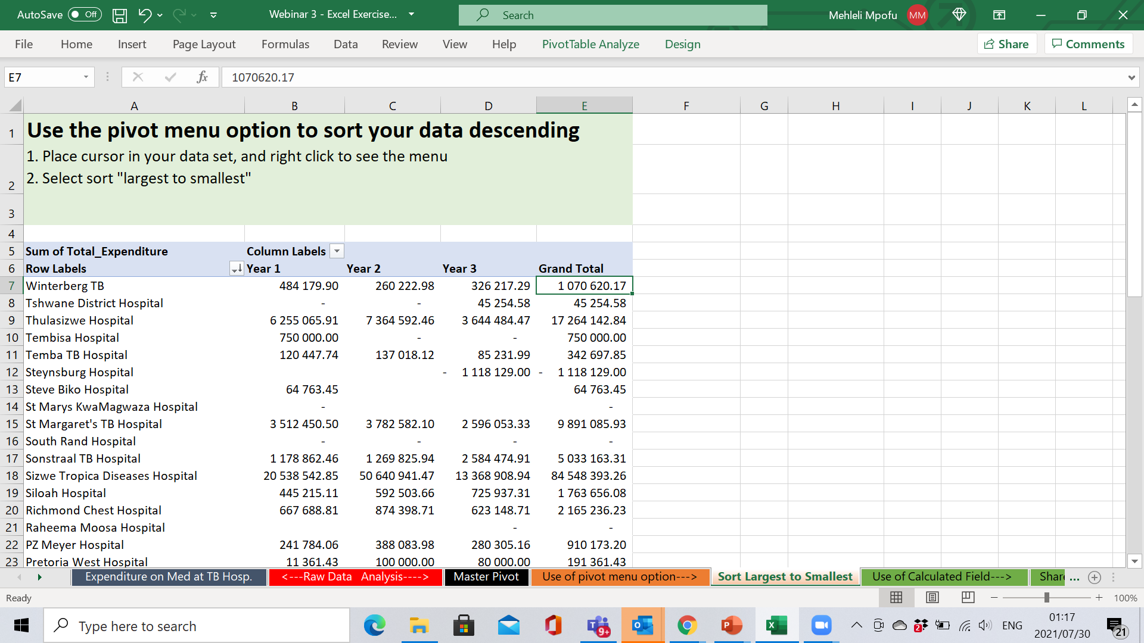
Exercise 2
Use of Pivot Menu Option to Sort Pivot Data

Slide 23
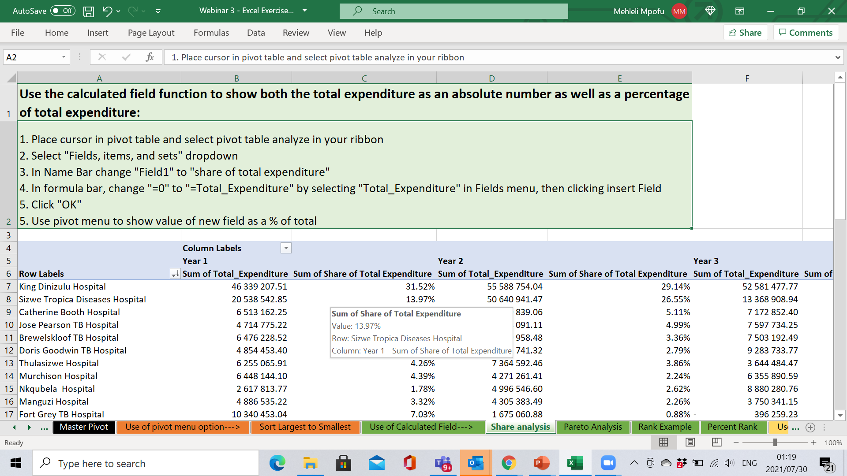
Exercise 3
Use of Calculated Field Function to do a Share Analysis

Slide 24
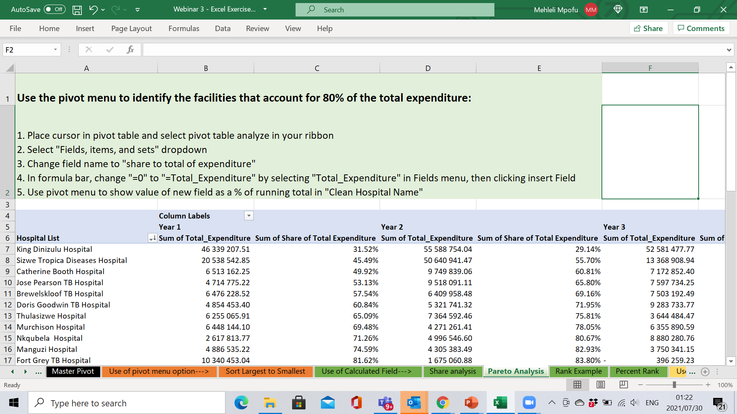
Exercise 4
Use of Calculated Field Function to do a Pareto Analysis

Slide 25
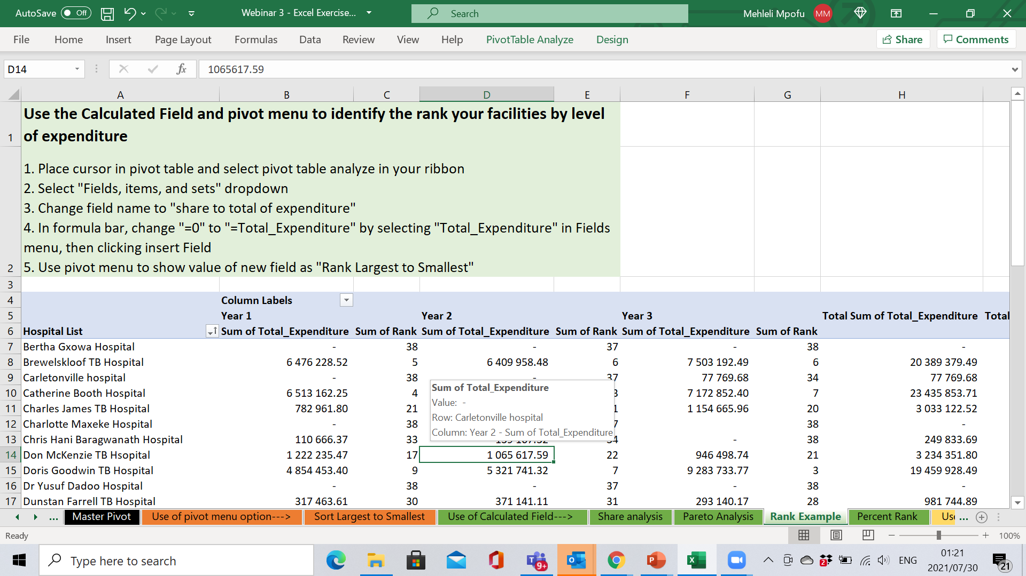
Exercise 5
Use of Calculated Field Function to do a Rank Analysis

Slide 26
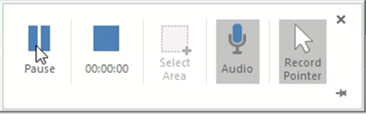
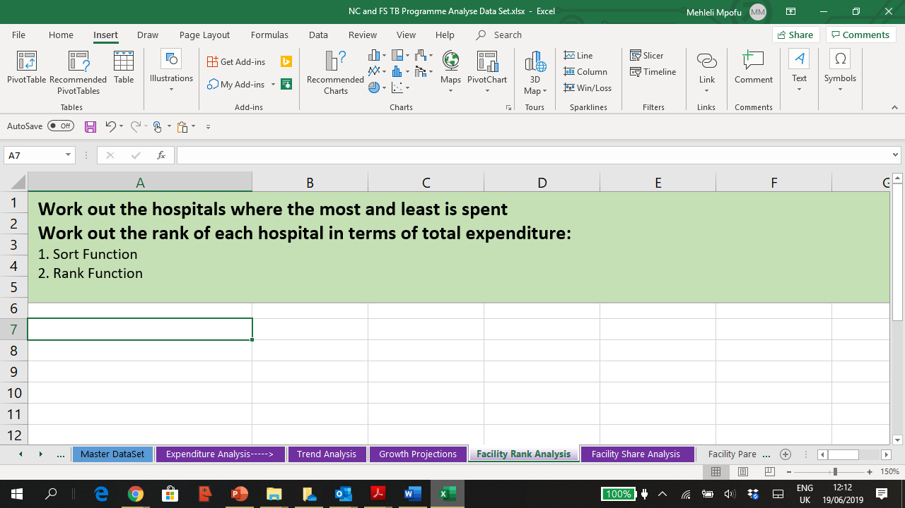
Sort Function and Rank Formula

Slide 27
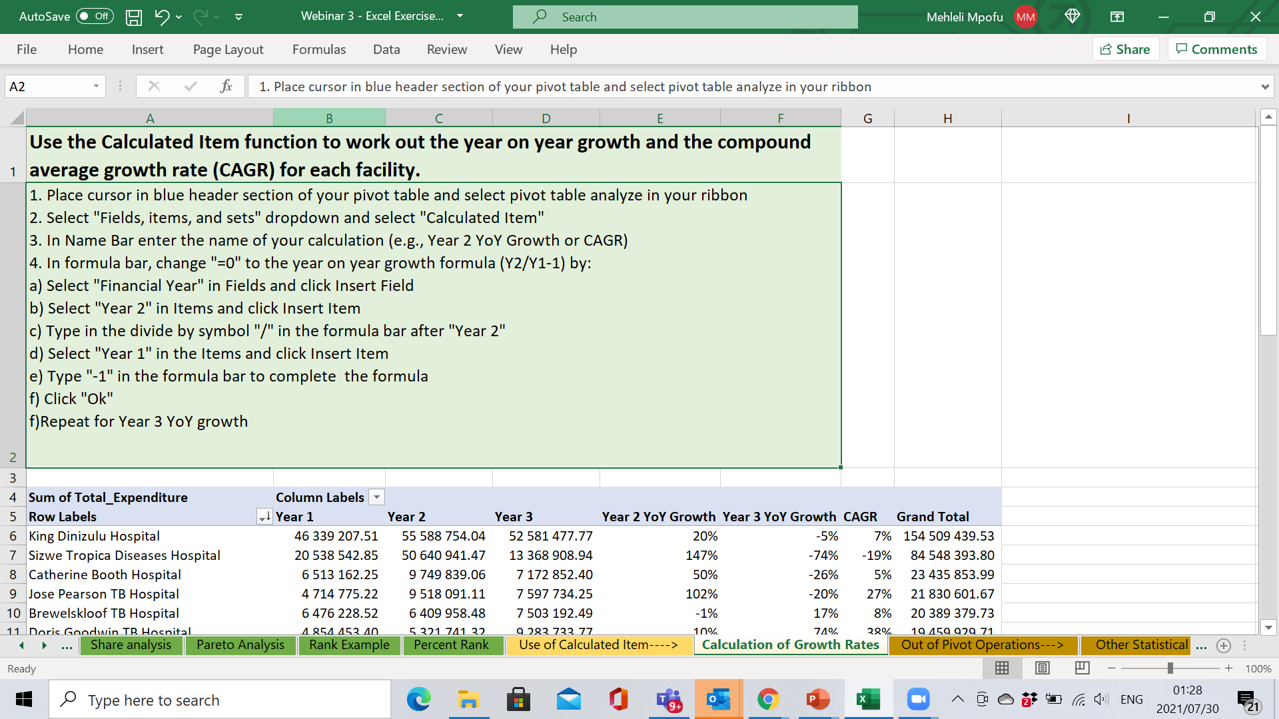
Exercise 6
Use of Calculated Item Function to work out Historical Growth Rates

Slide 28
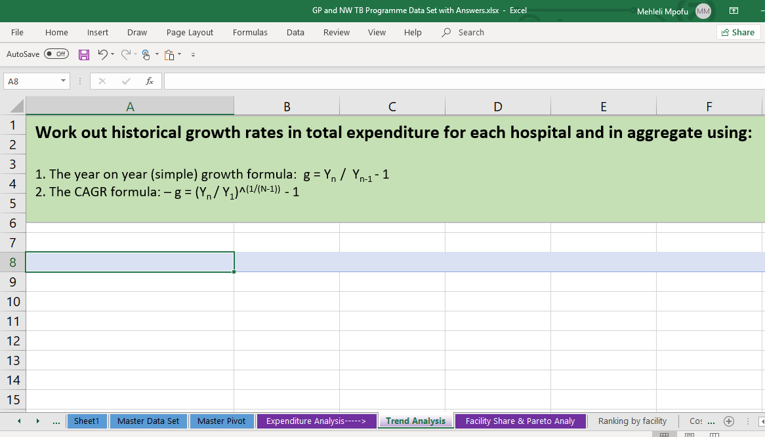
Trend analysis

Slide 29
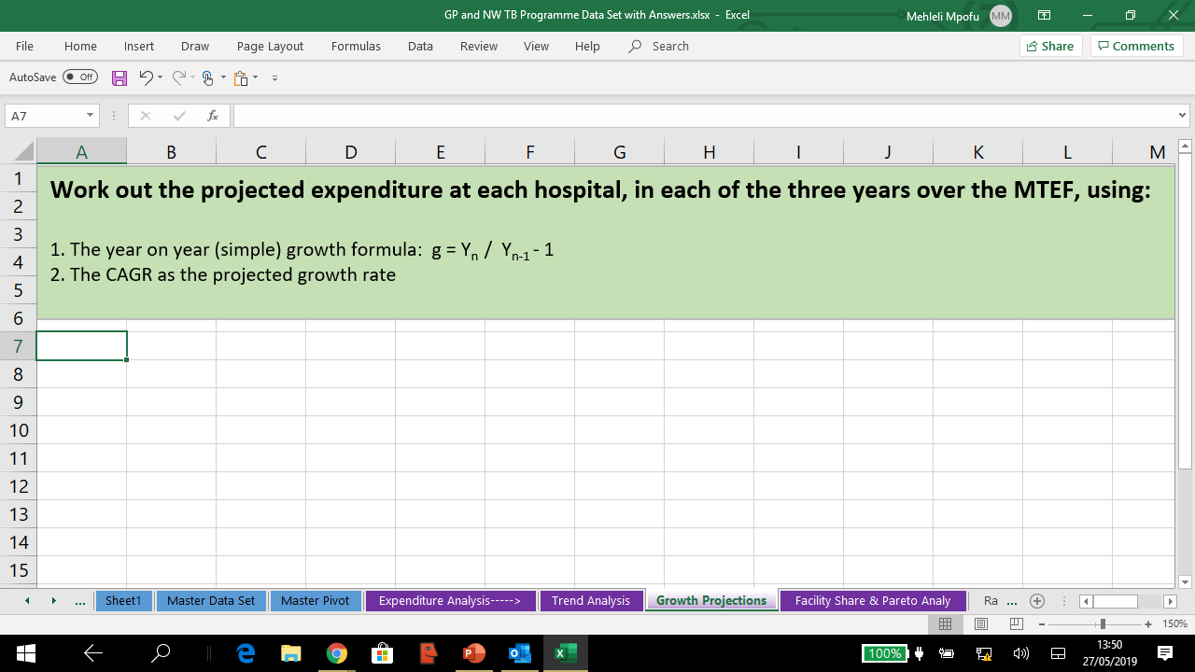
Growth projections

