Slide 1
SPENDING REVIEWS
Step 4: Expenditure Analysis
4.3 Group and Allocate

Slide 2
How to do an expenditure analysis?
5 steps:
  Find identify funding sources
  Consolidate & Clean data to show total expenditure
  Group & Allocate expenditure to expenditure buckets aligned to log frame
  Analyse to show trends and findings
  Interpret the key findings supported by evidence
1
2
3
4
5
Find
Consolidate & Clean
Group & Allocate
Analyse
Interpret
Preparation
Analysis

Slide 3
STEP 3:
Group & Allocate

Slide 4
Find
Consolidate & Clean
Group & Allocate
Analyse
Interpret
  Why we group?
    Nature of expenditure
    Direct and indirect cost
  Additional excel functions
    Text filter
STEP 3: GROUP & ALLOCATE
By the end of step 3 you will be able to link expenditure to understandable and explainable groups

Slide 5
Expenditure buckets = Grouping of similar expenditure items
Why we do it?
Understand nature of expenditure (who, where and what)
Understand the cost-effectiveness of the operating model
BAS/PERSAL are accounting systems
SCOA categories do not necessarily reflect expenditure as understood in policy terms
Expenditure Buckets

Slide 6
Understand nature of expenditure
Who?
Institutional role players
Branch or unit in institution
Where?
Point of service delivery, facility, operating location
What?
Programme outputs (institutional analysis / log frame)
Additional…
General overheads, programme overheads, direct programme cost
Notes:
Responsibility Centre at high level
Point of service delivery often at lowest level of responsibility code

Slide 7
Understand nature of expenditure – WHO?
National, province, district, municipality, or public entities
Department, responsibility centres
Understand who is spending
Look at previous institutional analysis
Notes:
Responsibility Centre at high level
Point of service delivery often at lowest level of responsibility code

Slide 8

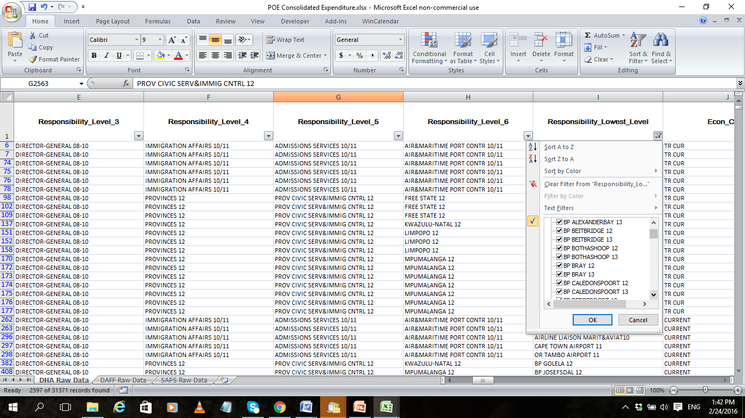
Understand nature of expenditure – WHERE?
Point of service delivery, facility or operating location
Schools, TVET colleges, libraries, museums, hospitals, leased buildings
Find locations in BAS -
lowest responsibility field
Notes:
Exception – e.g DAF no points of entry spending. But staff biggest expenditure and had staff numbers per entry point

Slide 9
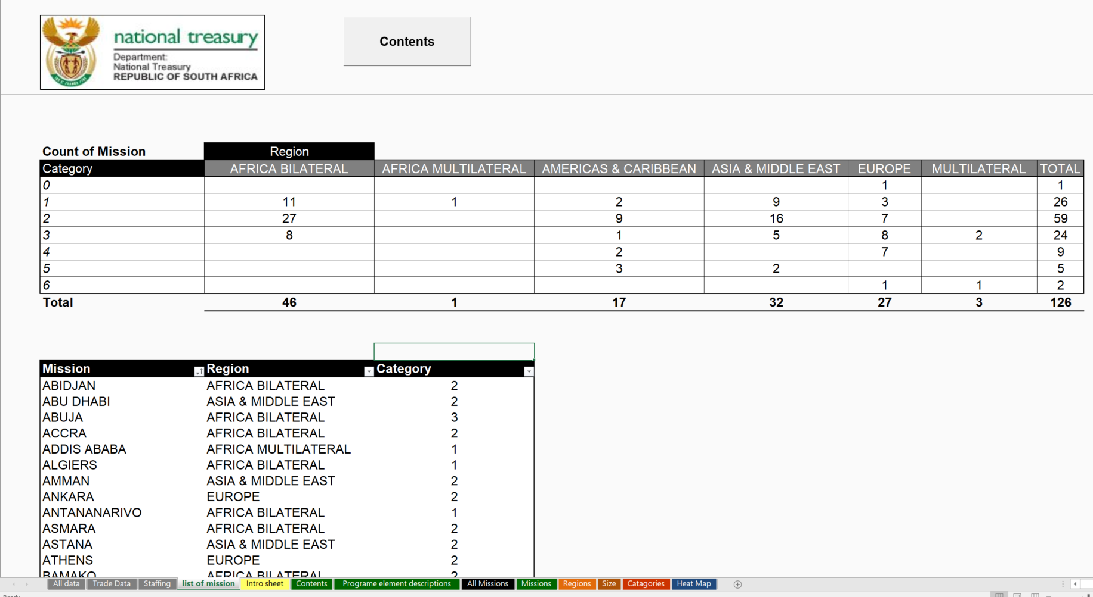
Understand nature of expenditure – WHERE?
Group operating locations in sensible categories – FOREIGN MISSION Example

Slide 10
Understand nature of expenditure – WHAT?
What information does the institutional analysis provide to understand expenditure?
Understand programme (assists for logframe)
Expenditure is not available at output level
Identify expenditure at an input level
Match this the appropriate activities and / or outputs
Notes:
Note this links to next moduel (looking forward)

Slide 11
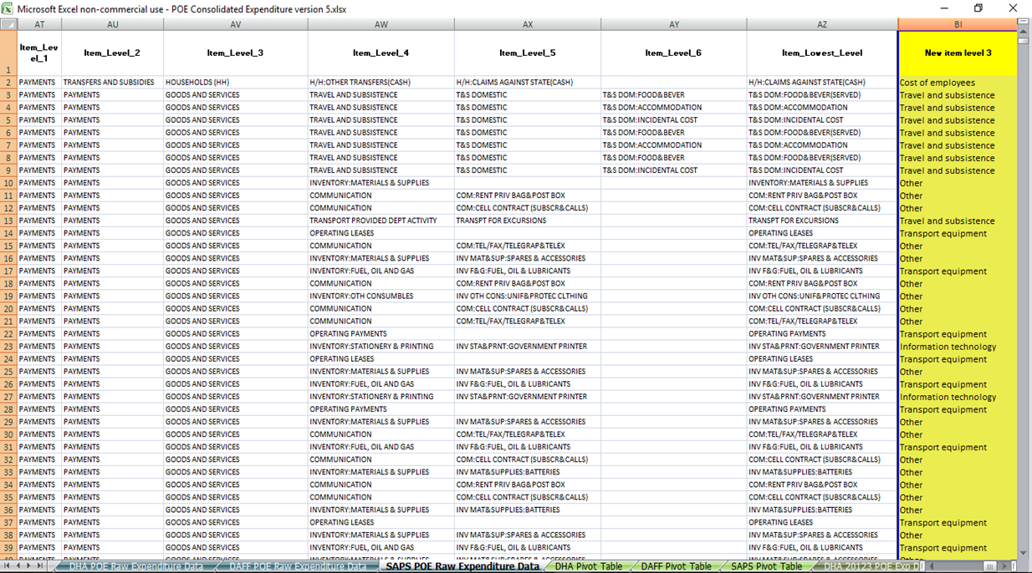
Understand nature of expenditure – WHAT?
BAS item levels combined to create new expenditure buckets
Use remove duplicates, text filter, and vlookup to add these to the data set

Slide 12
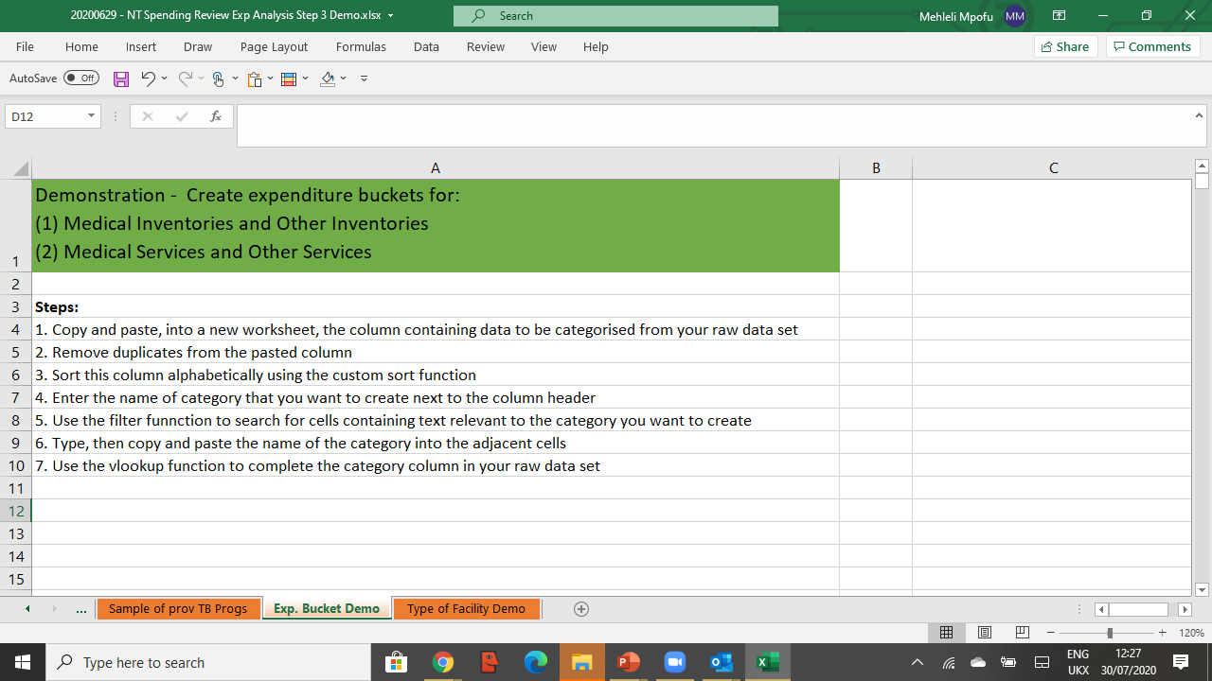

Understand nature of expenditure – WHAT?
Creating expenditure buckets
Notes:
Video… 2 / 3 expenditure…

Slide 13
Understand nature of expenditure – ADDITIONAL…
Backoffice
(General Support Functions)
Middle Office
(Functions that directly support a number of front offices)
Front office (e.g. costs involved in delivering services directly to citizens )
General overheads
Programme overheads
Direct programme costs
EXAMPLE
Policy and Oversight Functions
Shared service centres
(IT Systems and Regional Processing Centres)
Service delivery points
(e.g. Home Affairs Service Centres)
Notes:
Responsibility Centre at high level
Point of service delivery often at lowest level of responsibility code

Slide 14
Understand nature of expenditure – ADDITIONAL…

Slide 15
Group and Allocate Demo 1
Direct programme and overhead costs
Instructions
Consider the following situation and questions
Situation
A school has a monthly budget of R100,000.
R40,000 is for the headmaster’s salary
R50,000 is for the teachers’ salary
R5,000 is for the caretaker’s salary
R2,500 is for teaching material
R2,500 is for the annual sports day
      Questions
What are the direct programme costs for teaching?
What are the programme overhead costs for teaching?
What are the general overhead costs?
      Time
5 mins
Notes:
Open raw data of BAS from Limpopo / Mpumalanga for FY 2017/18
Open “

Slide 16
Instructions
Consider the following situation and questions
Situation
A school has a monthly budget of R100,000.
R40,000 is for the headmaster’s salary (POC)
R50,000 is for the teachers’ salary (DPC)
R5,000 is for the caretaker’s salary (POC)
R2,500 is for teaching material (DPC)
R2,500 is for the annual sports day (GOC)
      Questions
What are the direct programme costs for teaching?
What are the programme overhead costs for teaching?
What are the general overhead costs?
      Answer
DPC = R52,500
POC = R45,000 (assuming that head master does not teach and caretaker ensures that classroom is fit for teaching)
GOC = R2,500
Group and Allocate Demo 1
Direct programme and overhead costs - Answer
Notes:
Open raw data of BAS from Limpopo / Mpumalanga for FY 2017/18
Open “

Slide 17
Group and Allocate Demo 2
Grouping lowest level responsibility fields and lowest item field into expenditure buckets
Instructions
Observe the instructor working “3. WC TB Programme - Group and Allocate Exercise - Without Answer.xls” workbook
Demonstration
Conducting a tooth and tail analysis of expenditure on the TB Programme by:
    Grouping facilities into frontline vs. backoffice
    Grouping the item lowest level as direct, indirect, overhead, salary and wages, and other
    Creating a separate pivot table for each group to inspect the expenditure by groupings
  Discussion
  What do the observed expenditure patterns imply about the programme’s allocative efficiencies
Notes:
Open raw data of BAS from Limpopo / Mpumalanga for FY 2017/18
Open “

Slide 18
Group and allocate breakaway session
Grouping lowest level responsibility fields and lowest item field into expenditure buckets
Getting Started
Open the file “3. WC TB Programme - Group and Allocate Exercise - Without Answer”
Breakaway challenge
Conduct a tooth and tail analysis of expenditure on the TB Programme by:
  Grouping facilities into frontline vs. backoffice
  Grouping the item lowest level as direct, indirect, overhead, Salary and Wages and Other
  Creating a separate pivot table for each group to inspect the expenditure by groupings
  Discussing observed expenditure patterns and form an opinion on the programme’s allocative efficiencies
  General Guidelines
Follow similar steps used to clean the “Responsibility Lowest Level” field to group the “Cleaned Responsibility Lowest Level” field to back office and frontline office
Repeat for item lowest level. Given the number of rows, copy columns all item fields into the grouping item worksheet and use the higher item levels to guide your grouping
Create pivot table 1 containing new “Facility Group” field in the rows section, the financial years in the values section, and “Item Level 3” field in the filter section
Create pivot table 2 containing the new “Item Level Group” in the row section, financial years in the values section, and facility grouping in the filter section. Use the pivot filter to only show expenditure in frontline facilities in the pivot table
Detailed guidelines and steps are contained in the excel workbook

Slide 19




After doing Step 3: Group and allocate - You should be able to explain expenditure on your programme in terms of:
Who is spending on your programme
What the expenditure is incurred on (e.g., expenditure buckets)
How much is spent on direct programme costs, programme overheads, and general overheads
Where the expenditure is incurred?
Next step ‘Analyse’ will enable you to draw insights from your expenditure data:
By doing analysis to answer key questions
Before proceeding we encourage you to watch the demonstration on how to group and allocate in excel

