Slide 1
SPENDING REVIEWS
Step 4: Expenditure Analysis
4.2 Consolidate and Clean

Slide 2
Expenditure Analysis
Step 2 – Consolidate and Clean

Slide 3
How to do an expenditure analysis?
5 steps:
  Find identify funding sources
  Consolidate & Clean data to show total expenditure
  Group & Allocate expenditure to expenditure buckets aligned to log frame
  Analyse to show trends and findings
  Interpret the key findings supported by evidence
1
2
3
4
5
Find
Consolidate & Clean
Group & Allocate
Analyse
Interpret
Preparation
Analysis

Slide 4
How do we clean & consolidate data?
Use Excel techniques to:
Restructure the data into a suitable format
Simply / standardise basic elements of the data to assist in understanding what the data contains
Summarise data
Tools & Techniques
The following slides introduce some common / often used techniques.

Slide 5
Find
Consolidate & Clean
Group & Allocate
Analyse
Interpret
Create uniform dataset from multiple years
Additional Excel Functions
    Pivots
    Find & Replace
    Remove Duplicates
    Sort
    Vlookup
STEP 2: CONSOLIDATE & CLEAN
By the end of step 2 you will be able to structure a dataset

Slide 6
Why do we consolidate data?
Create a set of data over a time period
Combine budget programmes / multiple department data
Create a useful, as simple as possible dataset
Fortunately the programme budget structures in provincial budgets does most of the consolidating of data
Notes:
Note Vulindela & Consol has a predetermined structure to help navigate around the data… show you later

Slide 7
Why do we clean data?
BAS and Persal uses human input - GIGO
BAS and Persal fields change in different years
Provinces & departments capture differently
Some fields are centralised / user defined entries
Naming conventions change
Ring-fence useful information
Notes:
Note Vulindela & Consol has a predetermined structure to help navigate around the data… show you later
Need to understand what the data includes (Step 1)

Slide 8
This is what I am going to take you through
You will set up a Pivot table using the data you created during the “Find” step
  Arrange existing data using the programme budget structures
We will clean the Responsibility names of “legacy” issues – so that each clinic and hospital has only one name/title in the Responsibility segment
  We will use find and replace for one problem
  And a few more steps for the other problem
These steps involve:
  Removing duplicates to shorten a list of names to make them easier to work with
  Search for a portion of text in a cell so we can select the incorrect names quickly
  Use a lookup function to correct the original data
Last part is to look at the data…

Slide 9

Pivot
Why?
View data in different summarised formats quickly
Informs the next step
How?
A pivot table is a program tool that allows you to reorganise and summarise selected columns and rows of data in a spreadsheet or database table to obtain a desired report.
A pivot table doesn't actually change the spreadsheet or database itself.
Notes:
https://support.office.com/en-us/article/create-a-pivottable-to-analyze-worksheet-data-a9a84538-bfe9-40a9-a8e9-f99134456576?wt.mc_id=otc_excel#OfficeVersion=Windows
Very useful to review data that we have… provides guide to next steps…

Slide 10
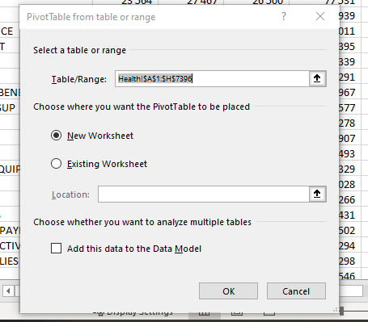
Pivot Table
Go to A1 of the “C&C Data” Tab
Go to Insert
  > Pivot Table
  > Choose New Worksheet
  >Change the tab name of the new worksheet with the Pivot to “TB Pivot”
Set up a Pivot using the Programme Budget structure:
  Province / Programme / Sub-Programme / Item level 4 and the years

Slide 11
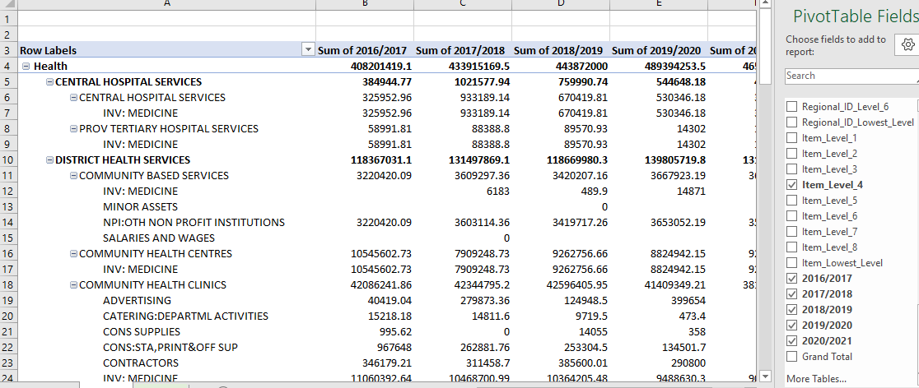
Select the fields
Your Pivot should look like this once you have clicked the fields
1) Tick the boxes here
2) Right click on any number and select “Pivot Table Options” – then see next slide

Slide 12
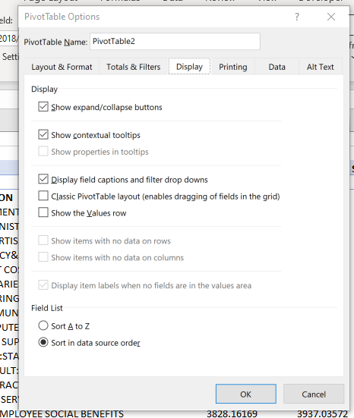
Make the display pretty
1) Select Display
2) Click on Classic PivotTable Layout (enables dragging of fields in the Grid)

Slide 13
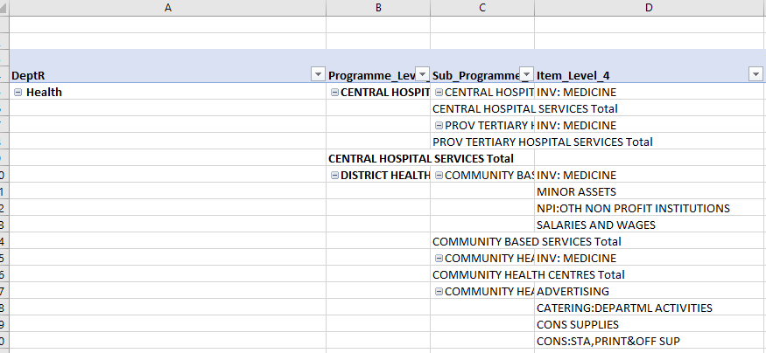
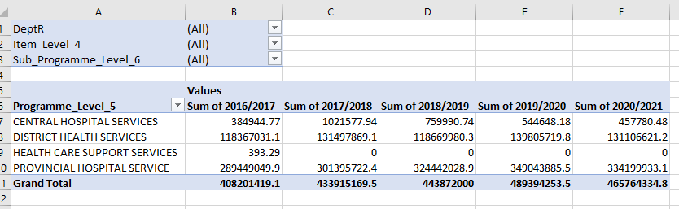
Make the display fabulous
“Push” these up to the left
So that it looks like this

Slide 14
Next few steps will look at cleaning data
Step 1 – Add Responsibility Lowest Level to the pivot
What do you notice about the names of the hospitals and clinics
  Clue – compare 2016/17 to 2017/18 onwards
  Which name is correct?

Slide 15
Cleaning data
We need to replace
  “HOSP” with “HOSPITAL” and
  “CLINICS” with “CLINIC”
You can run a search and replace with CLINICS, but not for HOSP as you will end up with “HOSPHOSPITAL”
Select all the data in Column L of “C&Clean”
Type “Ctrl + F”
  In Find Type CLINICS
  And in Replace Type CLINIC
  And Select “Replace All”
Fixing HOSPITAL takes a few more steps

Slide 16
Remove Duplicates
Why?
Easy shorten a long list
Quick to view to see if information is useful
How?
Select the range of cells that has duplicate values you want to remove. Tip: Remove any outlines or subtotals from your data before trying to remove duplicates.
Click Data > Remove Duplicates, and then Under Columns, check or uncheck the columns where you want to remove the duplicates. ... Click OK.
Notes:
https://support.office.com/en-us/article/create-a-pivottable-to-analyze-worksheet-data-a9a84538-bfe9-40a9-a8e9-f99134456576?wt.mc_id=otc_excel#OfficeVersion=Windows
Very useful to review data that we have… provides guide to next steps…

Slide 17
Remove Duplicates
Go Back to the “C&Clean” Tab
Copy all the “Responsibility Lowest Levels” (i.e. copy all the contents in Column L) and paste into Column A in the worksheet “Remove Duplicates”
Click on C at the top so the whole column is highlighted
Copy the contents of this column
Go to the sheet “Remove Duplicates”
Paste the contents in Column A
Keep the whole column highlighted
Now remove duplicates … see next slide

Slide 18
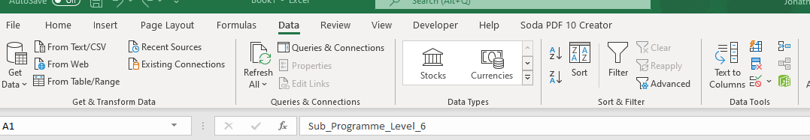
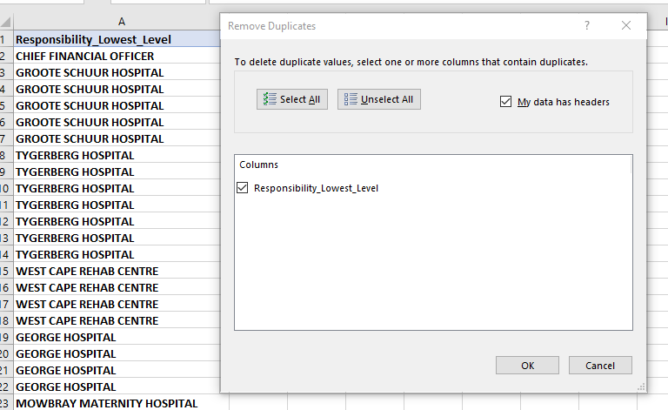
Remove Duplicates – go to Data
This tiny little thing
After you click “Ok” check how many Duplicates were found and how many unique values remain – what do these numbers mean?

Slide 19
Converting HOSP to HOSPITAL
Bear with me, this is the least tedious way to do this: We need to identify all “HOSP”s, change these to “HOSPITAL” and then update the Responsibility Lowest Level in the data using a VLOOKUP…
In the Remove Duplicates sheet
Copy the contents in Column A into Column B – (Copy Paste Column A into Column B)
In Column C use the function RIGHT() to extract the 4 letters on the right of each name in Column A
  In C2 Type =RIGHT(B2,4) and drag this down
  Add a filter to Column C and Select “HOSP” (See Slides 30, 31)
  With the filter on Use Find and Replace on Column B to replace “HOSP” with “HOSPITAL” (Leave the names in Column A as they are)
  Deactivate the filter in Column C and use the filter in Column A to check all HOSP has been removed
Notes:
If you do not know how to add a filter there are instructions in slides 30 and 31 on this

Slide 20

Vlookup
Why?
  Links cleaned information into working data sheet without affecting existing data
  Allows quick updates if assumptions change
How?
Formula = VLOOKUP (value, table, col_index, [range_lookup])
  value - The value to look for in the first column of a table.
  table - The table from which to retrieve a value
  col_index - The column in the table from which to retrieve a value.
  range_lookup - FALSE = exact match.
Notes:
https://support.office.com/en-us/article/create-a-pivottable-to-analyze-worksheet-data-a9a84538-bfe9-40a9-a8e9-f99134456576?wt.mc_id=otc_excel#OfficeVersion=Windows
Very useful to review data that we have… provides guide to next steps…

Slide 21
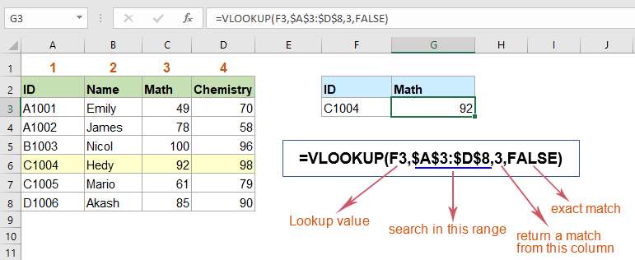
VLOOKUP – Go through next 5 slides on your own
Source https://www.extendoffice.com/documents/excel/6393-excel-vlookup-function.html

Slide 22
Vlookup
How it can be used
  Spit out a result from a table, like in previous slide
  Select specific data from a table
    Replicate the data, but just for certain categories
  Check if labels from one data set match another
  Import a column, or a few columns, of data from one table to another
Notes:
  The lookup value must be identical to the value looked for otherwise you will get a N/A
    Case sensitive, space sensitive, empty spaces etc
  Table must be structured with Lookup values in left column of table
    Vlookup looks to the right
  Always use “false”…especially with big data =VLOOKUP(A13,A3:D12,3,FALSE)

Slide 23
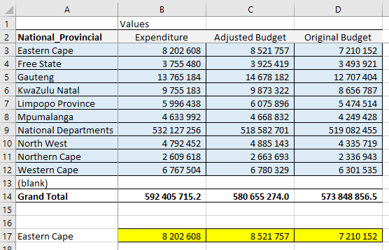
=vlookup(lookup_value,table_array,col_index,[range lookup])
1
2
3
4

Slide 24
=vlookup(lookup_value,table_array,col_index,[range lookup])
1
2
3
4
VLOOKUP looks to the right

Slide 25
"=VLOOKUP($A17,$A$3:$D$12,2,FALSE)
"=VLOOKUP($A17,$A$3:$D$12,3,FALSE)
"=VLOOKUP($A17,$A$3:$D$12,4,FALSE)

Slide 26
Clean the Responsibility Lowest Level using VLOOKUP
In the Sheet “C&Clean” insert a column next to column L (it will be the new Column M)
Title this “Responsibility_Lowest_Level_Clean”
Use a VLOOKUP in this new column to insert the correct names from Column B in the “Remove Duplicates” Sheet
  The formula in M2 should look like this:
  =VLOOKUP(L2,'Remove Duplicates'!A:B,2,FALSE)*
  Drag this down to the bottom of the sheet (or double click on the + IYKYK)
Refresh your Pivot table (PivotTable Analyze / Refresh) and unclick the old Responsibility Lowest Level and Click the clean option and take a look at the results (next slide)
* or =XLOOKUP(L2,'Remove Duplicates'!A:A,'Remove Duplicates'!B:B)

Slide 27
The VLOOKUP ‘replaces’ the value in the left with the value on the right
If the original value is correct, it will be replaced with the same correct description
If the original value is incorrect, it will be replaced with a corrected description

Slide 28
Use the updated pivot to answer the following
  What is the total expenditure in each year across all clinics?
  Which 3 clinics ranked highest in terms of spend per year in FY 2016/17, FY 2018/19 and FY 2020/21
    I will show you how to Sort in the Pivot

Slide 29
Consolidate and clean breakaway session
Clean expenditure data and create summation pivot
Getting started
Open the excel file called:
  “2a. WC TB Programme - Consolidated and Clean Exercise - Without Answer”
  Data represents WC’s expenditure on TB Programmes at hospitals, clinics, community health centres, and on programme administration and management as extracted during the find exercise
Breakaway challenge
    Create a Pivot table to show expenditure on TB in different hospitals and clinics in each of the year over the 5-year period
      What is the total expenditure in each year across all hospitals and clinics?
      Which 3 clinics ranked highest in terms of spend per year in FY 2016/17 and FY 2020/21
      Which 3 hospitals ranked highest in terms of spend per year in FY 2016/17 and FY 2020/21
    General and detailed guidelines for the exercise are contained in the excel workbook
Submission requirements
Email the updated workbook to your LTA as proof that you have mastered the exercise
Show and tell in your group and prepare to share summary in plenary
Notes:
Note ask participants to do this for THEIR province
This to show the find can result in difference information
Find Implementation Programme (related TB)
Find Facilities
Find Expenditure Items

Slide 30


After doing Step 2: Consolidate & Clean, you should understand:
Consolidated set of expenditure
All relevant departments / role-players
Appropriate time period
Cleaned
Consolidated dataset has standardised, simple common language descriptions
Related to the programme context
Next step ‘Group and Allocate’ is the last step in the preparation of data
This will link the expenditure data to the process maps and Logframe
Provide a dataset for analysis

Slide 31

Filter
Why?
The FILTER function allows you to filter a range of data based on criteria you define.
  Search
  Sort
How?
Apply filter to headings
Enter search criteria in filter
Notes:
https://www.youtube.com/watch?v=EF9a5XuOu2w

Slide 32
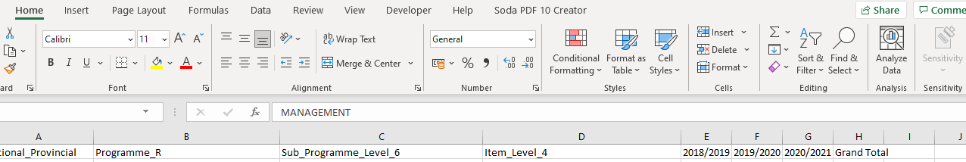

To add a filter
Click on B2 and then Freeze Panes (View / Freeze Panes)
Highlight Row 1
Click on Sort & Filter and select filter
A filter at the top of the row will appear

