Slide 1
Problem statement and refining your spending review topic
Spending Reviews 2021

Slide 2
Spending review methodology
Iteration between steps
Intro
Introduction & Savings
What to expect, how will we work?
Step 1
Problem statement and institutional analysis
What is this delivery programme about?
Step 2
Process maps and the programme’s logical framework
How does the programme work?
Step 3
Performance analysis and indicators
How is it measured and how should it be measured?
Step 4
Expenditure analysis
What are we spending on the programme?
Step 5
Cost modelling
What does it actually cost to deliver the programme?
Step 6
Savings and efficiency gains
Where and how do we find savings and efficiency gains?

Slide 3
Learning outcomes
By the end of this session, you should be able to:
Identify a topic for your spending review
Evaluate the extent to which your topic is suited for a spending review
Develop your problem statement

Slide 4
background

Slide 5


Objectives of spending reviews
In the current context of rising debt levels, spending reviews represent an opportunity. They have the potential to detect efficiency savings and opportunities for cutting low-priority or ineffective expenditure, and can therefore help achieve smart fiscal consolidation and free up space for new policy priorities, e.g. for additional public investment
OECD, 2019

Slide 6
What are spending reviews typically used for?
Evidence from the OECD
To scrutinise baseline expenditures
To estimate the impact of changes in a policy or a new policy on government spending
How much public funding will be needed for the new policy?
How does varying the policy parameters impact on public spending?
How much money is being spent?
On what are we spending public money?
Where are spending public resources?
Who is doing the spending within government?
Helps to identify savings, contributes to better decisions around reprioritisation, informs decisions about cutting low priority expenditure.
Helps policy makers to make decisions about the affordability of new policy or changes. Supports decisions around the implementation of policy.

Slide 7
how to identify a spending review topic?

Slide 8
To identify a topic for your spending review, you need to answer a few questions upfront...
What is the problem that government is trying to resolve through this programme or institution(s)?
Why is it important to examine this particular topic (at this time)?
Who will use the findings and reccomendations from the spending review?
What data or information do you need for the spending review?

Slide 9
Problem statement

Slide 10
Why does government intervene? What problems are governments trying to solve?
Social objectives
Economic objectives
Environmental objectives
Redistributing income and wealth
Promoting fair competition
Preserving the environment
Providing public goods
Mitigating against the impact of climate change
Promoting economic growth
Supporting the low-income & vulnerable groups
Achieving macroeconomic goals
Changing consumer/citizen behaviour
Protecting people

Slide 11
Why identify the problem statement upfront?
The spending review needs a “problem statement” that defines what government is trying to do/achieve with some set of activities. In all likelihood, you have chosen to focus on that particular set of activities because you know that there is room for improvement in the quality/impact of spending.

Slide 12
Problem statement
Grand problems have multiple and complex dimensions.
Govt. Prog
Govt. Prog
Pocket problem
Pocket problem
Grand Problem
Pocket problem
Pocket problem
Govt. Prog
Govt. Prog

Slide 13
Problem statements
Spending reviews focus on the types of pocket problems to which government programmes are designed to respond.
Tourism incentive programme
Industrial Development Zones, EMIA
Priority sector support
Barriers to exporting
Slow economic growth
Lack of support to emerging farmers
Competitiveness of local firms
Micro Agricultural Funding Institution of South Africa, Emerging Farmer Support programme
Clothing and Textile Competitiveness programme

Slide 14

The Problem Statement Puzzle
In each of your breakout rooms, pick a programme within the Western Cape province.
Identify the pocket problem that the programme is trying to resolve.
Tell us what you think the grand problem to which your pocket problem is linked.
Pick someone to report back! ☺

Slide 15
Example from basic education
Grand problems
Pocket problems
Although educational outcomes have improved since democracy, South African children still lag behind their peers from upper middle income developing countries when it comes to academic performance. There are many reasons that explain the performance of the education system: historical inequities between schools, poor quality of teaching, lack of LTSM, limited parental involvement in schooling etc.
The inadequacy of teacher support and development is manifested in knowledge gaps observed in many teachers when it comes to subject (disciplinary), curriculum and pedagogical content knowledge
In Service Teacher Training programme

Slide 16
How to use a problem statement in your spending review?
Problem statement
Government programme
Spending review objective
Small and emerging farmers do have the financial resources to buy agricultural inputs and equipment. Moreover, the lack of access to affordable finance was a binding constraint on the ability of small farmers to expand the scale of production.
MAFISA was established to provide loans at affordable interest rates to farmers through established financial intermediaries. Through the MAFISA programme, the intermediates procured inputs on behalf of the farmers.
To evaluate MAFISA’s success in reaching small and emerging farmers and achieve government’s objective of expanding agricultural production in an efficient and cost-effective way.

Slide 17
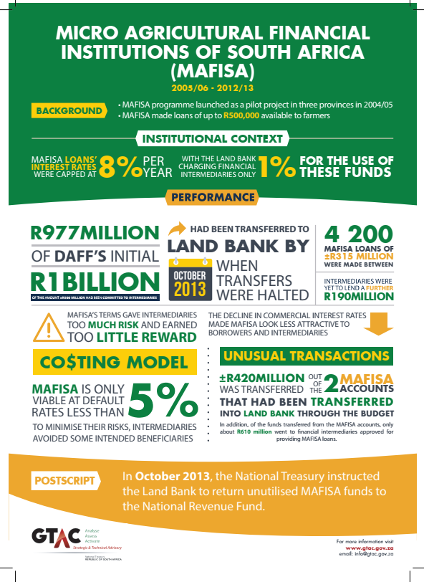
Cost-effectiveness of the MAFISA programme
Efficiency of the MAFISA model

Slide 18




How to identify your pocket problem?
When does it occur?
What is the problem?
Pocket problem (4 Ws)
Where is it happening?
Who does it affect?

Slide 19
Why is it important to examine this topic in a SR?

Slide 20
Why is it important to examine this topic in a SR?
If spending reviews are to be valuable budgeting tools, then they must meet address a specific decision-making need within a department or province.
What do you want to achieve with this spending review? Why are you looking at this particular programme?
  Does the programme have a history of over or underspending?
  Is it a national or provincial priority or game-changer?

Slide 21
Who will use the findings?
Effective spending reviews are planned and executed in a way that enhances the likely utilisation of findings to inform decisions.
To do this, officials involved in spending reviews should:
  Identify the primary intended users of the spending review and involve them throughout the process.
  Keep in mind the audience and primary intended users when writing the report.
  Collaborate with key stakeholders that findings are discussed, validated and credible.

Slide 22
INFORMATION AND DATA NEEDS

Slide 23







SR methodology
Policy, legislation and programme information
Decisions
Expenditure data
(BAS, PERSAL, LOGIS, Management Accounts)
Senior officials and political principals
Analyse
Evidence
Performance and administrative information/data
Authoritative capacity + willingness

Slide 24
Information and data
What information do you need to understand the programme?
What expenditure data do you need?
What administrative and performance information will you require for this spending review?
Where and from who are you going to get your data and information?

