Slide 1
PERSONNEL EXPENDITURE ANALYSIS

Slide 2
Compensation of Employees (CoE) and PERSAL Basics
Analysis I: Expenditure type (basic salary, benefits, allowances)
Analysis II: Drivers of CoE growth - Salaries
Analysis III: Drivers of CoE growth - Headcounts
Contents

Slide 3
Session 1: CoE and PERSAL Basics

Slide 4
By the end of Session 1, you will …
Know the significance of CoE within the total budget
Understand why we need to further analyse CoE
Distinguish between the two main drivers of CoE growth
Know basic terminology we use in CoE analysis
Have a basic understanding of the PERSAL environment
Identify the fields in PERSAL used for CoE analysis and know how to access them
Know how to display information as pivot tables and do additional calculations

Slide 5
CoE has increased faster than the budget as a whole
CoE in 2020/21: R37b of R71b in total spending
52.4% of expenditure v 51.6% in 2006/07
Second fastest growing item after transfers and subsidies
Only 0.1 points faster than total spending (10.1% v 10.0% per year)
53% of increase in spending between 2006/07 and 2019/20 went to CoE, 47% to everything else
Provincial Spending | GAUTENG
 | 2006/07 |  | 2020/21
 | Spending (thousands) | % of total | Spending (thousands) | % of total | Nominal CAGR
Current payments | 14 195 639 | 75.4% | 54 282 977 | 76.0% | 10.1%
Compensation of employees | 9 726 211 | 51.6% | 37 438 809 | 52.4% | 10.1%
Goods and services | 4 469 428 | 23.7% | 16 844 168 | 23.6% | 9.9%
Transfers and subsidies | 2 933 347 | 15.6% | 12 562 457 | 17.6% | 10.9%
Payments for capital assets | 1 705 331 | 9.1% | 4 617 656 | 6.5% | 7.4%
Total | 18 834 317 | 100.0% | 71 463 090 | 100.0% | 10.0%

Slide 6
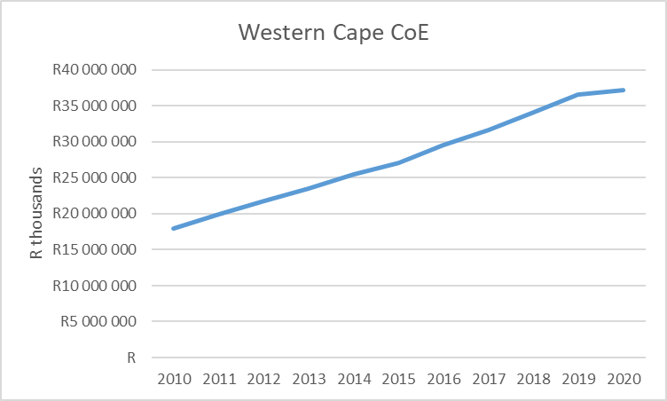
Analyzing total CoE
Year | CoE (R 000’s) | Y-o-y growth
2010 | R17 885 290
2011 | R19 830 941 | 10.9%
2012 | R21 629 958 | 9.1%
2013 | R23 416 965 | 8.3%
2014 | R25 410 935 | 8.5%
2015 | R26 979 823 | 6.2%
2016 | R29 379 154 | 8.9%
2017 | R31 519 840 | 7.3%
2018 | R33 985 105 | 7.8%
2019 | R36 484 474 | 7.4%
2020 | R37 112 472 | 1.7%
Key questions:
Why is CoE growing so fast?
Can we stop this growth and how?
Traditional approach: Analyse Total CoE
Notes:
Traditionally, we would analyse total CoE. And we know that it is growing fast – typically at a rate higher than CPI. For the past few years NT capped growth in CoE budgets. Departments had to stay within the parameters set by NT and at the same time implement the negotiated wage agreement. So increasingly it becomes critical to better understand COE growth in more detail.

Slide 7
What is CoE analysis?
Compensation of Employees (CoE) is total remuneration (incl. basic salary, benefits and allowances) paid to all personnel in a specified accounting period (month / year).
CoE is determined by
Number of personnel and the Salaries paid to them
CoE analysis
Identifies and measures drivers of CoE growth by separately considering trends in
number of personnel and
average salaries

Slide 8
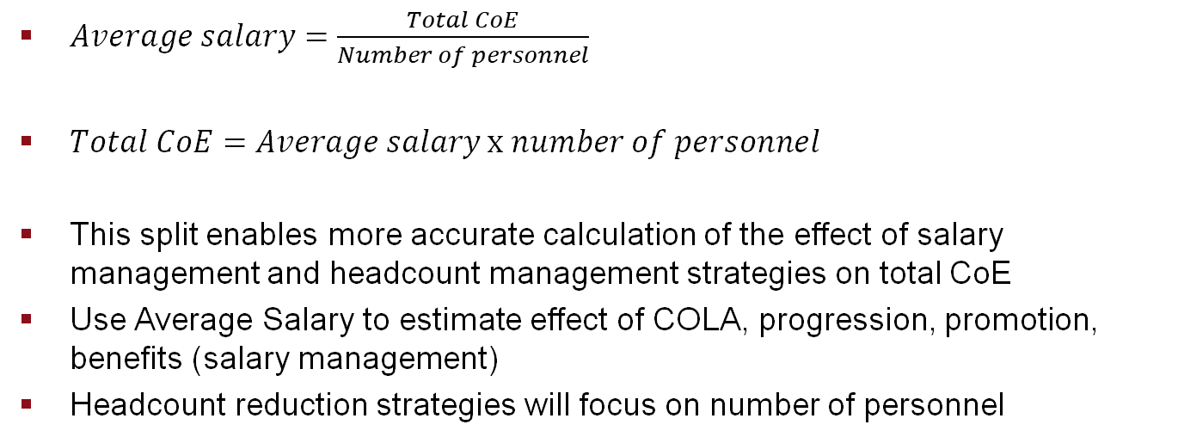
Understanding total CoE
$Average salary=\frac{Total CoE}{Number of personnel}$
$Total CoE=Average salary x number of personnel$
This split enables more accurate calculation of the effect of salary management and headcount management strategies on total CoE
Use Average Salary to estimate effect of COLA, progression, promotion, benefits (salary management)
Headcount reduction strategies will focus on number of personnel
Department | CoE 2020/21 (R ‘000) | Personnel | Average Salary? (R)
Agriculture | 398 908 | 986 | 404 708
Community Safety | 151 883 | 317 | 478 748
Cultural Affairs And Sport | 203 477 | 540 | ?
Economic Development And Tourism | 125 775 | 210 | ?
Education | 17 546 271 | 41 824 | ?
… | … | … | …
Total | 37 112 472 | 86 907 | ?

Slide 9
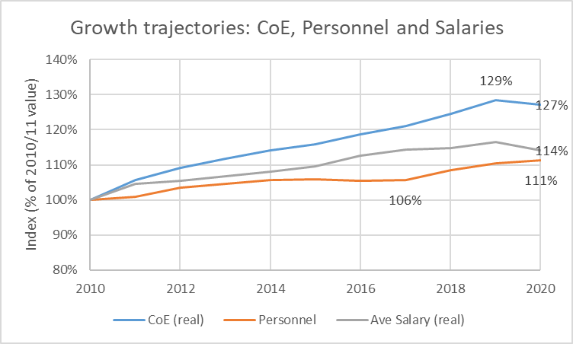
How much did personnel growth and salary growth each contribute to CoE growth?
Personnel grew by 11% (from 100 to 111)
Real Salaries grew by 14% (from 100 to 114)
Real CoE grew by 29% (from 100 to 129)
Year | CoE (R 000) real 2020 | Personnel | Ave salary (R) Real 2020
2010 | R 29 193 246 | 78 072 | R 373 926
2011 | R 30 842 191 | 78 824 | R 391 282
2012 | R 31 837 975 | 80 730 | R 394 374
2013 | R 32 597 320 | 81 704 | R 398 970
2014 | R 33 322 975 | 82 479 | R 404 019
2015 | R 33 842 082 | 82 594 | R 409 742
2016 | R 34 666 202 | 82 317 | R 421 132
2017 | R 35 314 461 | 82 523 | R 427 935
2018 | R 36 381 087 | 84 755 | R 429 252
2019 | R 37 525 029 | 86 175 | R 435 453
2020 | R 37 112 472 | 86 907 | R 427 038

Slide 10
PERSAL
The Personnel and Salary System (PERSAL) data is the primary source for analysis of personnel trends and compensation expenditure.
PERSAL was designed for personnel administration, but its properties and information value makes it a critical resource for strategic human resource analysis, planning and budgeting.
PERSAL is used by all national and provincial government departments (excl. Defence). It has been in operation since 1990 and is the consolidation of twenty former non-standard systems.
Various PERSAL reports are available at departmental level for the last three years on Vulindlela.

Slide 11
PERSAL is a big dataset
Personal
16 million
records per year
Salaries, allowances
105 million records per year
Promotions
700 000 records per year
Appointments
105 000 records per year
Terminations
122 000 records per year
Data available from 2006 to recent month
Notes:
GTAC has access to transactional level data:
Personal data – one record per person per month (14 million records per year)
Expenditure (National and Provincial) - one record per person per payment (salary, allowance, etc) (100 million records per year)
Promotions
Appointments
Terminations
The data is of a good quality in terms of detail, timeliness, completeness and consistency.
The data is actual payments made to employees, so there is a degree of self moderation which contributes to accuracy of amounts.
BAS draws data from PERSAL, but in less detail. You can analyse COE on BAS, but it only provides expenditure, there is no information on the numbers of personnel.

Slide 12
PERSAL
categories
Across the 5 PERSAL datasets there is information on:
Demographics, identity, leave, medical, pension, service, qualification, appointment type
Sector, Departmental structure, Program structure, Organisational structure
Expenditure classification
Salary information
Post information
Occupational structure
Events: Appointment, Progression, Termination
Notes:
From this micro level PERSAL data, we created a dataset with all the information required to analyse compensation spending at departmental level. In the next video I will do an overview of the data. I hope that this video helped to better understand what we mean by CoE analysis or personnel analysis. Thanks for joining me.

Slide 13
Variable | Description
Amount | The total remuneration expenditure per person per year is calculated. The amount includes basic salary, pension, benefits and allowances which are part of compensation. Fields used to classify the expenditure include item (SCOA item) and allowance type.
Classification of remuneration expenditure | Basic salary, pension, housing allowance, overtime – “allowance description” in PERSAL
Salary level | All salaries are classified according to the public service non-OSD salary scale to arrive at a standardized salary level, ranging from 0 to 16. It seems that the value “0” is used to indicate a salary which is not on the salary scale. The notch associated with salary level 0 is variable, but tends to be low notches.
Key scale table | This indicates the salary scale and dispensation. This field is used to distinguish the different occupation specific dispensation (OSD) and other salary groups
Notch | Basic annual salary without benefits and allowances
Province/Department/Programme | Description of which province, department or programme a payment is made in.
Nature of appointment | Description of how the individual is employed, i.e. permanent, contract or probation
Occupation | Provide details of occupation of the posts, i.e. professional, managers, engineers, medical specialists etc.
Age/Years of service | Either in number of years or grouped in 5 or 10 year intervals
Persal Number | The unique identifier used to link a person’s personal details to expenditure
Financial year | The data is summarised per person per year. Some analysis may also require the month
Full-time-equivalent (FTE) | Personnel headcount for the full financial year. A person who were paid for 12 months is 1 FTE, while a person who were paid for only 6 months is half a FTE. This number takes personnel numbers for all the months into consideration and is much more stable than a headcount derived from only one month.

Slide 14
Example of Salary Scale
Salary level | Notch number | Salary scale for public-service non-OSD 2018
 |  | Full-time notch | Part-time notch
 |  |  | 6/8th | 5/8th | 3/8th
1 | 1 | 89 631 | 67 224 | 56 019 | 33 612
 | 2 | 90 963 | 68 223 | 56 853 | 34 110
 | 3 | 92 340 | 69 255 | 57 714 | 34 629
 | 4 | 93 714 | 70 287 | 58 572 | 35 142
 | 5 | 95 127 | 71 346 | 59 454 | 35 673
2 | 1 | 96 549 | 72 411 | 60 342 | 36 207
 | 2 | 98 007 | 73 506 | 61 254 | 36 753
 | 3 | 99 471 | 74 604 | 62 169 | 37 302
 | 4 | 100 965 | 75 723 | 63 102 | 37 863
 | 5 | 102 483 | 76 863 | 64 053 | 38 430
 | 6 | 104 016 | 78 012 | 65 010 | 39 006
 | 7 | 105 579 | 79 185 | 65 988 | 39 591
 | 8 | 107 157 | 80 367 | 66 972 | 40 185
 | 9 | 108 771 | 81 579 | 67 983 | 40 788
 | 10 | 110 403 | 82 803 | 69 003 | 41 400
 | 11 | 112 059 | 84 045 | 70 038 | 42 021
 | 12 | 113 730 | 85 299 | 71 082 | 42 648
3 | 1 | 115 437 | 86 577 | 72 147 | 43 290
 | Etc.
Notch progression and Promotion

Slide 15
CoE and PERSAL Basics Demo 1
Explain data model vs spreadsheet approach
Create pivot table – rows, columns, filters, value, sorting rows / columns, conditional formatting, change layout, report format
Key fields necessary to explore salary growth:
  CoE (amount), real CoE (2020 Rand value)
  FTE
  key scale
  salary level
  description (department) and programme levels
Calculate average salary, year-on-year growth, CAGR, growth over time period

Slide 16
Break-away:
Exercise 1
1. Which OSD group had the highest average salary?
    List the total CoE in the Health department per OSD group (key scale) for 2020/21, together with the personnel numbers (FTE).
    Calculate the average salary per salary scale.
2. Determine the real average salary growth between 2010 and 2020 for Health (Year-on-year, total and CAGR) and interpret the results.
3. For the WC (all departments combined) group the salary levels 1 to 4, 5 to 8, 9 to12, and 13 to 16. Show a table with total remuneration (CoE), FTE and average salary for 2015 and 2020. Highlight the top salary level groups ito FTE growth and average salary growth (CAGR).
Additional:
4. Create a table and graph showing the top 5 OSD groups composition (% personnel) for 2010, 2015 and 2020. Were there any notable changes in the composition?
5. Determine which programme had the highest growth in personnel expenditure between 2019/20 and 2020/21 in absolute rand terms and in percentage terms. Which proportion of the growth was for personnel and which for salary?
6. Determine the programme in the Western Cape with the highest growth in average salary between 2019/20 and 2020/21.

Slide 17
Session 2:
Analysis I – Composition of CoE (basic salary, benefits, allowances)

Slide 18
By the end of Session 2, you will have an understanding of…
The composition of a total salary
relative contribution of basic salary, medical and housing benefits and overtime and other allowances to total salary
salary adjustment factors that are normally applied to basic salary, housing and medical allowances
How to access allowance information in the dataset
Application of salary adjustment factors

Slide 19
Remuneration, allowances and benefits
PSCBC Resolution 3 of 1999 regulates remuneration, allowances and benefits. These are regularly updated through the collective bargaining process.
Detailed documentation on conditions of service (housing, medical assistance, service bonus, severance package, etc.) is available from the DPSA document archive on the link http://www.dpsa.gov.za/dpsa2g/cs_documents.asp.
The calculation of and application of allowances and benefits are detailed in the DPSA’s Financial Manual , which is updated annually.

Slide 20
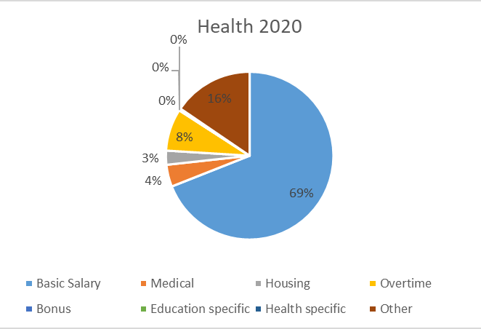
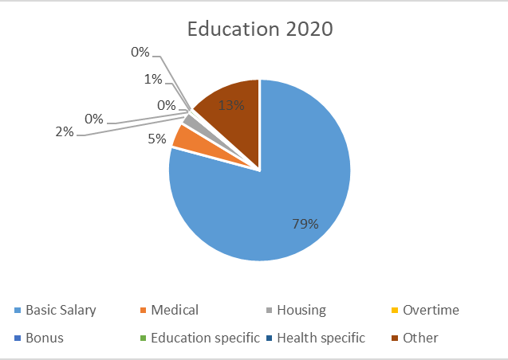
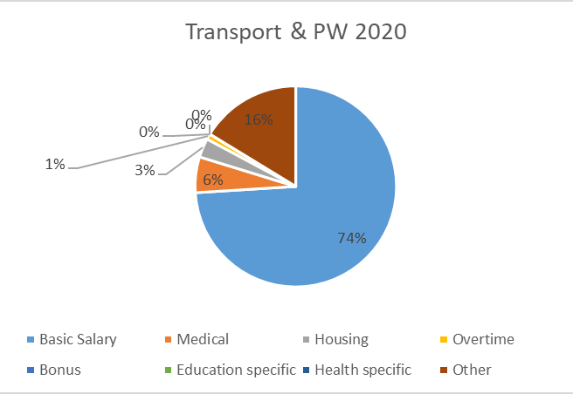
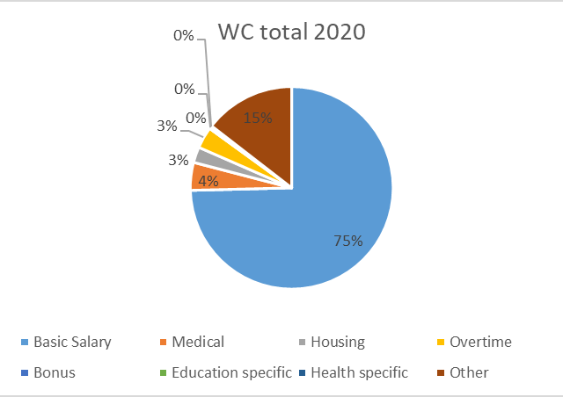
Composition of CoE across WC departments
Basic Salary was 75% of total overall, ranged between 69% and 79%. COLA is applied to Basic Salary
Medical around 4% - grows at CPI plus 2.5%.
Housing around 3% - grows at CPI rate
Overtime – Health only 8%
Other is sum of large number of small allowances – grow at same rate as basic salary

Slide 21
Example: Salary Record of a Medical Specialist in WC Health
 |  |  | Month
Allowance type | Notch | Sal lvl | 4 | 5 | 6 | 7 | 8 | Total
BASIC SALARY | 981843 | 12 | 57,274 | 57,274 | 57,274 | 57,274 |  | 229,097
FIXED OVERTIME (DENTISTS/MEDICAL/OTHER PERSONNEL) | 981843 | 12 | 30,462 | 30,462 | 30,462 | 30,462 |  | 121,849
NON PENSIONABLE CASH ALLOWANCE (SMS/MMS) | 981843 | 12 | 17,100 | 17,100 | 17,100 | 17,100 |  | 68,402
PENSION EMPLOYER CONTRIBUTION | 981843 | 12 | 7,446 | 7,446 | 7,446 | 7,446 |  | 29,783
LEAVE DISCOUNTING \ GRATUITY (UNUSED LEAVE CR) | 981843 | 12 |  |  |  |  | 3,050 | 3,050
EMPLOYERS CONTRIBUTION: PHWSBC | 981843 | 12 | 5 | 5 | 5 | 5 |  | 20
EMPLOYER CONTRIBUTION : PSCBC | 981843 | 12 | 1 | 1 | 1 | 1 |  | 6
Total |  |  | 112,289 | 112,289 | 112,289 | 112,289 | 3,050 | 452,206

Slide 22
Example: Salary Record of a teacher in WC Education
Allowance | Notch | Sal lvl | 4 | 5 | 6 | 7 | 8 | 9 | 10 | 11 | 12 | 1 | 2 | 3 | Grand Total
BASIC SALARY | 375,747 | 08 | 31,312 | 31,312 | 31,312 | 31,312 |  |  |  |  |  |  |  |  | 125,249
 | 381,405 | 09 |  |  |  |  | 31,784 | 31,784 | 31,784 | 31,784 | 31,784 | 31,784 | 31,784 | 31,784 | 254,270
BASIC SALARY: BACKDATED | 381,405 | 09 |  |  |  | 472 |  |  |  |  |  |  |  |  | 472
PENSION EMPLOYER CONTRIBUTION | 375,747 | 08 | 4,071 | 4,071 | 4,071 | 4,071 |  |  |  |  |  |  |  |  | 16,282
 | 381,405 | 09 |  |  |  | 61 | 4,132 | 4,132 | 4,132 | 4,132 | 4,132 | 4,132 | 4,132 | 4,132 | 33,116
SUPERVISORS ALLOWANCE (LEVEL III) | 375,747 | 08 | 15,656 | 3,914 | 3,914 | 3,914 |  |  |  |  |  |  |  |  | 27,398
 | 381,405 | 09 |  |  |  | 59 | 3,973 | 3,973 | 3,973 | 3,973 | 3,973 |  |  |  | 19,924
MEDICAL EMPLOYER CONTRIBUTIONS | 375,747 | 08 | 3,671 | 3,671 | 3,671 | 3,671 |  |  |  |  |  |  |  |  | 14,684
 | 381,405 | 09 |  |  |  |  | 3,671 | 3,671 | 3,671 | 3,671 | 3,671 | 3,671 | 3,671 | 3,985 | 29,682
SERVICE BONUS | 375,747 | 08 |  |  |  | 31,312 |  |  |  |  |  |  |  |  | 31,312
HOUSING ALL : RENTAL | 375,747 | 08 | 900 | 900 | 900 | 900 |  |  |  |  |  |  |  |  | 3,600
 | 381,405 | 09 |  |  |  |  | 900 | 900 | 900 | 900 | 900 | 900 | 900 | 900 | 7,200
GEHS INDIVIDUAL SAVE | 375,747 | 08 | 498 | 498 | 498 | 498 |  |  |  |  |  |  |  |  | 1,993
 | 381,405 | 09 |  |  |  |  | 498 | 674 | 557 | 557 | 557 | 557 | 557 | 557 | 4,514
SERVICE BONUS: ADDITIONAL (NT) | 381,405 | 09 |  |  |  | 472 |  |  |  |  |  |  |  |  | 472
EMPLOYER CONTRIBUTION: ELRC | 375,747 | 08 | 8 | 8 | 8 | 8 |  |  |  |  |  |  |  |  | 30
 | 381,405 | 09 |  |  |  |  | 8 | 8 | 8 | 8 | 8 | 8 | 8 | 8 | 60
EMPLOYER CONTRIBUTION : PSCBC | 375,747 | 08 | 1 | 1 | 1 | 1 |  |  |  |  |  |  |  |  | 6
 | 381,405 | 09 |  |  |  |  | 1 | 2 | 1 | 1 | 1 | 1 | 1 | 1 | 12
SURCHARGE (NT) | 381,405 | 09 |  |  |  |  |  |  |  |  |  |  |  | (628) | (628)
Total |  |  | 56,117 | 44,375 | 44,375 | 76,751 | 44,967 | 45,143 | 45,025 | 45,025 | 45,025 | 41,053 | 41,053 | 40,739 | 569,648

Slide 23
Annual salary adjustments
Allowances based on notch are adjusted with COLA:
  E.g. basic salary, pension, overtime
Allowances not based on notch:
  Medical – CPI + 2.5%
  Housing – CPI

Slide 24
Analysis I – Composition of CoE (basic salary, benefits, allowances) Demo 2
Modelling the impact of wage agreements to components of CoE (growth factors to different expenditure types)
  Explore the fields amount_BasicSalary, amount_ Overtime, amount_Housing amount_ Medical amount_ Bonus.
  CoE affected by COLA is the Total excl. Medical and Housing
Pivot table: Show values as percentage of total, show detail at person level.
Create pivot chart – editing (add chart title, axis titles, remove field buttons)
Show formulas
Number formatting

Slide 25
Break-away:
Exercise 2
1. Cost the implementation of adjustments to salary and benefits: The total CoE, medical and housing allowances are given per salary level for 2020/21 on the next slide and in the Excel workbook sheet named “Exercise 2 – Q1”.
Calculate the total cost of implementation of the salary adjustments listed below (cost of living adjustments and benefits):
Cost of living adjustments:
  CPI + 1% for salary levels 1-7
  CPI + 0.5% for salary levels 8-10
  CPI for salary levels 11-12
  CPI-0.5% for salary levels 13-16
  (Hint: COLA is applied to Total CoE minus Housing minus Medical)
Housing and Medical Allowances:
  Housing allowance: adjust with CPI
  Medical allowance: adjust with CPI+2.5%
(Take CPI as 4.5%)
Give the total cost overall as final answer.
What assumptions (if any) did we make that may affect the accuracy of the cost estimation?

Slide 26
CoE, medical and housing allowances per salary level for 2020/21
Break-away:
Exercise 2
Salary level | Total CoE (R) | Medical allowances (R) | Housing allowances (R)
1 | 64 516 661 | 2 439 348 | 2 677 728
2 | 1 058 658 679 | 98 495 202 | 71 513 352
3 | 1 194 430 950 | 91 606 707 | 67 748 927
4 | 874 439 340 | 81 646 773 | 52 219 720
5 | 2 876 024 218 | 231 710 854 | 142 596 076
6 | 1 705 191 119 | 102 127 578 | 62 752 616
7 | 8 443 814 475 | 342 037 118 | 174 398 263
8 | 5 076 450 045 | 289 902 387 | 144 737 056
9 | 5 430 701 191 | 252 345 643 | 128 531 043
10 | 2 912 250 221 | 109 468 489 | 58 697 744
11 | 3 395 781 296 | 31 069 581 | 12 763 376
12 | 3 335 729 583 | 17 189 812 | 5 917 740
13 | 316 292 575 | 2 810 130 | 1 691 003
14 | 110 505 971 | 903 198 | 300 120
15 | 54 471 757 | 270 847 | 25 488
16 | 42 728 526 | 420 501 | 67 200
Total | 36 891 986 607 | 1 654 444 168 | 926 637 452

Slide 27
Break-away:
Exercise 2
2. Assessing overtime expenditure across all OSD groups:
  Calculate the expenditure in overtime across the OSD groups in 2020/21.
  Calculate the growth (Y-o-Y, CAGR and total) in overtime expenditure across the OSD groups between 2015/16 and 2020/21. Which OSD group had the fastest growth for each growth calculation?
  Compare overtime as a percentage of total CoE across the different OSD groups for the period 2015/16 to 2019/20 and interpret the results.
  Compare overtime expenditure per FTE across different OSD groups for the period 2015/16 to 2019/20 and order them from highest to lowest.
Additional exercise:
3. Determine the number of personnel at each salary level who received a housing allowance in 2020/21 and the total spent on the housing allowance per salary level.

Slide 28
Session 3:
Analysis II - Drivers of CoE growth: Salary increases

Slide 29
By the end of Session 3, you will have an understanding of ...
Key drivers of salary growth
The effect of CPI and COLA and how to analyse them separately
The effect of promotions on CoE growth
Notch progression and the joint effect of COLA and notch progression

Slide 30
Drivers of CoE growth
Salary growth:
Annual cost of living adjustments (COLA)
Notch progression
Promotion
Increase in benefits and allowances
Drivers of headcount growth
Appointments
Terminations

Slide 31
How much did personnel growth and salary growth each contribute to CoE growth?
Real CoE grew by 29% (from 100 to 129)
Personnel grew by 11% (from 100 to 111)
Real Salaries grew by 14% (from 100 to 114)
Year | CoE (R 000) real 2020 | Personnel | Ave salary (R) Real 2020
2010 | R 29 193 246 | 78 072 | R 373 926
2011 | R 30 842 191 | 78 824 | R 391 282
2012 | R 31 837 975 | 80 730 | R 394 374
2013 | R 32 597 320 | 81 704 | R 398 970
2014 | R 33 322 975 | 82 479 | R 404 019
2015 | R 33 842 082 | 82 594 | R 409 742
2016 | R 34 666 202 | 82 317 | R 421 132
2017 | R 35 314 461 | 82 523 | R 427 935
2018 | R 36 381 087 | 84 755 | R 429 252
2019 | R 37 525 029 | 86 175 | R 435 453
2020 | R 37 112 472 | 86 907 | R 427 038

Slide 32
Cost of living adjustments and CPI
PSCBC resolution | Level | Year | COLA (%) | CPI (%)
Res 4 of 2010 | levels 1 to 12 | 2010 | 7.5 | 4.3
Res 2 of 2011 | levels 1 to 12 | 2011 | 6.8 | 5.0
Res 1 of 2012 | levels 1 to 12 | 2012 | 7 | 5.7
 | levels 1 to 12 | 2013 | 6.6 | 5.7
 | levels 1 to 12 | 2014 | 7.2 | 6.2
Res 2 of 2015 | levels 1 to 12 | 2015 | 7 | 4.5
 | levels 1 to 12 | 2016 | 7.6 | 6.3
 | levels 1 to 12 | 2017 | 7.3 | 5.3
Res 1 of 2018 | levels 1 to 7 | 2018 | 7 | 4.7
 | levels 8 to 10 | 2018 | 6.5
 | levels 11 and 12 | 2018 | 6
 | levels 1 to 7 | 2019 | 6.2 | 4.1
 | levels 8 to 10 | 2019 | 5.7
 | levels 11 and 12 | 2019 | 5.2
 | levels 1 to 7 | 2020 |  | 3.3
 | levels 8 to 10 | 2020
 | levels 11 and 12 | 2020
DPSA - Remuneration Documents

Slide 33
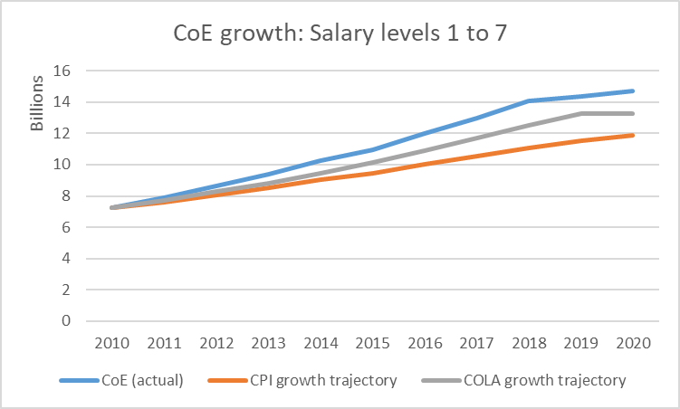
Year | CoE (R 000) Lvl 1 to 7 | CPI factor | COLA factor | CPI growth trajectory | COLA growth trajectory
2010 | 7 243 798 | 1.043 | 1.075 | 7 243 798 | 7 243 798
2011 | 7 887 980 | 1.050 | 1.068 | 7 605 988 | 7 736 376
2012 | 8 627 982 | 1.057 | 1.070 | 8 039 529 | 8 277 923
2013 | 9 405 208 | 1.057 | 1.066 | 8 497 782 | 8 824 266
2014 | 10 248 341 | 1.062 | 1.072 | 9 024 645 | 9 459 613
2015 | 10 973 736 | 1.045 | 1.070 | 9 430 754 | 10 121 786
2016 | 11 983 471 | 1.063 | 1.076 | 10 024 891 | 10 891 041
2017 | 12 983 152 | 1.053 | 1.073 | 10 556 211 | 11 686 087
2018 | 14 081 131 | 1.047 | 1.070 | 11 052 353 | 12 504 113
2019 | 14 355 185 | 1.041 | 1.062 | 11 505 499 | 13 279 368
2020 | 14 693 105 | 1.033 | 1.000 | 11 885 181 | 13 279 368
Example: Effect of COLA higher than CPI
CPI growth factor = 1.05x1.057x…x1.033
=1.641 -> 64.1%
COLA growth factor = 1.068x1.07x…x1
=1.833 -> 83.3%
Contribution of COLA exceeding CPI:
R13.3 bn – R11.9 bn= R1.4 bn

Slide 34
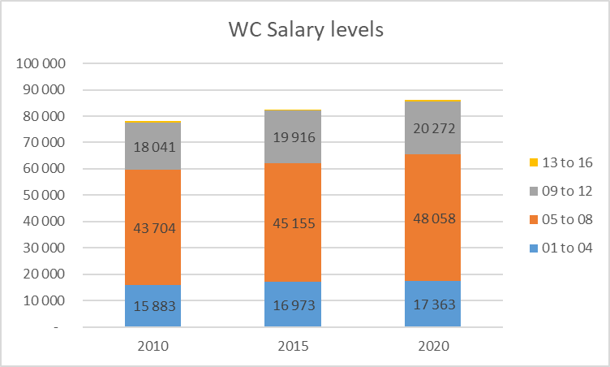
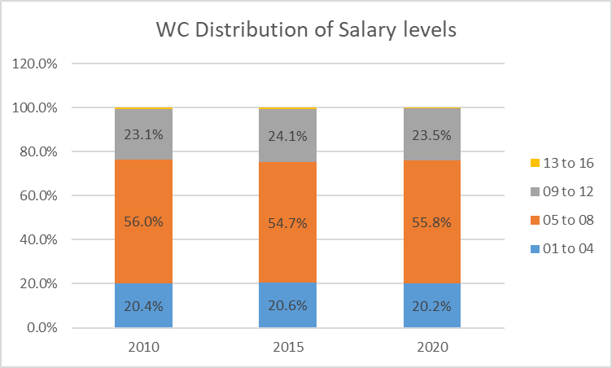
Promotions
Promotion: Advancing one or more salary levels
Distribution of salary levels remained constant
No evidence of salary level inflation overall

Slide 35
Cost of promotions
notch total after promotions minus notch total before promotions
% increase in notch total
Apply % increase in notch total to total CoE
Apply % increase in notch total to total CoE affected by notch changes

Slide 36
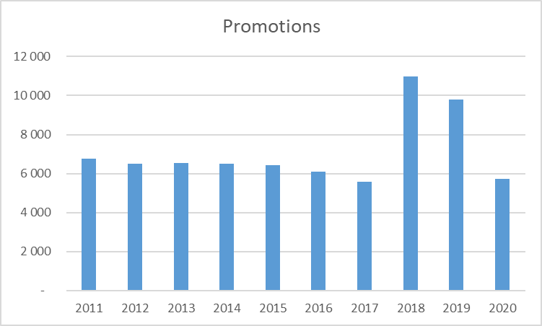
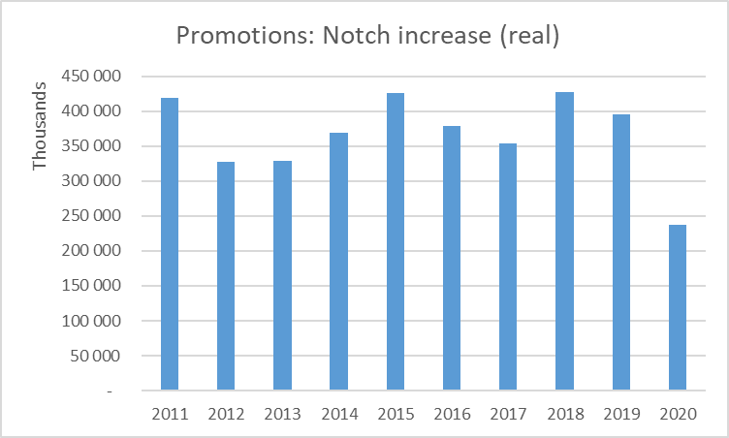
Cost of promotions in Western Cape
Around 6 000 promotions per year, higher numbers in 2018/19 and 2019/20.
Promotions increased basic salaries by +- R350 million per year (real), lower in 2020/21.
Notch value added by promotions were between 0.8% and 1.7% of total notch value between 2011/12 and 2020/21.

Slide 37
Notch progression
Progression: advancing to the next notch within the same salary level.
Notch increase 1.5% - with some exceptions
Combined effect of COLA and notch progression: Notches are increased by COLA, in addition, people move up by one notch (1.5%).
Calculation: New notch=Current notch x COLA factor x Progression factor
Example: Current notch is R100 000, COLA is 7% and progression is 1.5%
New notch=100 000 x 1.07 x 1.015 = 108 605.
Notch increase is 8.605%

Slide 38
Notch progression example
 | Notch (individual on lvl 7) | Growth factor (calc) | COLA (from table) | Progression: Growth factor/COLA
2010 | 140 208
2011 | 149 742 | 1.068 | 1.068 | 1.000 | No progr
2012 | 162 630 | 1.086 | 1.070 | 1.015 | 1 notch
2013 | 175 965 | 1.082 | 1.066 | 1.015
2014 | 191 820 | 1.090 | 1.072 | 1.017
2015 | 208 323 | 1.086 | 1.070 | 1.015
2016 | 230 928 | 1.109 | 1.076 | 1.030 | 2 notches
2017 | 251 508 | 1.089 | 1.073 | 1.015
2018 | 273 144 | 1.086 | 1.070 | 1.015
2019 | 294 432 | 1.078 | 1.062 | 1.015
2020 | 298 848 | 1.015 | 1.000 | 1.015
New notch = COLA x Progr x current notch
COLA x Prog = New notch/current notch
Prog = (New notch/current notch)/COLA
New notch/current notch=growth factor
Prog = growth factor/COLA
How much did the notch grow due to progression? (1.015)⁷ x 1.017 x 1.03
How much did the notch grow due to COLA? 1.068 x 1.07 x … x 1.062
Growth factor: new notch/current notch=149 742/140 208= 1.068

Slide 39
Looking for savings: Slower salary growth
Lower cost of living adjustments (wage agreement)
Fewer promotions
Fewer progressions
Review allowances and incentives (reduce overtime, performance bonuses)
Notes:
So how do we slow down salary growth? Departments can control progression, promotions and reduce overtime and performance bonuses. Performance bonuses amounted to R2 bn overall in 2019/20 and shifts and overtime made up R14 bn. This (and other discretionary benefits and allowances) could be used by departments to slow down salary growth.
So in summary, personnel analysis involves looking for savings in two broad areas: reducing personnel numbers and reducing salary growth.

Slide 40
Analysis II - Drivers of CoE growth: Salary increases Demo 3
Modelling the combined impact of COLA and notch progression on CoE.
the field “notch” in PERSAL data
Using growth factors and percentage growth
Applying growth factors for COLA and notch progression
Utilising the PERSAL dataset to assess individuals in the organisation

Slide 41
Break-away:
Exercise 3
1. Estimating the cost of promotion: Use the table below that shows the notch total (total basic annual salary) per salary level and full-time equivalent per salary level. Estimate the change in notch total if everybody in level 1-4 is promoted to level 5. (Hint: calculate average notch per salary level).
Salary level | FTE’s | Notch total (R 000)
1 | 470 | 50 850
2 | 6 417 | 757 818
3 | 6 090 | 931 168
4 | 4 387 | 622 951
5 | 10 561 | 2 085 282
6 | 5 228 | 1 349 674
7 | 21 374 | 6 846 106
8 | 10 895 | 3 837 208
9 | 9 696 | 4 176 324
10 | 4 142 | 2 266 999
11 | 3 991 | 3 277 340
12 | 2 443 | 2 910 954
13 | 272 | 324 949
14 | 81 | 114 255
15 | 33 | 57 744
16 | 20 | 42 721
Total | 86 100 | 29 652 345
Source: PERSAL: Western Cape 2021

Slide 42
Break-away:
Exercise 3
2. Calculate the combined effect of notch progression and COLA on CoE:
Use the table below that shows the basic annual salary per salary level and calculate the notch total if a notch progression of 1.5% is applied to all salary levels and a COLA of 4% is applied to salary levels 1 to 10 only.
Salary level | Personnel | Notch total (R 000)
1 | 470 | 50 850
2 | 6 417 | 757 818
3 | 6 090 | 931 168
4 | 4 387 | 622 951
5 | 10 561 | 2 085 282
6 | 5 228 | 1 349 674
7 | 21 374 | 6 846 106
8 | 10 895 | 3 837 208
9 | 9 696 | 4 176 324
10 | 4 142 | 2 266 999
11 | 3 991 | 3 277 340
12 | 2 443 | 2 910 954
13 | 272 | 324 949
14 | 81 | 114 255
15 | 33 | 57 744
16 | 20 | 42 721
Total | 86 100 | 29 652 345
Source: Western Cape 2021

Slide 43
Session 4:
Analysis III - Drivers of CoE growth: Headcounts

Slide 44
By the end of Session 4, you will have an understanding of ...
Headcounts as a driver of salary growth
The effect of natural attrition (not filling all vacancies) on CoE growth
Combined effect of salary growth and personnel growth on CoE growth

Slide 45
Drivers of CoE growth
Salary growth
Annual cost of living adjustments (COLA)
Notch progression
Promotion
Increase in benefits and allowances
Headcount growth
Appointments
Terminations
Non-permanent personnel

Slide 46
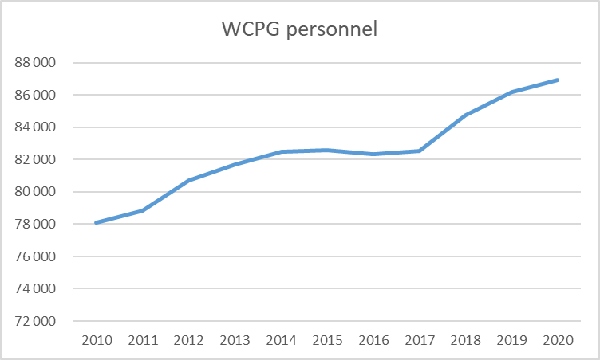
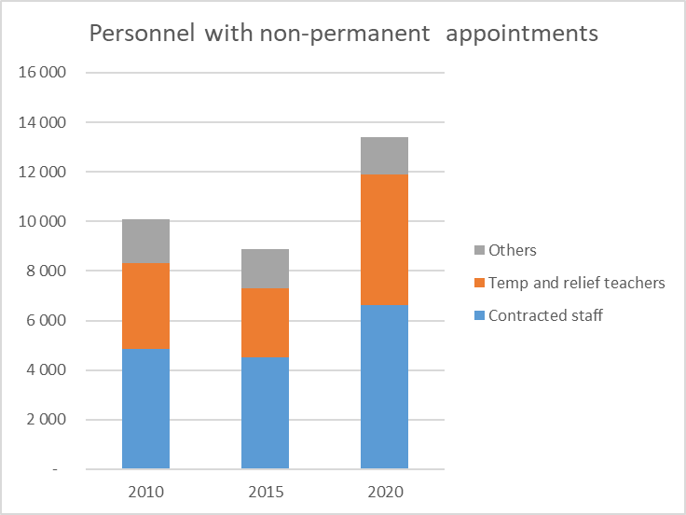
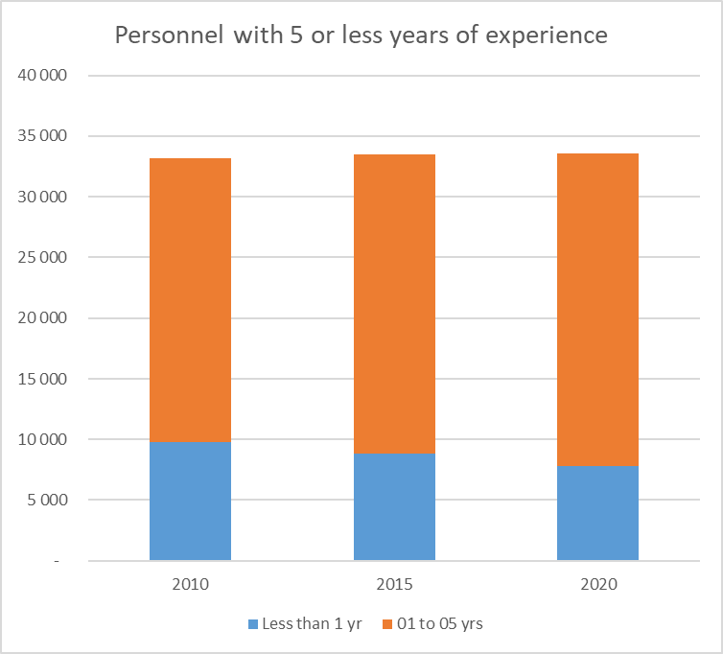
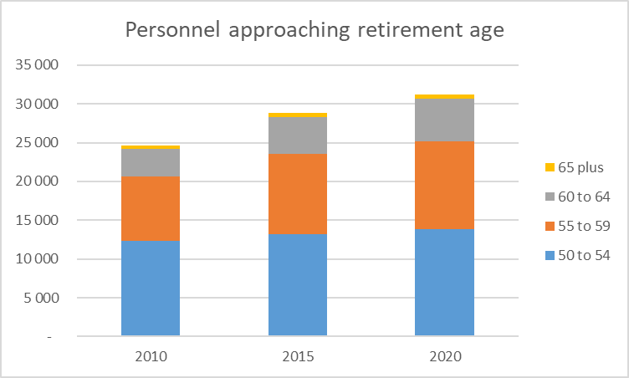
Managing Headcount growth

Slide 47
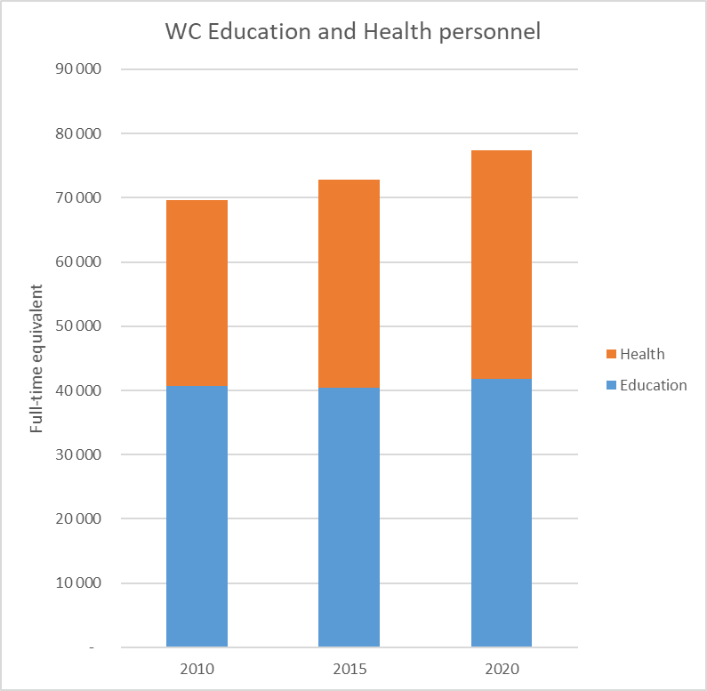
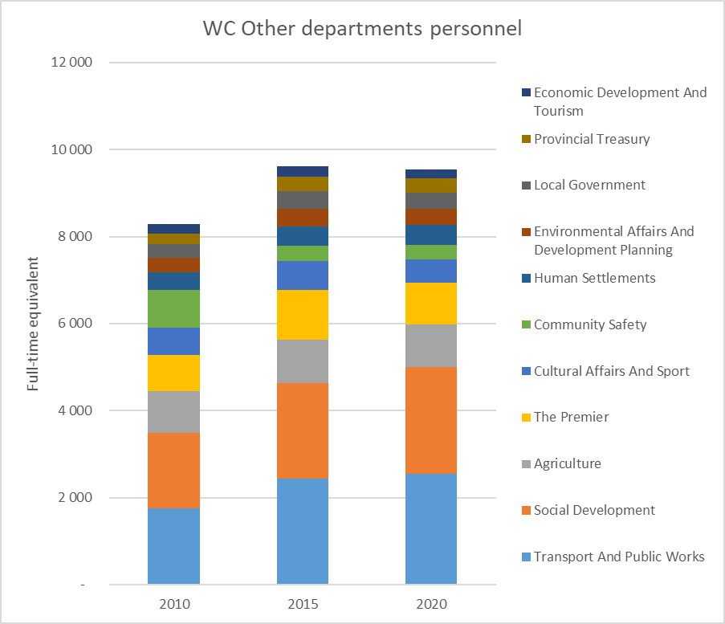
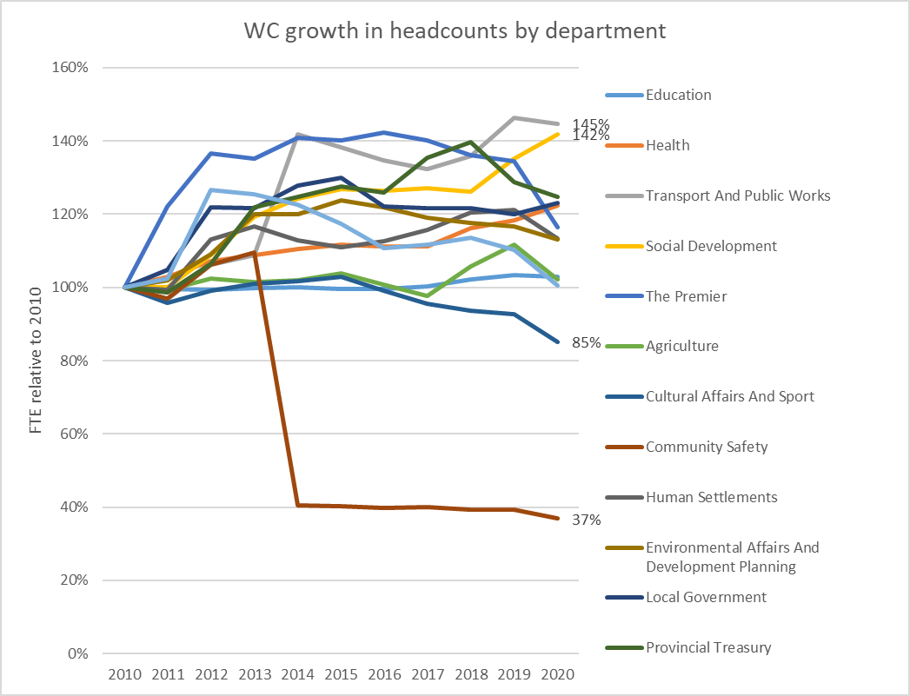
WC personnel growth by department

Slide 48
Entries and exits
Between 2006 and 2019, entries of new staff into WCG exceeded exits by about 1.2:1
  ±8% of staff leave each year
  ±9% of staff appointed each year
Terminations are proportional to the size of the departments:
  DoE: 48% staff, 53% of terminations
  DoH: 41% staff, 35% of terminations
IMPLICATION: Substantial headcount reductions could occur if replacement rate were <1
 | Appointments 2019 | Terminations 2019 | Difference
Education | 4 597 | (4 079) | 518
Health | 3 734 | (2 727) | 1 007
Social Development | 418 | (137) | 281
Agriculture, Rural Development and Economic Development | 204 | (203) | 1
Roads, PW, Transport and Community Safety | 382 | (244) | 138
The Premier | 170 | (184) | (14)
Other | 218 | (194) | 24
Total | 9 723 | (7 768) | 1 955

Slide 49
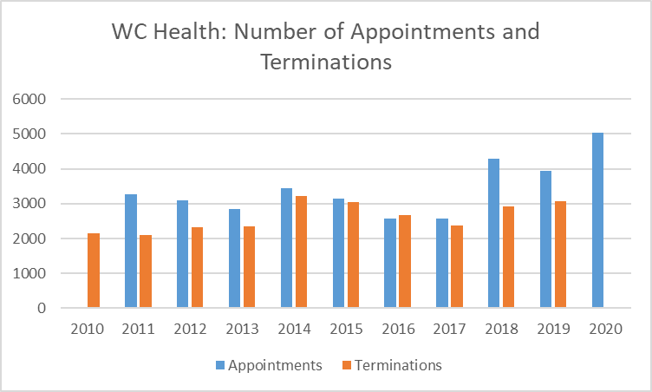
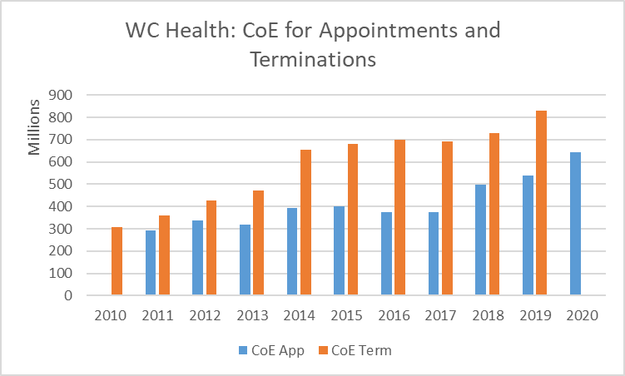
Example: WC Health Appointments and Terminations
More appointments than terminations --> Headcount growth
Appointments at lower levels and terminations at higher salary levels --> terminations CoE greater than CoE required for new appointments.

Slide 50
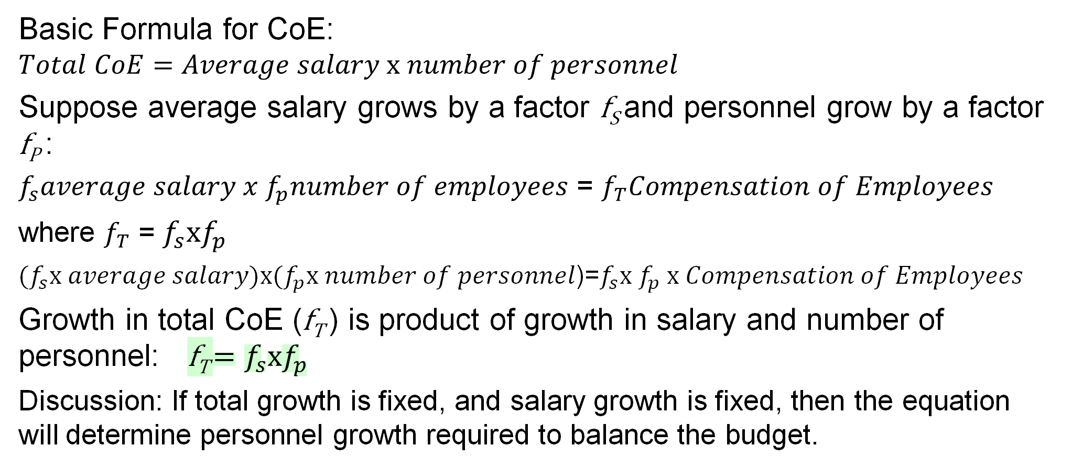
Combined effect of growth in salaries and headcounts
Basic Formula for CoE:
$$Total CoE=Average salary x number of personnel$$
Suppose average salary grows by a factor f_{S} and personnel grow by a factor f_{P} :
$f_{s}average salary x f_{p}number of employees$ = $f_{T}Compensation of Employees$
where $f_{T}$ = $f_{s}xf_{p}$
$(f_{s}x average salary)x(f_{p}x number of personnel$)=$f_{s}x{ f}_{p} x Compensation of Employees$
Growth in total CoE (f_{T} ) is product of growth in salary and number of personnel: f_{T} $=f_{s}xf_{p}$
Discussion: If total growth is fixed, and salary growth is fixed, then the equation will determine personnel growth required to balance the budget.

Slide 51
Analysis III - Drivers of CoE growth: Headcounts Demo 4
How different age compositions affect total notch
Appointments in the data
Terminations in the data

Slide 52
Break-away:
Exercise 4
Calculate the effect of changes in headcount on CoE: Use the information in the table provided below and calculate the effect on CoE if 2 000 additional personnel are appointed at level 6 while all salaries remain the same as in 2020/21 (hint: determine the average salary per salary level).
Calculate CoE per age group: Determine the number of personnel aged 60 or older per department and their total CoE expenditure in 2020/21. If 20% of that age group terminate their employment, what could the savings in CoE be?
Combined effect of Salary and Headcount growth: Suppose that CoE growth is fixed at 3% and salary growth is 4.5%. Estimate (without using any data) the percentage change in personnel numbers that should be sufficient to balance the budget? (hint: Total CoE = Average Salary x Headcount)

Slide 53
Break-away:
Exercise 4
WCPG CoE and personnel per Salary level in 2020/21:
Salary level | CoE (R) | Personnel | Ave Salary
1 | 64 516 661 | 470
2 | 1 058 658 679 | 6 417
3 | 1 194 430 950 | 6 090
4 | 874 439 340 | 4 387
5 | 2 876 024 218 | 10 561
6 | 1 705 191 119 | 5 228
7 | 8 443 814 475 | 21 374
8 | 5 076 450 045 | 10 895
9 | 5 430 701 191 | 9 696
10 | 2 912 250 221 | 4 142
11 | 3 395 781 296 | 3 991
12 | 3 335 729 583 | 2 443
13 | 316 292 575 | 272
14 | 110 505 971 | 81
15 | 54 471 757 | 33
16 | 42 728 526 | 20
Source: Western Cape 2021

