Slide 1
EXPENDITURE ANALYSIS: PERSONNEL
PERSAL analysis
Notes:
In this module we will look at a detailed analysis of the compensation of employees.
This is a significant share of total expenditure in any department and therefore an area for potential savings and efficiency gains.

Slide 2
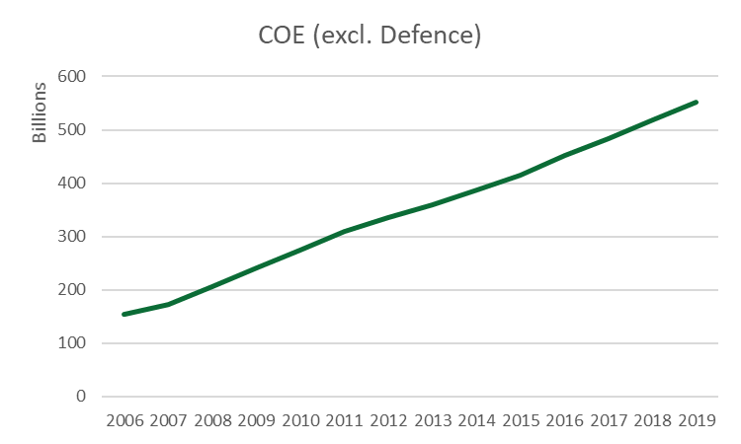
Analysing total CoE
Traditional approach: Analyse Total CoE
 | CoE (Bn Rand) | Y-o-Y growth | Growth (Bn Rand)
2006 | 154.1
2007 | 173.3 | 12% | 19.2
2008 | 206.4 | 19% | 33.0
2009 | 241.3 | 17% | 34.9
2010 | 274.9 | 14% | 33.6
2011 | 309.1 | 12% | 34.2
2012 | 335.6 | 9% | 26.5
2013 | 358.9 | 7% | 23.3
2014 | 387.9 | 8% | 29.0
2015 | 414.3 | 7% | 26.5
2016 | 451.1 | 9% | 36.8
2017 | 484.2 | 7% | 33.1
2018 | 518.7 | 7% | 34.5
2019 | 551.1 | 6% | 32.4
Why is CoE growing so fast?
Can personnel numbers grow slower?
How fast are salaries growing?
Notes:
Traditionally, we would analyse total CoE. And we know that it is growing fast – typically at a rate higher than CPI. For the past few years NT capped growth in CoE budgets. Departments had to stay within the parameters set by NT and at the same time implement the negotiated wage agreement. So increasingly it becomes critical to better understand COE growth in more detail.

Slide 3
Typical expenditure analysis
What is the pace of CoE growth?
Controlling / containing CoE growth –
Locus of decision-making
Identify drivers of CoE growth
Total COE expenditure depends on
The number of personnel
Salaries and benefits
How to save CoE
Personnel reduction
Reduce benefits
Slower salary growth
Notes:
Intuitively we understand that CoE will be increased if we increase our establishment and or we increase salaries. To slow down CoE growth we therefore have to control both the number of personnel and their salaries. So a personnel analysis aiming at finding savings will focus on two main components, namely personnel reduction and salary growth reduction.

Slide 4
Counting personnel
Determine the number of personnel per year
  Traditional approach – headcounts as at a specific date, e.g. 30 September
  Full-time equivalent approach –
    1 Full-time equivalent (FTE) is 12 months of work performed per year
    Total FTE=total number of months worked divided by 12
    Examples: 6 months worked is 0.5 FTE, 24 months worked is 2 FTE, etc.
Department A | Department B
2 people worked for 12 months each | 12 people worked for 1 month each
Total months worked=2*12=24 | Total months worked=12*1=12
Total FTE=total months worked/12 = 24/12 =2 | Total FTE=total months worked/12 = 12/12 =1
Total FTE=2 | Total FTE=1
Headcount as at 31 March: 2 | Headcount as at 31 March: Anything between 0 and 12
Notes:
We count personnel in terms of full-time equivalents. This is much more stable and better related to the total CoE than headcounts at a specific date. The headcounts measure comes from a past era of small data when we were limited to counting manually or to the rows in a spreadsheet. It provides a very static snapshot picture of the personnel situation which we know is highly variable from month to month as people move in and out of departments. The example on the slide shows two departments A and B. Department A has two people who each worked the whole year. So their full time equivalent is 2 and their headcounts is also 2. But department B had 12 people, each working for one month only. If we add the FTE’s it equates to 1. The headcount could be anything between 0 and 12. This is an extreme example, but it shows that headcount can be quite misleading in terms of personnel size as compared to full time equivalent.
The Full time equivalent approach takes the whole year into account. A person who was on the establishment for only part of the year will be counted proportionally to the time she spent in the department. So if Mmanto received a salary for 6 months, she will be half a fll-time equivalent and if James received a salary for 12 months he will be one full-time equivalent. There could be a big difference between headcounts and full time equivalents in departments with many people who are appointed for part of the year only, or in cases where bulk appointments happen during the year.

Slide 5
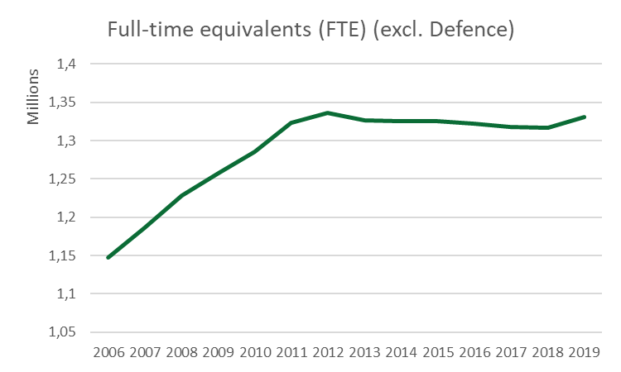
Personnel trends
 | FTE | Y-o-Y growth | Growth
2006 | 1 147 084
2007 | 1 186 081 | 3.4% | 38 997
2008 | 1 228 022 | 3.5% | 41 941
2009 | 1 257 451 | 2.4% | 29 429
2010 | 1 285 228 | 2.2% | 27 777
2011 | 1 323 432 | 3.0% | 38 205
2012 | 1 335 876 | 0.9% | 12 444
2013 | 1 326 968 | -0.7% | - 8 908
2014 | 1 325 776 | -0.1% | - 1 192
2015 | 1 325 516 | 0.0% | - 260
2016 | 1 322 586 | -0.2% | - 2 930
2017 | 1 317 765 | -0.4% | - 4 821
2018 | 1 316 954 | -0.1% | - 811
2019 | 1 331 034 | 1.1% | 14 080
After 2012 FTEs dropped
In recent years personnel growth was not the key factor in overall CoE growth
Is this true for all function groups, budget groups, depts, etc?
Opportunity for savings at departmental level? Appointments vs terminations – age profile
Notes:
Personnel numbers can be extracted from PERSAL data by counting the number of months each staff member is paid through PERSAL. Between 2006 and 2019 the FTE increased from 1.147 million to 1.331 million people. Most of the growth took place up to 2012. Thereafter it slowly decreased, but with a slight uptick in the last year. So currently, for the aggregate, personnel growth is not the key driver of overall CoE growth. But this, of course is not necessarily true at departmental level and should be further investigated.

Slide 6
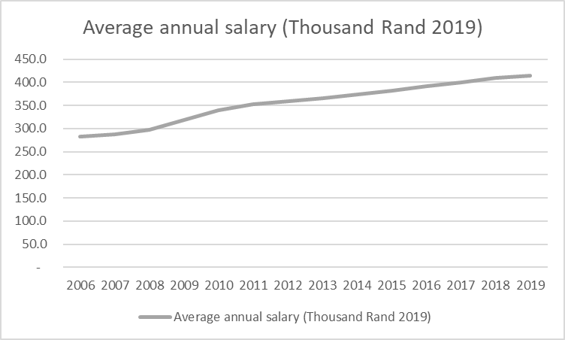
Salaries, benefits and allowances
 | Total COE (Rand Bn 2019) | FTE (millions) | Average annual salary (real) = Total COE (real)/FTE (R‘000 2019) | Y-o-Y growth
2006 | 325.0 | 1.147 | 283.3
2007 | 341.2 | 1.186 | 287.7 | 1.5%
2008 | 364.1 | 1.228 | 296.5 | 3.1%
2009 | 399.3 | 1.257 | 317.6 | 7.1%
2010 | 436.3 | 1.285 | 339.5 | 6.9%
2011 | 467.4 | 1.323 | 353.2 | 4.0%
2012 | 480.2 | 1.336 | 359.5 | 1.8%
2013 | 485.7 | 1.327 | 366.0 | 1.8%
2014 | 494.5 | 1.326 | 373.0 | 1.9%
2015 | 505.3 | 1.326 | 381.2 | 2.2%
2016 | 517.5 | 1.323 | 391.3 | 2.6%
2017 | 527.5 | 1.318 | 400.3 | 2.3%
2018 | 539.9 | 1.317 | 409.9 | 2.4%
2019 | 551.1 | 1.331 | 414.0 | 1.0%
Inflation-adjusted salaries increased by more than 2% in many years:
Above CPI cost of living adjustments
Promotion / progression
Improved benefits
Introduction of OSDs
Opportunity for savings at departmental level?
(Progression, some allowances e.g. overtime, bonus)
Notes:
The graph shows the inflation adjusted average annual salary in 2019 rand value. The average salary in 2019 was R414 000, increasing by more than R130 000 in 2006. So clearly salaries, benefits and allowances grew faster than inflation over this period. It is well known that COLA adjustments for a large group of public servants were above CPI. Furthermore, benefits such as medical and housing improved. Many public servants qualify for annual notch increases, which is currently 1.5% per year for most occupational dispensations. These factors jointly contributed to the wage bill being too high and growing faster than other budget items at the same time.

Slide 7

Looking for savings: Personnel reduction
 | Appointments (PERSAL) | Exits (PERSAL) | Gains
2007 | 101 019 | 57 430 | 43 589
2008 | 99 743 | 66 572 | 33 171
2009 | 82 584 | 52 514 | 30 070
2010 | 85 538 | 54 415 | 31 123
2011 | 90 549 | 61 799 | 28 750
2012 | 64 399 | 62 518 | 1 881
2013 | 66 758 | 75 318 | - 8 560
2014 | 75 169 | 82 403 | - 7 234
2015 | 84 119 | 76 655 | 7 464
2016 | 68 942 | 73 569 | - 4 627
2017 | 63 754 | 66 314 | - 2 560
2018 | 62 010 | 66 924 | - 4 914
Fewer Appointments
More transfers between depts
More terminations:
Age profile
Early retirement
Notes:
Personnel reduction can be achieved by natural attrition, retirement, voluntary severage packages and early retirement incentives. Contract appointments could be reduced. Natural attrition is achieved by not filling all vacancies. In 2018 there were close to 5 000 fewer appointments than terminations, so natural attrition is already a reality at the aggregate level. Each department has to monitor this balance between terminations and appointments. The age profile gives an indication of possible savings in the age group 55 plus (the candidates for early retirement and retirement). In SAPS alone R4.6 billion was spent on CoE in the 56 plus age group in 2018/19.

Slide 8
Looking for savings: Slower salary growth
Lower cost of living adjustments (wage bargaining)
Fewer promotions
Fewer progressions
Review allowances and incentives (reduce overtime, performance bonuses)
Remuneration type | 2018/19 (R) | 2019/20
Salary | 426 595 607 662 | 454 292 999 015
Medical Aid | 20 483 034 663 | 22 284 948 749
Housing | 15 964 488 870 | 17 191 840 329
Shifts & Overtime | 12 618 127 354 | 14 349 324 666
Other | 4 301 504 234 | 4 651 520 899
Travel And Transport | 2 261 223 578 | 326 772 428
Leave | 2 142 376 537 | 2 304 781 694
Health Specific | 2 281 392 458 | 2 470 376 016
Performance | 2 624 865 644 | 2 008 947 746
Education Specific | 1 830 151 740 | 2 020 319 660
Notes:
So how do we slow down salary growth? Departments can control progression, promotions and reduce overtime and performance bonuses. Performance bonuses amounted to R2 bn overall in 2019/20 and shifts and overtime made up R14 bn. This (and other discretionary benefits and allowances) could be used by departments to slow down salary growth.
So in summary, personnel analysis involves looking for savings in two broad areas: reducing personnel numbers and reducing salary growth.

Slide 9
PERSAL
Personnel data and salary data
National Departments & Provincial Departments use PERSAL
Capture information on:
  Employees
  Remuneration transactions related to those employees
All fields are coded and code tables list the options
Notes:
We use a big data approach, using personnel expenditure records as captured on PERSAL. PERSAL covers national and provincial departments in a lot of detail.

Slide 10
PERSAL is a big dataset
Personal
16 million
records per year
Salaries, allowances
105 million records per year
Promotions
700 000 records per year
Appointments
105 000 records per year
Terminations
122 000 records per year
Data available from 2006 to recent month
Notes:
GTAC has access to transactional level data:
Personal data – one record per person per month (14 million records per year)
Expenditure (National and Provincial) - one record per person per payment (salary, allowance, etc) (100 million records per year)
Promotions
Appointments
Terminations
The data is of a good quality in terms of detail, timeliness, completeness and consistency.
The data is actual payments made to employees, so there is a degree of self moderation which contributes to accuracy of amounts.
BAS draws data from PERSAL, but in less detail. You can analyse COE on BAS, but it only provides expenditure, there is no information on the numbers of personnel.

Slide 11
PERSAL
categories
Across the 5 PERSAL datasets there is information on:
Demographics, identity, leave, medical, pension, service, qualification, appointment type
Sector, Departmental structure, Program structure, Organisational structure
Expenditure classification
Salary information
Post information
Occupational structure
Events: Appointment, Progression, Termination
Notes:
From this micro level PERSAL data, we created a dataset with all the information required to analyse compensation spending at departmental level. In the next video I will do an overview of the data. I hope that this video helped to better understand what we mean by CoE analysis or personnel analysis. Thanks for joining me.

