Slide 1
SPENDING REVIEWS
LEVEL 3
Step 4: Expenditure Analysis

Slide 2
How to do an expenditure analysis?
5 steps:
  Find identify funding sources
  Consolidate & Clean data to show total expenditure
  Group & Allocate expenditure to expenditure buckets aligned to log frame
  Analyse to show trends and findings
  Interpret the key findings supported by evidence
1
2
3
4
5
Find
Consolidate & Clean
Group & Allocate
Analyse
Interpret
Preparation
Analysis

Slide 3
STEP 4:
ANALYSE

Slide 4
introduction

Slide 5
Find
Consolidate & Clean
Group & Allocate
Analyse
Interpret
STEP 4: ANALYSE
  Generate key insights using
  Total expenditure per time period
  Trend analysis
  Growth projections
  Ranking
  Share analysis
  Pareto
  Unit costs
  Benchmarking
  Regression analysis
By the end of step 4 you will be able to derive key insights into expenditure

Slide 6
Key takeaway
  Good analysis is the result of asking the right questions and using the right analytical techniques to answer the questions

Slide 7
Analysis starts with good questions
Question of interest
Applicable analytical technique
What is the total expenditure per time period?
In aggregate or expenditure item or bucket?
Summation using pivot tables
Is expenditure on the programme decreasing or increasing?
Trend analysis
Use Year on Year Growth Rate Formula
Use Compound Annual Growth Rate Formula
At what rate is expenditure decreasing or increasing?
What could future expenditure on the programme be?
Growth projections
Use of simple growth formula
Descriptive
On what or where is the most and the least money spent on?
Ranking
Use of sort functions
Use of rank functions
What share of the total expenditure is spent on various expenditure buckets?
What is the implementation programme’s cost structure?
Share and pareto analysis
Use of percentage functions
Use of sort, percentage, sum, and conditional formatting
Is the variation in expenditure across locations justifiable?
Unit cost analysis
Benchmarking
Probing
Is the expenditure on the implementation programme too high or too low?
What is the relationship between expenditure and performance?
What are the key drivers of expenditure on the programme?
Regression analysis
X-Y scatter graph

Slide 8
Descriptive QUESTIONS AND ASSOCIATED analysis

Slide 9
Trend analysis = collecting and displaying information in order to spot a pattern
Why we do it?
To identify the trajectory of expenditure
  Is it increasing or decreasing?
  What rate is it increasing or decreasing?
To have a basis to predict future expenditure
How to do it?
Present data in chronological order – using a pivot table
      Use the year on year growth formula – g = Y_{n} / Y_{n-1} - 1
      Use Compound Annual Growth Rate (CAGR) formula
        CAGR = (Y_{n} / Y₁)^^{(1/(N-1))} - 1
      Caution
      Always use CAGR to work out the average annual growth across multiple years
        Caters for compounding effects
        Correctly averages out positive and negative year on year growth rate.
Trend analysis

Slide 10
Growth projection
A growth projection is a simple prediction of future expenditure
Why we do it?
      To understand what future expenditure could be
How to do it?
      Use simple growth formula (i.e., Y_{N}⁼Y_{n-1}* (1+g%)) (NB: N > 1)
      The forecast formula in excel
      Caution
      Where more accurate information about future growth is available one should use that .e.g., An agreed to wage or price increase

Slide 11
Identifying what or where the most/least money is spent
Why we do it?
      To identify expenditure buckets or locations where expenditure differs significantly from other locations or categories
      To identify expenditure buckets or locations to prioritise
      To identify where we can learn from
How to do it?
      Sort expenditure either in ascending or descending order
      Plot out an x-y scatter graph to see the spread expenditure per location
      Work out each data-point as a percentage of the average
      Caution
      This analysis is best done using unit costs
Outlier or rank analysis

Slide 12
Expressing the proportionality of different components
Why we do it?
      To understand a programme’s cost structure
      To identify the expenditure buckets or locations to prioritise
How to do it?
      Workout expenditure per bucket or location as a percentage of the total expenditure
Share analysis

Slide 13
80% of the problems (expenditure) are caused by 20% of the issues (expenditure buckets or locations)
Why we do it?
      To identify the expenditure buckets or locations to prioritise
How to do it?
      Sort the expenditure per expenditure bucket or location in ascending award
      Workout expenditure per bucket or location as a percentage of the total expenditure
      Count the number of expenditure bucket or locations that resultant in a cumulative sum >=80%
Pareto analysis
(80/20 rule)

Slide 14
Probing QUESTIONS AND ASSOCIATED analysis

Slide 15
Analysis starts with good questions
Question of interest
Applicable analytical technique
What is the total expenditure per time period?
In aggregate or expenditure item or bucket?
Summation using pivot tables
Is expenditure on the programme decreasing or increasing?
Trend analysis
Use Year on Year Growth Rate Formula
Use Compound Annual Growth Rate Formula
At what rate is expenditure decreasing or increasing?
What could future expenditure on the programme be?
Growth projections
Use of simple growth formula
Descriptive
On what or where is the most and the least money spent on?
Ranking
Use of sort functions
Use of rank functions
What share of the total expenditure is spent on various expenditure buckets?
What is the implementation programme’s cost structure?
Share and pareto analysis
Use of percentage functions
Use of sort, percentage, sum, and conditional formatting
Is the variation in expenditure across locations justifiable?
Unit cost analysis
Benchmarking
Probing
Is the expenditure on the implementation programme too high or too low?
What is the relationship between expenditure and performance?
What are the key drivers of expenditure on the programme?
Regression analysis
X-Y scatter graph

Slide 16
UNIT COST is the expenditure incurred to produce a single unit (goods or services) within specifications
It is easy for goods where:
  We can divide the expenditure by the number of units produced / used during a specific time period
It is not so easy for services where:
  It’s difficult to define the right unit to use, and/or identify the right costs to include
  The service involves multiple organisations / budget programmes and is across different service locations
Unit Cost

Slide 17
Understand unit costs
Examples of units
Spending reviews | Applied Unit
Provincial and National Rental Accommodation | Square meter
Health Catering | Patient days equivalent
Health Security Services | Number of hospital beds
Expenditure on human movement at ports of entries (borders) | Total number of arrivals and departures
Fleet management | Number of km’s travelled
Expenditure on foreign missions | Number of staff per mission
In service training for teachers | Number of teachers trained
Notes:
Responsibility Centre at high level
Point of service delivery often at lowest level of responsibility code

Slide 18
Instructions
Pause the video for a few minutes, whilst you consider you the following situation and question
Situation
      Question
Which school is the most efficient in scholar transport
NB: Which definition of a unit should you apply
Using unit costs – Example 1
 |  | School A | School B | School C | School D
Performance and expenditure information | Number of students transported | 20 | 40 | 40 | 20
 | Length of return trip | 20 | 20 | 15 | 25
 | Number of trips undertaken per week | 10 | 10 | 10 | 10
 | Expenditure per week | 5000 | 10000 | 7500 | 6250
Unit costs | Expenditure per number of students transported | 250.00 | 250.00 | 187.50 | 312.50
 | Expenditure per trip | 500.00 | 1,000.00 | 750.00 | 625.00
 | Expenditure per kilometer | 25.00 | 50.00 | 50.00 | 25.00
 | Expenditure per passenger kilometer | 1.25 | 1.25 | 1.25 | 1.25

Slide 19
Instructions
Pause the video for a few minutes, whilst you consider you the following situation and question
Situation
      Answer
There are equally efficient
To normalise variations in distance and number of students, the unit to use is passenger kilometer
We pay a provider to make a certain of number of seats available to transport children a certain distance – hence the supply side unit of seat kilometer
Using unit costs – Example 1 - Answer
 |  | School A | School B | School C | School D
Performance and expenditure information | Number of students transported | 20 | 40 | 40 | 20
 | Length of return trip | 20 | 20 | 15 | 25
 | Number of trips undertaken per week | 10 | 10 | 10 | 10
 | Expenditure per week | 5000 | 10000 | 7500 | 6250
Unit costs | Expenditure per number of students transported | 250.00 | 250.00 | 187.50 | 312.50
 | Expenditure per trip | 500.00 | 1,000.00 | 750.00 | 625.00
 | Expenditure per kilometer | 25.00 | 50.00 | 50.00 | 25.00
 | Expenditure per passenger kilometer | 1.25 | 1.25 | 1.25 | 1.25

Slide 20
Instructions
Pause the video for a few minutes, whilst you consider you the following situation and question
Situation
      Question
Which department pays the least for rented accommodation
NB: Which costs should or should not be included in the unit cost calculation
Using unit costs – Example 2
 |  | Dept 1 | Dept 2 | Dept 3 | Dept 4
Performance and expenditure information | Number of staff assigned to units using the building | 100 | 120 | 135 | 90
 | Size of space rented (m2) | 1000 | 1000 | 1000 | 1000
 | Rentals per month inclusive of parking | 75000 | 90000 | 105000 | 120000
 | Rentals per month exclusive parking | 75000 | 72000 | 94500 | 96000
Units Costs | Expenditure per m2 inclusive of parking | 75 | 90 | 105 | 120
 | Expenditure per m2 exclusive of parking | 75 | 72 | 95 | 96

Slide 21
Instructions
Pause the video for a few minutes, whilst you consider you the following situation and question
Situation
      Answer
If providing staff is important, use exp per m² inclusive of parking
If providing staff parking is NOT important, use exp per m² exclusive of parking
This example is also relevant for unit costs analysis associated with the delivery of goods which have associated transportation and storage costs.
Using unit costs – Example 2
 |  | Dept 1 | Dept 2 | Dept 3 | Dept 4
Performance and expenditure information | Number of staff assigned to units using the building | 100 | 120 | 135 | 90
 | Size of space rented (m2) | 1000 | 1000 | 1000 | 1000
 | Rentals per month inclusive of parking | 75000 | 90000 | 105000 | 120000
 | Rentals per month exclusive parking | 75000 | 72000 | 94500 | 96000
Units Costs | Expenditure per m2 inclusive of parking | 75 | 90 | 105 | 120
 | Expenditure per m2 exclusive of parking | 75 | 72 | 95 | 96

Slide 22
Benchmarking measures performance against the best (aka “best in class.”)
We benchmark to identify for areas for improvement
Sometimes instead of comparison to best in class, we simply compare to similar organisations
Benchmarking

Slide 23
Understand benchmarking
Use unit costs
Compare like with like
    Comparing the same implementation programme
Account for obvious drivers in performance differences
Be wary of averages
Notes:
Responsibility Centre at high level
Point of service delivery often at lowest level of responsibility code

Slide 24
Understand benchmarking – compare like with like
  Same department, different names
  Same programme, different design
  In laundry services, transport services to and from a provincial laundry could be included in the expenditure in one location and be excluded at another location
  Lease rates could be include or exclude parking, installation charges etc.
  Same name, different functions
  Government SCM is Procurement only. Private sector SCM includes supplier management, procurement, distribution, warehousing etc.
  Spelling mistakes
  Mis-categorisation
  Clinics vs. hospital
Notes:
Responsibility Centre at high level
Point of service delivery often at lowest level of responsibility code

Slide 25
Understand benchmarking – account for obvious drivers of performance difference
  Economies of scale, which results in unit costs at bigger locations being smaller than units costs at smaller locations
  The economic, social, and environmental characteristics of the region that an operating location is located in could affect the costs of goods and service at that location e.g.,
    The costs of living various across cities, especially if there are in different countries
    Remote locations have additional costs that are not found in non-remote locations
  Variance in mix of units at different locations e.g.
  Different disease burdens across hospitals
  Different subject mix at educational facilities
  We thus categorise operating location to account for these drivers of difference
Notes:
Responsibility Centre at high level
Point of service delivery often at lowest level of responsibility code

Slide 26
  Accounting for economics of scale with traffic volumes – port of entry example
Drivers of performance difference
Extremely high (used by >5% of traveller)
Very high (used by 2-5% of travellers)
High (used by 0.5-2% of travellers)
Low (Used by 0.1 -0.5% of travellers)
Very low (Used by less than 0.1% of travellers)
 | Very low (Handle less than 0.1%) | Low (Handle 0.1 -.5% of goods moved | High (Handle 0.5-2% of goods moved | Very high (Handle 2-5% of good moved) | Extremely high (Handle >5% of goods move)
Group 3 – High human movement POE
Group 1 – High human and goods movement POE
POE grouping in terms of human movement based on percentage of travellers using POE
Group 4 – Low goods and human movement POE
Group 2 – High goods movement POE
POE grouping in terms of good movement based on percentage of the volume and value of goods transported through the POE

Slide 27
  Accounting for regional characteristics – office rental example
Drivers of performance difference
CBD | Central Business District
Main Centre | Main Centre refers to an urban area with significant economic activity and an office rental market for which there are industry benchmarks, or where independent reports to obtain data were commissioned.
VTSD | The term “Villages, Towns and Small Dorpies” is used to refer to non-urban areas, where there is not necessarily an established office rental market, and where have industry benchmarks for commercial offices do not exist

Slide 28
  Accounting for regional characteristics and economies of scale – hospital example
Drivers of performance difference
Cluster | Number of Beds | Rural/Urban Nature
Low Capacity Rural | <=200 beds | Rural
Low Capacity Urban | <= 200 beds | Peri-Urban and Urban
Medium Capacity Rural | > 200 <= 400 beds | Rural
Medium Capacity Urban | > 200 <= 400 beds | Peri-Urban and Urban
High Capacity Rural | > 400 beds | Rural
High Capacity Urban | > 400 beds | Peri-Urban and Urban

Slide 29

Understand benchmarking – Be wary of averages
  Outliers
  When using averages to draw conclusions – always consider the spread of the underlying data
    The statistician drowned cause the average depth of the river was 1 metre
  Especially when comparing across groups e.g.,
    Schools two different regions
    Hospitals that use one mode of service delivery compared to hospitals that use another mode of service delivery
Notes:
Responsibility Centre at high level
Point of service delivery often at lowest level of responsibility code

Slide 30
  Always look at spread of the underlying data
The dangers of average
No of POE
Size of deviation from average
How to do it in excel:
Sort data ascending or descending
Decide on the data range for each grouping
Manually assign data to each group according to the range it falls into
Count the number of entries per grouping then plot
30

Slide 31
Instructions
Pause the video for a few minutes whilst you consider you the following situation and question
      Question
Is outsourcing cheaper than insourcing
The dangers of averages
Average Expenditure per PDE* for high capacity urban hospitals (Rands)
Underlying spread of expenditure per PDE for high capacity urban hospitals
Insourced
Ave = R59
Outsourced
Ave = R62
* PDE = Patient day equivalent

Slide 32
Instructions
Pause the video for a few minutes whilst you consider you the following situation and question
      Answer
Based on the spread of the underlying data, the result of the study are inconclusive
One can work out confidence levels to demonstrate the statistical significance of the differences in the averages
The dangers of averages
Average Expenditure per PDE* for high capacity urban hospitals (Rands)
Underlying spread of expenditure per PDE for high capacity urban hospitals
Insourced
Ave = R59
Outsourced
Ave = R62
* PDE = Patient day equivalent

Slide 33
Regression analysis is a powerful statistical method that allows you to examine the relationship between two or more variables of interest e.g.,
  Food intake and weight gain
  Rainfall and food production
  Expenditure and results
It can be used to:
  Test if spending more on a programme results in better programme outcomes
  Identify the extent to which certain performance or administrative indicators are cost drivers
Regression analysis

Slide 34
Understand regression analysis – Does spending more results in better results?
College Overall NCV pass rate by expenditure per FTE for NCV by province
The higher the R² value the greater the relation between the expenditure and outcomes
Notes:
Responsibility Centre at high level
Point of service delivery often at lowest level of responsibility code

Slide 35
Understand regression analysis – Does spending more results in better results?
Comparison of ranking mission expenditure and to ranking in terms to total trade
Is there a relationship between the expenditure per mission and the amount of trade between south Africa and that country?
Notes:
Responsibility Centre at high level
Point of service delivery often at lowest level of responsibility code

Slide 36
A cost driver is any factor which causes a change in the cost of an activity e.g.,
  Number of person served
  Distance travelled
  Number of staff employed
  Number of inputs purchased
Identifying the most significant cost driver, helps optimise resources when selecting actions to manage total costs
Cost drivers

Slide 37
Understand regression analysis – identifying cost drivers
What explanation can you give for this, if this chart was for hospitals or a facility like a library?
Relationship between number of customers served vs. total expenditure
Group B
Group A
Total Expendititre
(Rand)
The higher the R² value the greater the relation between the indicator and expenditure
Number of customers strongly influences total expenditure above a certain threshold
Number of visitors per annum
Notes:
Responsibility Centre at high level
Point of service delivery often at lowest level of responsibility code

Slide 38
Understand regression analysis – identifying cost drivers
Does vehicle age impact a fleet’s operating costs
Costs generally go up as the vehicles get older
Notes:
Responsibility Centre at high level
Point of service delivery often at lowest level of responsibility code

Slide 39
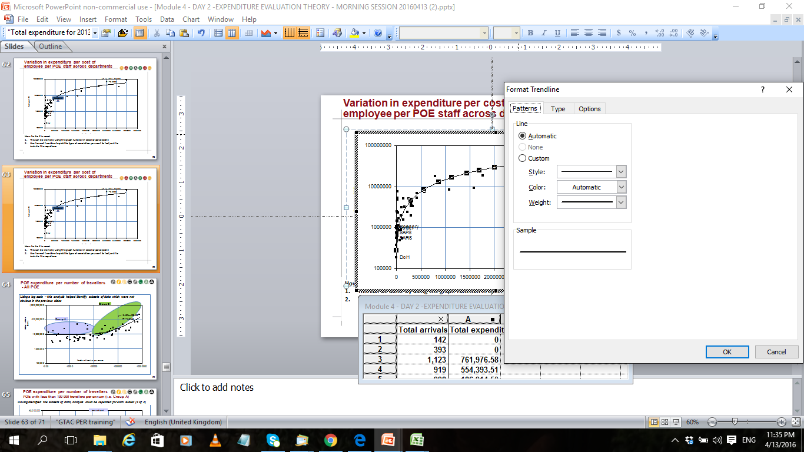
  Regression analysis is done using
  The graph function in excel or powerpoint
  The trendline to pick the type of correlation you want to test, and to include the equations
Regression analysis

Slide 40
Regression analysis
      Instruction
Pause the video for a few minutes and consider the following question and situation
      Question
On a scale of 1 to 5 (5= very high) to what extent is the indicator a cost driver for expenditure on catering in hospitals in the following illustrations?
Guideline: Use the R² value to decide
Catering expenditure (Rand million)
Number of Patients
Number of Meals Served
Percentage of Patients on Social Grants

Slide 41
Regression analysis
      Instruction
Pause the video for a few minutes and consider the following question and situation
      Question
On a scale of 1 to 5 (5= very high) to what extent is the indicator a cost driver for expenditure on catering in hospitals in the following illustrations?
Catering expenditure (Rand million)
Number of Patients
Number of Meals Served
Percentage of Patients on Social Grants
1
5
1
Correlation is not causality

Slide 42
After doing Step 4: Analyse- You should be to generate key insights by PROPERLY doing the following analysis
  Trend analysis
  Growth projections
  Ranking
  Share analysis
  Pareto
  Unit cost analysis
  Benchmarking
  Regression analysis
Next step ‘Interpret’ will show you how to convert your analysis to key findings
If you need guidance on excel, we encourage you to watch the supplementary excel demo video

Slide 43
Thank you
81 12 49

Slide 44
Worked Excel Examples

Slide 45
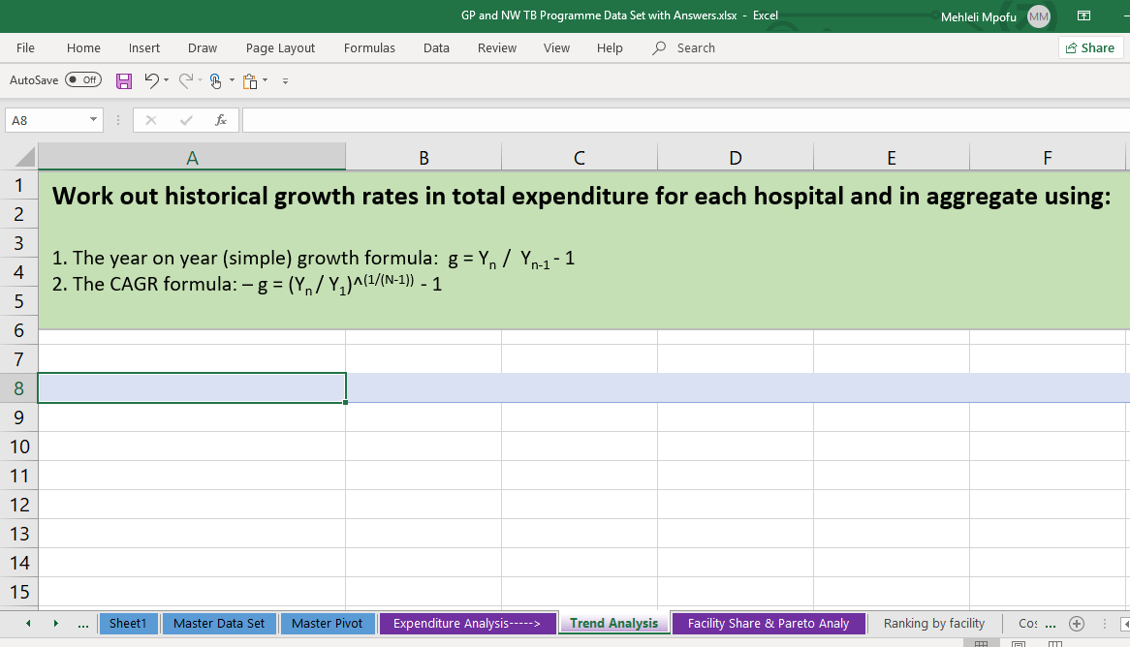

Trend analysis

Slide 46
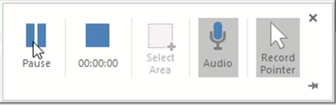
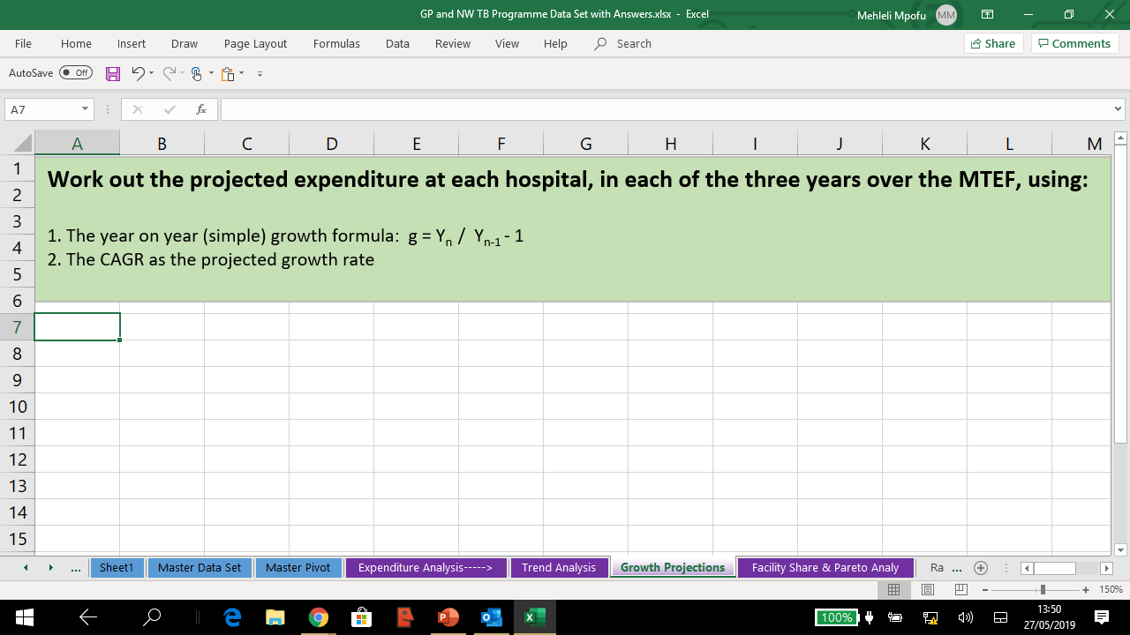
Growth projections

Slide 47
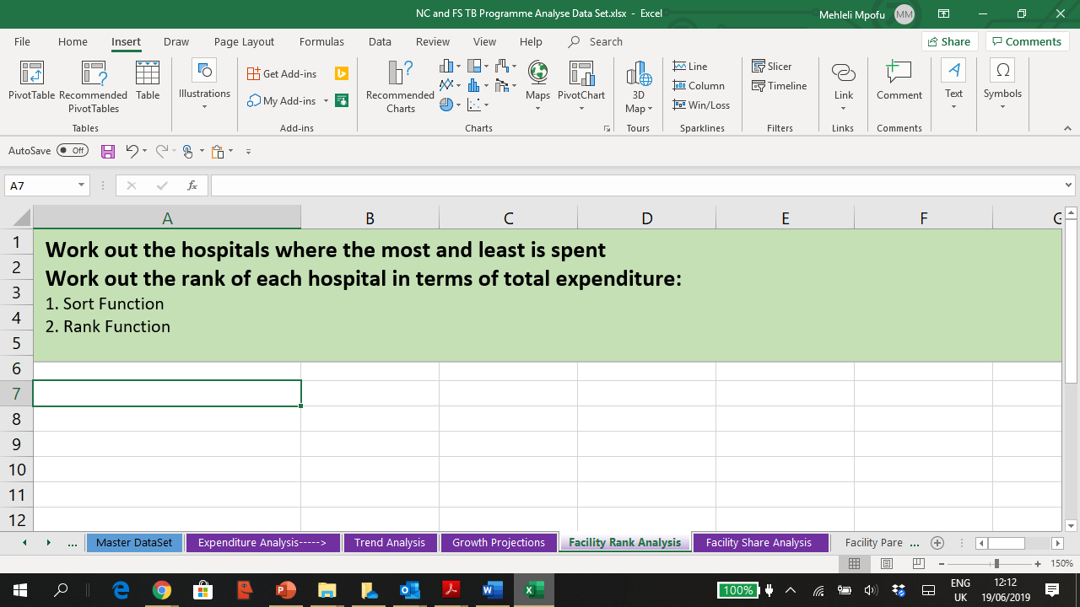
Sort Function and Rank Formula

Slide 48
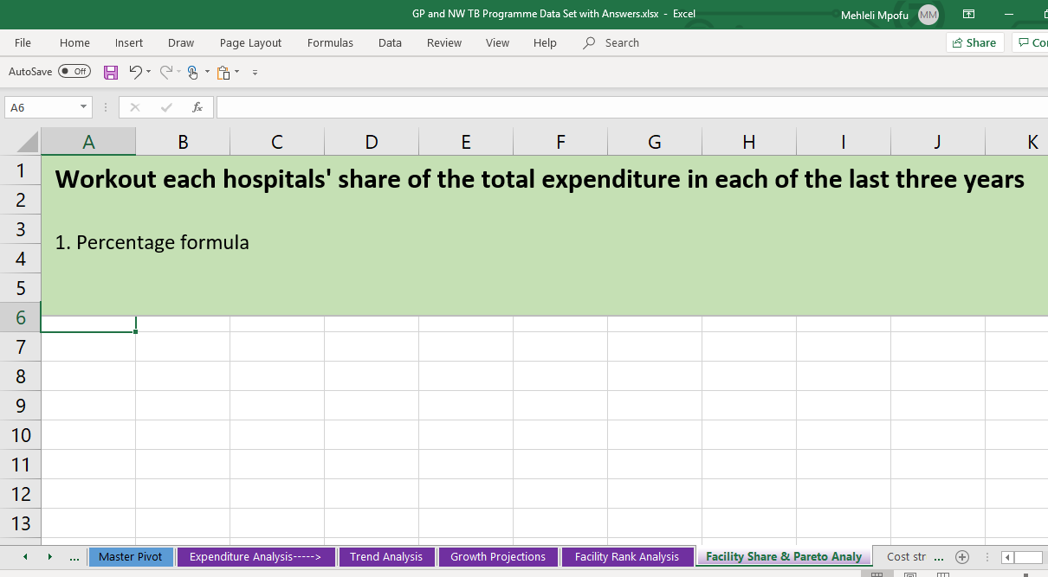
Share analysis

Slide 49
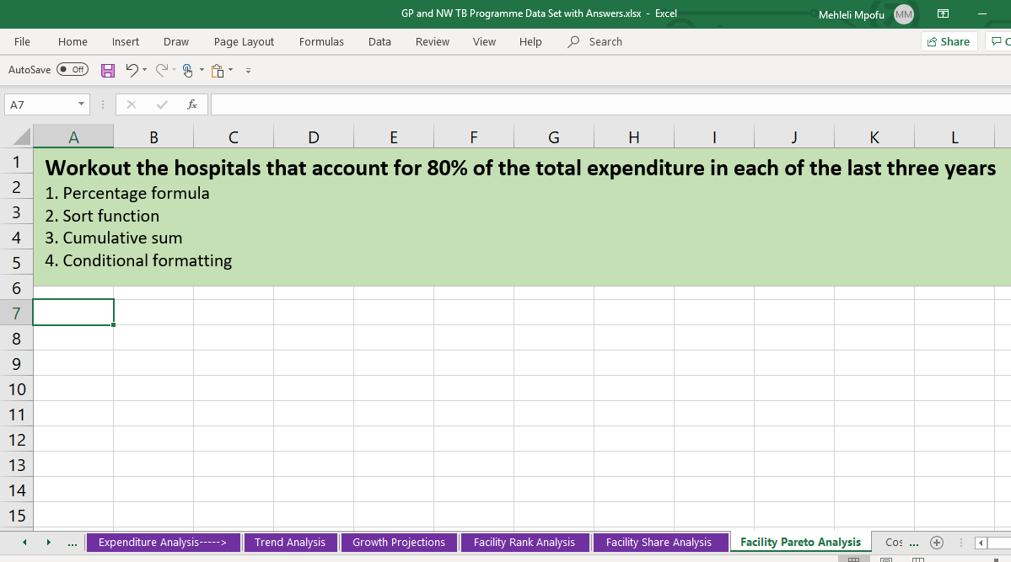
Pareto analysis

Slide 50
Thank you
81 12 49

