Slide 1
SPENDING REVIEWS
LEVEL 3
Step 4: Expenditure Analysis

Slide 2
How to do an expenditure analysis?
5 steps:
  Find identify funding sources
  Consolidate & Clean data to show total expenditure
  Group & Allocate expenditure to expenditure buckets aligned to log frame
  Analyse to show trends and findings
  Interpret the key findings supported by evidence
1
2
3
4
5
Find
Consolidate & Clean
Group & Allocate
Analyse
Interpret
Preparation
Analysis

Slide 3
STEP 3:
Group & Allocate

Slide 4
Find
Consolidate & Clean
Group & Allocate
Analyse
Interpret
  Why we group?
    Nature of expenditure
    Direct and indirect cost
  Key excel functions
    Remove duplicates
    Text filter
    Vlookup
STEP 3: GROUP & ALLOCATE
By the end of step 3 you will be able to link expenditure to understandable and explainable groups

Slide 5
Expenditure buckets = Grouping of similar expenditure items
Why we do it?
Understand nature of expenditure (who, where and what)
Understand the cost-effectiveness of the operating model
BAS/PERSAL are accounting systems
SCOA categories do not necessarily reflect expenditure as understood in policy terms
Expenditure Buckets

Slide 6
Understand nature of expenditure
Who?
Institutional role players
Branch or unit in institution
Where?
Point of service delivery, facility, operating location
What?
Programme outputs (institutional analysis / log frame)
Additional…
General overheads, programme overheads, direct programme cost
Notes:
Responsibility Centre at high level
Point of service delivery often at lowest level of responsibility code

Slide 7
Understand nature of expenditure – WHO?
National, province, district, municipality, or public entities
Department, responsibility centres
Understand who is spending
Look at previous institutional analysis
Notes:
Responsibility Centre at high level
Point of service delivery often at lowest level of responsibility code

Slide 8

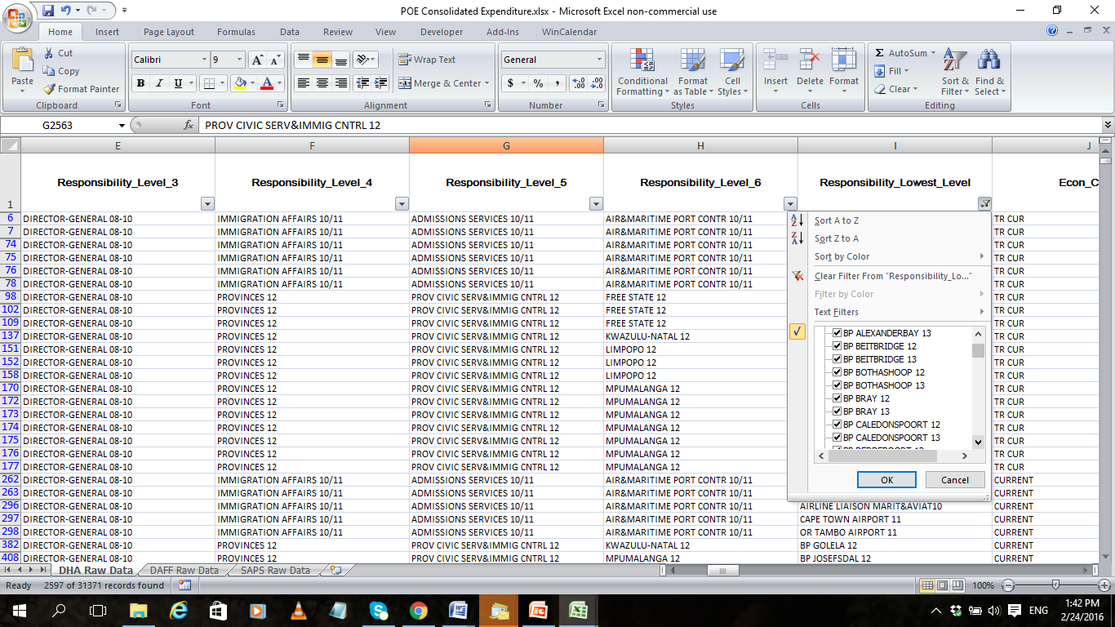
Understand nature of expenditure – WHERE?
Point of service delivery, facility or operating location
Schools, TVET colleges, libraries, museums, hospitals, leased buildings
Find locations in BAS -
lowest responsibility field
Notes:
Exception – e.g DAF no points of entry spending. But staff biggest expenditure and had staff numbers per entry point

Slide 9
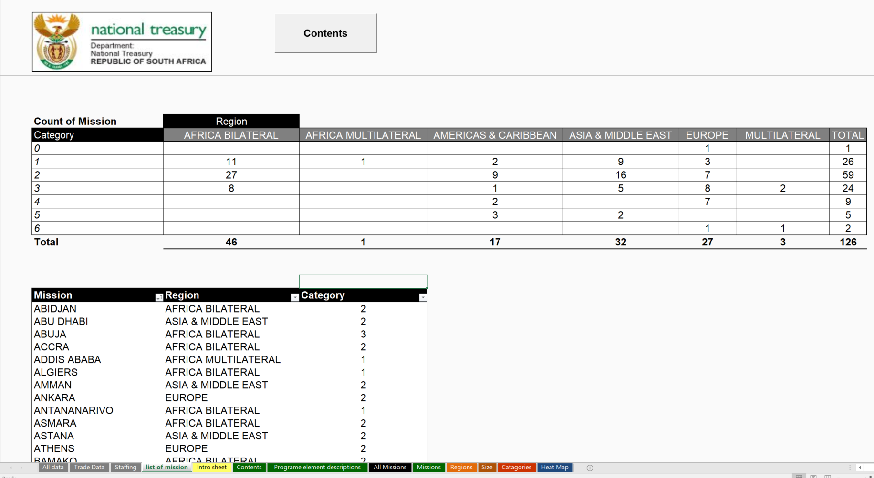
Understand nature of expenditure – WHERE?
Group operating locations in sensible categories – FOREIGN MISSION Example

Slide 10
Understand nature of expenditure – WHAT?
What information does the institutional analysis provide to understand expenditure?
Understand programme (assists for logframe)
Expenditure is not available at output level
Identify expenditure at an input level
Match this the appropriate activities and / or outputs
Notes:
Note this links to next moduel (looking forward)

Slide 11
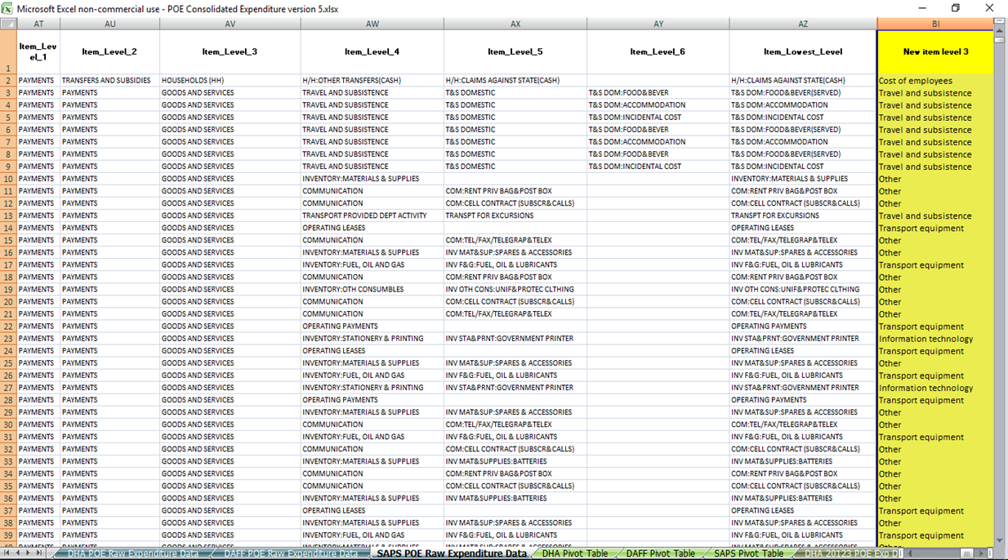
Understand nature of expenditure – WHAT?
BAS item levels combined to create new expenditure buckets
Use remove duplicates, text filter, and vlookup to add these to the data set

Slide 12
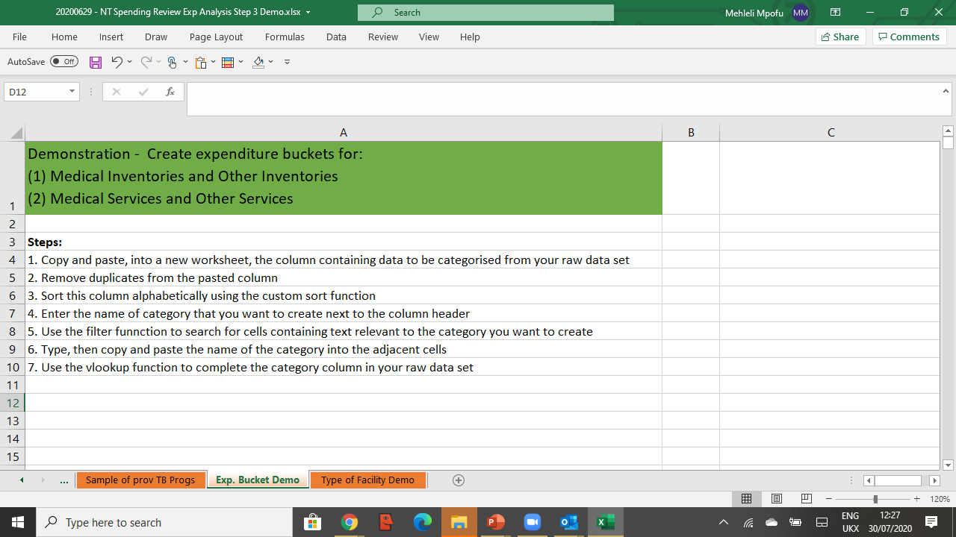

Understand nature of expenditure – WHAT?
Creating expenditure buckets
Notes:
Video… 2 / 3 expenditure…

Slide 13
Understand nature of expenditure – ADDITIONAL…
Backoffice
(General Support Functions)
Middle Office
(Functions that directly support a number of front offices)
Front office (e.g. costs involved in delivering services directly to citizens )
General overheads
Programme overheads
Direct programme costs
EXAMPLE
Policy and Oversight Functions
Shared service centres
(IT Systems and Regional Processing Centres)
Service delivery points
(e.g. Home Affairs Service Centres)
Notes:
Responsibility Centre at high level
Point of service delivery often at lowest level of responsibility code

Slide 14
Understand nature of expenditure – ADDITIONAL…

Slide 15
Direct programme and overhead costs
Instructions
Consider the following situation and questions
Situation
A school has a monthly budget of R100,000.
R40,000 is for the headmaster’s salary
R50,000 is for the teachers’ salary
R5,000 is for the caretaker’s salary
R2,500 is for teaching material
R2,500 is for the annual sports day
      Questions
What are the direct programme costs for teaching?
What are the programme overhead costs for teaching?
What are the general overhead costs?
      Time
Pause the video until you have answered the questions

Slide 16
Instructions
Consider the following situation and questions
Situation
A school has a monthly budget of R100,000.
R40,000 is for the headmaster’s salary (POC)
R50,000 is for the teachers’ salary (DPC)
R5,000 is for the caretaker’s salary (POC)
R2,500 is for teaching material (DPC)
R2,500 is for the annual sports day (GOC)
      Questions
What are the direct programme costs for teaching?
What are the programme overhead costs for teaching?
What are the general overhead costs?
      Answer
DPC = R52,500
POC = R45,000 (assuming that head master does not teach and caretaker ensures that classroom is fit for teaching)
GOC = R2,500
Direct programme and overhead costs

Slide 17




After doing Step 3: Group and allocate - You should be able to explain expenditure on your programme in terms of:
Who is spending on your programme
What the expenditure is incurred on (e.g., expenditure buckets)
How much is spent on direct programme costs, programme overheads, and general overheads
Where the expenditure is incurred?
Next step ‘Analyse’ will enable you to draw insights from your expenditure data:
By doing analysis to answer key questions
Before proceeding we encourage you to watch the demonstration on how to group and allocate in excel

Slide 18
Work Excel Examples

Slide 19
Thank you
81 12 49

