Slide 1
SPENDING REVIEWS 2021
Policy and institutional analysis

Slide 2
Spending review methodology
Iteration between steps
Intro
Introduction & Savings
What to expect, how will we work?
Step 1
Problem statement
Policy and institutional analysis
What is this delivery programme about?
Step 2
Process maps and the programme’s logical framework
How does the programme work?
Step 3
Performance analysis and indicators
How is it measured and how should it be measured?
Step 4
Expenditure analysis
What are we spending on the programme?
Step 5
Cost modelling
What does it actually cost to deliver the programme?
Step 6
Savings and efficiency gains
Where and how do we find savings and efficiency gains?

Slide 3



Recap and way forward
Problem statement
Gives the rationale for a government programme (the why)
Who in government does what to deliver the programme?
Policy and institutional analysis
Process maps and logical framework
How does government organise and sequence its processes to deliver the programme?

Slide 4
Policy and INSTITUTIONAL ANALYSIS

Slide 5
Why do an policy and institutional analysis?
Policies and institutions shape what people do, through rules, incentives and sanctions.
Government is a complex structure that involves multiple organs of state across different spheres and levels.
Programmes are implemented within this complex and sometimes fragmented system of government.
An institutional analysis can help us unravel this complexity and understand delivery and spending better.

Slide 6
Policy review – sources of information
Constitution
Laws
Policy
White Papers
Sector strategies
Norms and standards
Green Papers
Sector legislation
Cross-cutting legislation (e.g. B-BBEE Act)
Regulations
Medium Term Strategic Framework (MTSF)
Programmes and processes
Operational plans, standard operating processes, business plans

Slide 7
Policy review
In a spending review, the purpose of a policy review is to understand the resource implications of policies, legislation and plans.
Some guiding questions:
  What are the policy goals and objectives?
  Are the objectives aligned, complementary or somewhat conflicting?
  How does policy, legislation or plans influence expenditure?
  What type of expenditure does it influence?
    Compensation of employees
    Goods and services
    Capital payments
  What are the cost implications of the delivery model chosen by the policy?

Slide 8
Example - LTSM
Policy/Legislation
Description
Influence on spending
Constitution
Enshrines the right to basic education in the Constitution. Court decisions confirm that access to LTSM is a key component of this right.
Makes it compulsory for government to provide schooling and LTSM to all children between the ages of 7 and 15
South African Schools Act
Requires the state to fund public schools. The Minister must determine norms and standards for the funding of public schools.
Norms and standards should identify the level of funding per learner.
Norms and standards
Set National Guidelines for funding learners to create equity amongst provinces.
Norms and standards set the levels of funding per learner according to quintiles.
National Book catalogue
Lists the recommended prices for prescribed textbooks for specified quantities.
Influences what provinces can buy.
Provincial LTSM policy
Sets norms and standards for LTSM (books and stationary) for learners. Makes decisions about the LoTL
Influences what and what quantities of books and stationary provinces buy.

Slide 9

Institutional analysis
Governance and oversight
Policy making and planning
Monitoring and evaluation
Budgeting and funding
Who?
Implementation and execution

Slide 10
When looking at the “who”….
Who holds who accountable?
  Policy makers, MinMec, MinMeC sub committees, implementing agents, suppliers, regulatory bodies, unions, industry bodies
Who reports and on what?
Who approves policies, processes, budgets, expenditure and personnel allocation?
How do funds flow? (Follow the money)
Who makes decisions about resource allocation?
Who decides on the allocation of funding and personnel?
Are there norms and standards set by national government? How to provinces allocate resources in practice?

Slide 11
What is an institutional map?
An institutional map outlines all the stakeholders involved in the programme at different levels of government.
It also includes the non-state actors (private sector and non-governmental organisations)

Slide 12
A word on complexity
Complexity costs money!
The more complex the arrangements, the more resources you need you run the system.
That is where expenditure analysis becomes powerful. It shows you the full cost of complexity in government.

Slide 13

The Complexity Costing Conundrum
You are costing SMME support.
Initially you thoughts that there were only 3 departments involved in SMME support.
However, after your institutional map, you find that there are 5 departments in total involved in SMME support.
Estimate how much are we spending on SMME support.

Slide 14
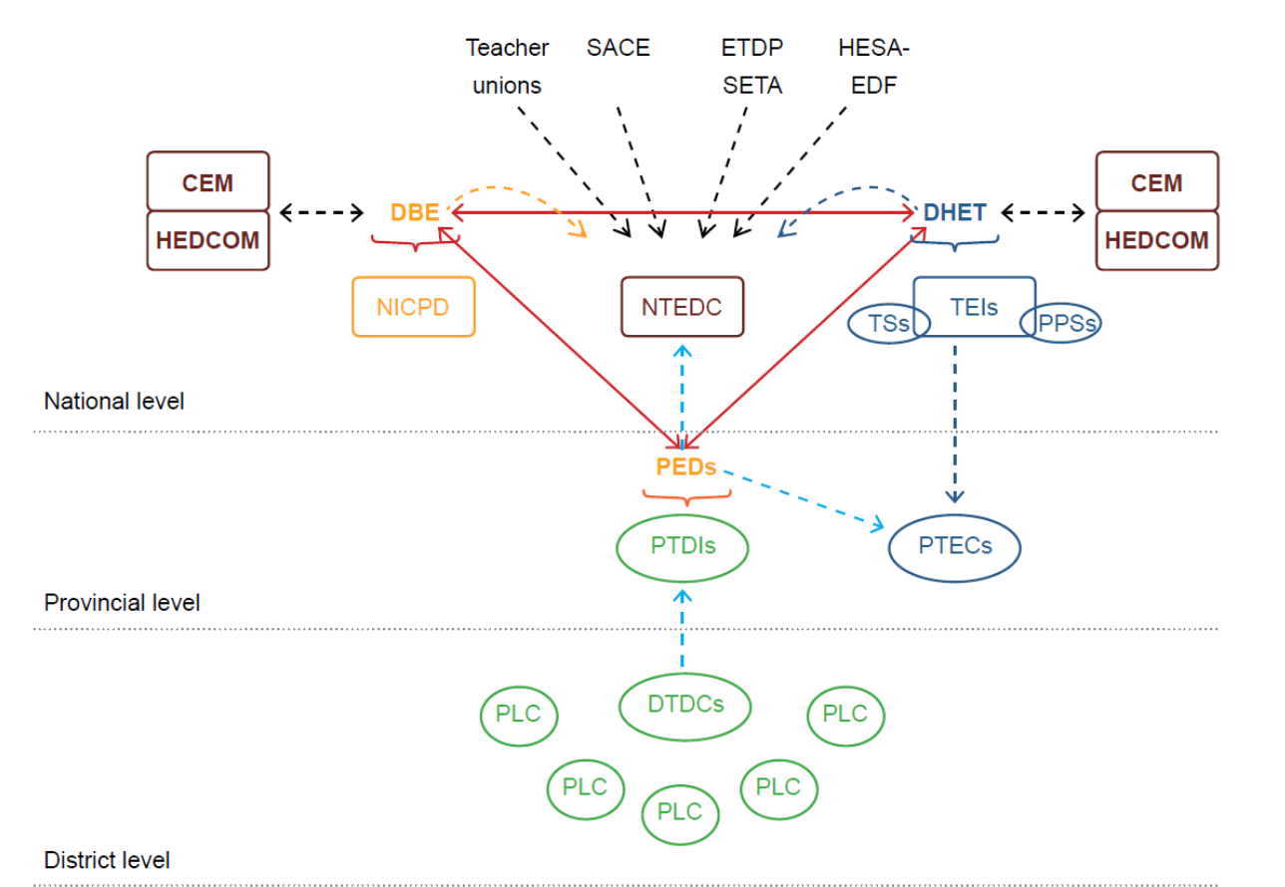
Institutional map – In Service Teacher Training

Slide 15
NPO registration institutional map and governance arrangements
Who does the organisation want to serve?
What kind of services will it provide?
Does the organisation want to receive government funding?
Does the organisation want to offer a Section 18A tax certificate?
Children / youth
Other groups
Elder Persons
CPO
Adoptions
Partial care
CYCC
ECD
NPO Directorate
Yes – Register as NPO
National DSD
CPO designations
Yes – Apply for funding
Provincial DSD
CPO designations
Separate registration processes
Yes – Apply for funding
Municipality
Get zoning and health clearance for buildings
Yes – Register as PBO
SARS

Slide 16
Flow of funds and reporting arrangements - LTSM
S40 IYM reporting Model
Quarterly Performance Conditional Grants
DBE
National Treasury
EC S32 IYM Model
EC Consolidated AFS
IYM Model
No of learners (SASAMS)
AFSs
Monthly Fin.reports
Provincial Head Office
Provincial Treasury
S32 IYM Model
Consolidated Prov. AFS
Curriculum mix
Number of learners, Teachers
District Offices
Circuit Management Centres
Public Ordinary Schools
Public Special Schools
ECD
Independent Schools
Financial Autonomy for LTSM procurement
Centralized procurement

Slide 17
Flow of funds

Slide 18
Reflecting on your institutional map and flow of funds
Are the institutions involved configured optimally?
  Are their potential overlaps in functions or duplications in effort?
  Is there potential for streamlining the value chain?
Do we understand how the programme is funded?
  Are there potential inefficiencies in the current way flows to the programme?
    Multiple sources funding the same thing?
    Duplication in funding between national, provincial and local government?

