Slide 1
SPENDING REVIEWS 2021
Process Maps and Logframes

Slide 2
Spending review methodology
Iteration between steps
Intro
Introduction & Savings
What to expect, how will we work?
Step 1
Problem statement
Policy and institutional analysis
What is this delivery programme about?
Step 2
Process maps and the programme’s logical framework
How does the programme work?
Step 3
Performance analysis and indicators
How is it measured and how should it be measured?
Step 4
Expenditure analysis
What are we spending on the programme?
Step 5
Cost modelling
What does it actually cost to deliver the programme?
Step 6
Savings and efficiency gains
Where and how do we find savings and efficiency gains?

Slide 3



Recap and way forward
Problem statement
Gives the rationale for a government programme (the why)
Who in government does what to deliver the programme?
Policy and institutional analysis
Process maps and logical framework
How does government organise and sequence its processes to deliver the programme?

Slide 4
UNPACKING HOW A GOVERNMENT PROGRAMME WORKS

Slide 5



Why do we need to understand how a government programme works?
Most government programmes are ‘black boxes’.
Unless you work directly with it, it is not always apparent how a programme works to deliver services.
In this step of the spending review, you will use analytical techniques to unpack how a government programme works.
Otherwise, it becomes very difficult to analyse expenditure without a frame of reference => your understanding of the programme.

Slide 6
Learning outcomes
By the end of this module, you will be able to:
  Apply the analytical techniques to understand the programme
  Analyze the programme’s logic or processes to identify savings and efficiency gains.

Slide 7
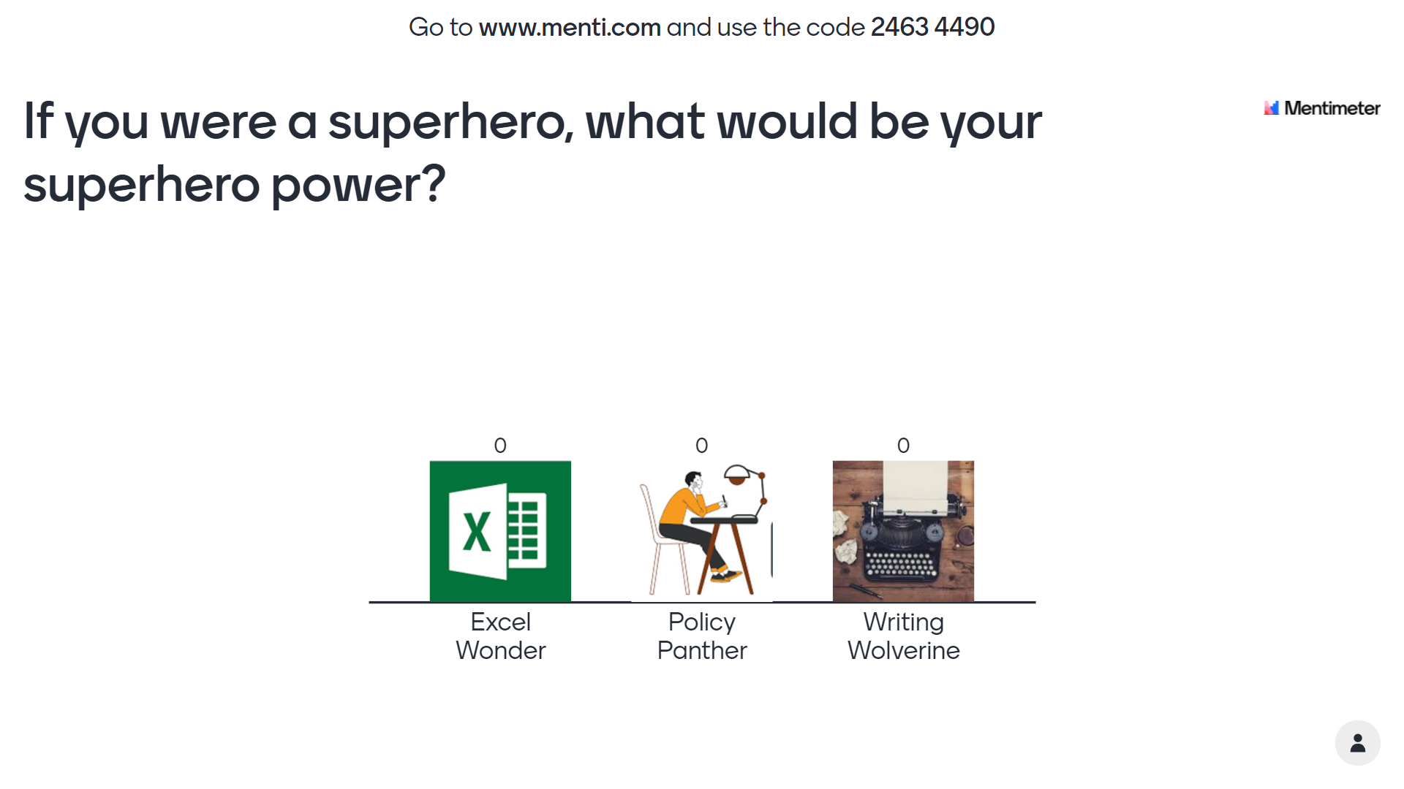

Slide 8
Terminology
We use these terms interchangeably in spending reviews
Processes
Business processes
Government processes
Logical framework
Programme logic
Logframe

Slide 9
Analytical tools

Slide 10
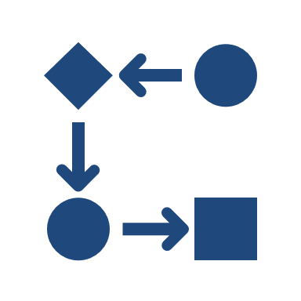

Process maps and logical frameworks
Process Maps
Logical frameworks
Shows the path of work that connects different activities and people within an organisation.
It shows how resources are deployed in a programme/organisation to meet specific goals.
Process maps shows the sequence of work but also captures the feedback loops between activities.
Shows how inputs are translated into activities, outputs and outcomes.
Highlights the programme’s logic – how government uses its resources to deliver on its objectives.
Links the programme to the problem statement/rationale for the intervention
A process map makes the work visible!
A logical framework shows how underlying theory of change.

Slide 11
How to draw a process map?
Process maps have their own language. They use shapes to show the different types of process.
You can draw out process maps in on a PowerPoint slide deck.
Click Insert > Shape > Flowchart
Process
Alternative process/different pathway
Output
Decision
Direction of workflow
Feedback loop

Slide 12
Process map for LTSM
Develop CAPS
Develop policy on LTSM
Develop norms and standards on LTSM
Draft and price national book catalogue
Consultation between national and provinces
Estimate the cost of textbook needs
Consolidate needs analysis
Submit school needs analysis
Issue approval catalogue
Yes
Approve
No
Allocate budget
Issue ordering guidelines
Submit LTSM requirements to district
Verify requisitions from school
Send requisition to LTSM
Process payments to publishers
Process payments
Books delivered and paid
Send delivery notes to districts
Deliver orders to schools
Place orders with publishers
DBE
PED
Schools

Slide 13
What is a logical framework?
A logic model explains how the activities in a programme contribute to a chain of results that produce the intended outcomes and impacts.
In its simplest form, it is represented as:
Inputs
Activities
Outputs
Outcomes
Impacts

Slide 14
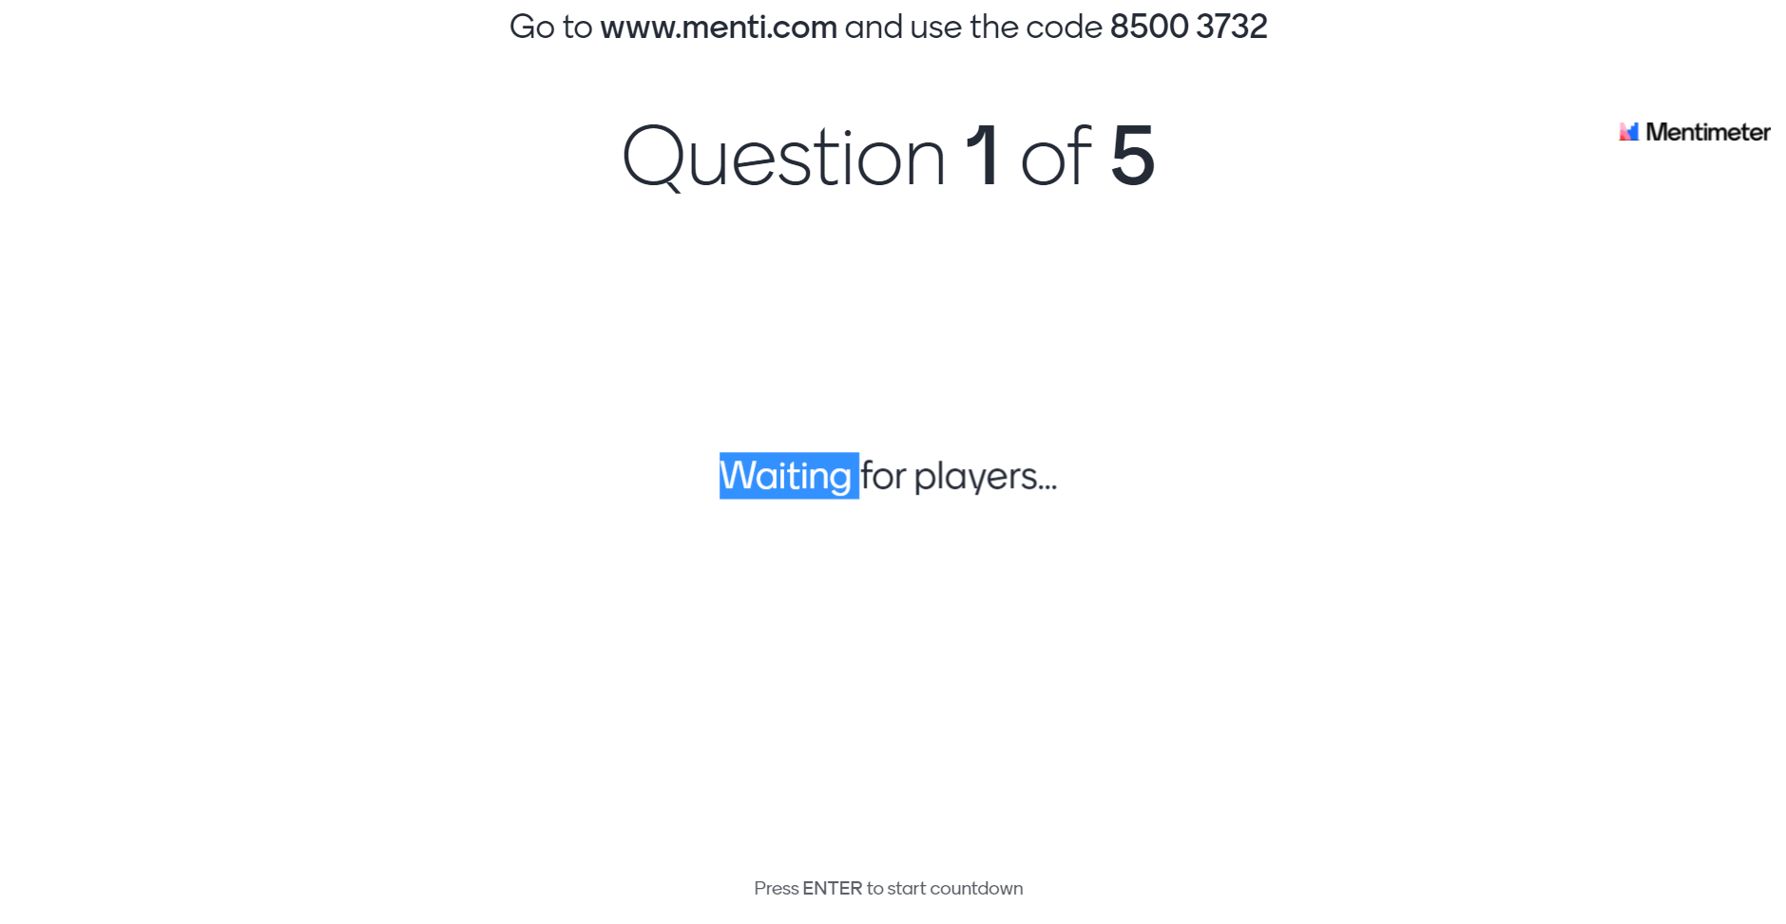
Let’s Menti

Slide 15



Logical framework – nomenclature
INPUTS - All assets and capabilities - drawn in the production process to deliver the outputs and outcomes desired
ACTIVITIES - Collection of functions and processes (actions, jobs, tasks) that consume resources required to produce outputs
INTERMEDIATE OUTPUT - are products that are produced for internal purposes necessary for the delivery of goods or services to the public or other beneficiaries such as other government departments

Slide 16



Logical framework – nomenclature
FINAL OUTPUTS - are goods or services – the “products” – a department/entity delivers to external parties/citizens.
OUTCOME - are the intended impacts of outputs. What benefit does government deliver to the target group?
IMPACT - Impact would typically target societal level changes over the long-term.

Slide 17
How to use Logframes in a spending review?
INPUTS
ACTIVITIES
OUTPUTS
OUTCOMES
IMPACTS
Efficiency (how much of every output are you producing for every R input)
Economy (involves analysing how much is spent on what and where and benchmarking unit costs)
Cost-effectiveness (how much of an outcome are you producing for every input?)

Slide 18
Process maps versus logical frameworks – some guidance
Use process maps when:
  Analysing ‘internal’ programme or back-office functions
  Allocate expenditure to processes within an organisation
  Costing a new process or function
  Concerned with process efficiency (e.g. efficiency of a registration system)
Use logical frameworks
  For service delivery programmes
  When you want to understand what outputs and outcomes the money is ‘buying’ (value for money’)
  Understand the programme assumptions (e.g. demand for services)
  Assess the programme logic.

Slide 19
Let’s practice
Instructions
  Spilt into two groups
  One group should draw a process map whereas the other group must draw the logical framework.
  Be as detailed as you can!
  30 minutes and 10 minutes in plenary for each group to present.
Topic: Getting your children to school in the morning!

