Slide 1
Costing master class
Using and developing Excel-based models to cost
government policies and programmes

Slide 2
Agenda
Introductions and objectives of the masterclass
Presentation - (Q&A at any time)
  Preparing to build a costing model
  Costing formula
  Principles of costing
  Steps in building a costing model
  Body break – 12:30 – 12.35
Demonstration of the ECD Model
Closure

Slide 3
The core of all Costing Models

Slide 4
Preparing to use / build a costing model
Costing model
Market prices
Actual service delivery
Non-government funding
Programme
logic
analysis
Norms and Standards
Processes, activities and inputs
Expenditure
analysis
Price
Govt price standards
Regulations
Govt Accounts
Institutional structure
Demand
Expenditure reports
Legislation
Institutional
analysis
Key policy questions
?
Key performance
indicators
Policy
Performance information
Powers and Functions Assigned (usually in a Constitution)
Demographic and Administrative Data

Slide 5
What’s in a costing model?
Costing is the process of using the following equation to estimate total programme costs
This equation is used in many different forms to estimate the cost of many layers and types of activities
x
x
=
Cost
Quantity
Input
Price

Slide 6
Costing brings fiscal realities into policy discussions
Policy often reflects ambitious, idealistic best practice
    scope of the policy
    norms and standards
    coverage of intended beneficiaries
  objectives are laudable, but not fiscally affordable or sustainable
A costing model explores the fiscal implications of policy
  identify pragmatic options that are more affordable and sustainable.
    moderating the scope of the policy
    reducing the norms and standards from best to good practice
    restricting the eligible beneficiaries to those most in need
  construct the costing model so that the implications of these changes can be explored

Slide 7
Principles for evaluating and building costing models

Slide 8
Balancing the art and science of costing
80/20 principle – too much detail is a bad thing!
Transparency – show all assumptions and calculations
Formatting principle – keep it simple and be consistent
Ordering principle – arrange the worksheets logically
Colouring-in principle – use colours to identify cells
KISS principle – keep it (all parts of the model) simple…
Apply these principles from the very beginning
it saves a lot of time!
Principles for building costing models

Slide 9
Balancing the art and science of costing
Always keep in mind that
Building a good costing model is
a blend of both art and science
One is objective and the other subjective
  The science dimension involves data, formulas and math
    The calculations are either right or wrong
  The art dimension involves imagination, assumptions and judgement
    Does the design of the model adequately reflect reality?
    Are the key assumptions reasonable, realistic and informed?
Getting the balance right requires judgement - strengthened by experience

Slide 10
80/20 principle
Too much detail is a bad thing!
  focus on the 20% of cost components which account for 80% of the costs
  focus on getting 80% of the costs by doing 20% of the costing work
How does one avoid too much detail?
  Focus on identifying the key cost drivers -
    the main programme elements and activities
    the key groups of clients or beneficiaries of the service
    the main inputs, activities and outputs of the service
  Avoid trying to work out “How long is a piece of string?”
    simply make an informed assumption or
    identify a plausible range

Slide 11
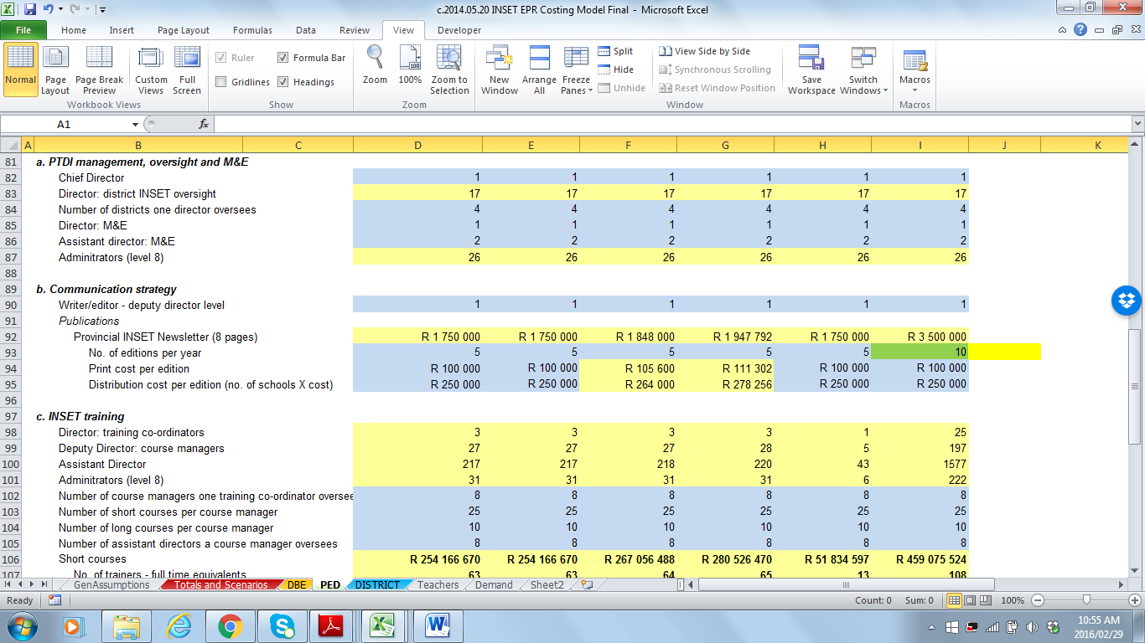
Transparency
Show all assumptions and calculations
  avoid using hidden sheets, hidden cells or hidden formulae
Avoid building assumptions into the formulae
  Wrong if: Administrators (level 8) : 26 = (D82*9)+D83
  Right if: 26 =IF($C$1=$U$14,(D82*9)+D83,D82+D83)
    Can you explain the difference?
Use the notes function to provide explanations

Slide 12
Formatting principle
Keep formatting simple and be consistent
  structure similar sheets the same way
    data sheets, working sheets, results sheets
  avoid blank columns or rows when working with series data
    makes it more difficult to drag or copy & paste formulae
  summary data should be structured in exactly the same way on each sheet - identical cell references
    this facilitates the consolidation / adding-up of information

Slide 13
Ordering principle
Arrange the worksheets logically
  contents and descriptions, result sheets, working sheets, data
  colour the sheet Tabs to distinguish different kinds of sheets

Slide 14
Colouring-in principle
Use colours to identify different types of cells
  information cells –
    descriptions of inputs or assumptions
  number input cells –
    where number assumptions are inputted
  formula cells –
    where the results of formulae are shown
clear / white
light blue
light yellow

Slide 15
KISS principle
Keep it (all parts of the model) simple…
  Show calculations in steps rather than using long formula
  Use sheets to separate different types of data/information
  Use the Group function to make it easier to navigate

Slide 16
Balancing Art and Science
KISS
principle
80/20
principle
building a good Costing Model
Colouring-in principle
Transparency principle
Ordering
principle
Formatting principle
Apply these principles from the very beginning
it saves a lot of time!

Slide 17
Questions or comments?

Slide 18
Steps in Building A costing Model

Slide 19
Why can’t we simply use a costing model template?
Discuss why you have not simply been given a “costing model template” (like the budget format template) for costing government programmes?
Within the context of building costing models, discuss what is meant by “form follows function”?
What do you think the advantages and disadvantages are of building a unique costing model for each new costing project?

Slide 20
Preparation
Specify
Summarise
Check
Build formulae
Design
Policy choices
Steps in building a costing model
Step 1 – Preparation
Step 2 – High level design of the costing model
Step 3 – Specify activities, demand and inputs
Step 4 – Build the costing formulae
Step 5 – Summarise the costing results
Step 6 – Check, check, check
Step 7 – Develop the policy choices sheet
The process is very often not linear, and one finds oneself having to go back to previous steps
Building a costing model is a learning process

Slide 21
Step 1 - Preparation
Preparation
Are all the prerequisites in place?
  Have you done the background research?
  Have you gathered the data you require?
Do you have a really good understanding of the programme?
  Process map / flow chart of programme (covered in Module 1)
  The logical framework (covered in Module 2)
  The norms and standards (covered in Module 3)
    If clear norms and standards do not exist, then you will need to develop your own set, which become variables in the model
  The expenditure analysis (covered in Module 4)
Do you know what policy questions you need to answer?

Slide 22
Understand the institutional context of programme delivery
Costing models need to be structured to reflect the institutional environment
So the costing model may need to calculate costs by:
  sphere of government,
  individual province or municipality,
  different national and provincial departments,
  public entities,
  non-governmental organisations,
  and sometimes even private sector entities and individuals.

Slide 23
Keep focussed on the key policy questions
Keep asking yourself:
What are the key policy questions that this model
should be able to answer?
Then design the model so that it can be used to ask and answer those questions quickly and easily
  develop short-cut methods of asking and answering
    e.g. toggling a few buttons/numbers on one sheet
  set this up in a front ‘policy choices’ sheet
  use graphs (that are simple)…to present answers
Policy-makers want answers to a limited number of questions
  the trick is to answer each question in the way it is asked

Slide 24
Example:
  In nutrition programmes you want pregnant women to take folic acid before, during pregnancy and also while they are breastfeeding.
Politicians may want to ask:
  What is the impact of increasing/decreasing expenditure on this intervention by 20%? How many more/fewer pregnant women will benefit from this intervention?
  What is the impact on the budget of expanding the intervention from all pregnant and breastfeeding women to all women in the reproductive age group?
Each of these questions requires a different model
  It helps a to know which questions politicians are likely to ask and therefore whether you need to develop one
  or two models.
Why does “the way the question is asked” matter?

Slide 25
Balance key policy questions against core information
A costing model must answer the key policy questions
  Since these differ, the design of each costing model will differ
Still, all models should show:
  capital versus operating costs
  set-up versus ongoing costs – especially for new initiatives
  personnel costs
    disaggregated by function of employee
      e.g. show nurse and doctor salaries separately
  the cost of key inputs
    different medicines in health
    textbooks vs classroom consumable in education
    transport vs food vs salary costs in a feeding scheme

Slide 26
Step 2 – High level design of the Costing Model
Design
Develop the overall structure of the workbook
  Identify what worksheets you need and name them
  Develop sensible tab ‘names’ (not numbers or letters)
  Colour the tabs for sheets with data, workings and results
  Will you require a ‘GenAssumptions sheet?
Design the overall structure of the different kinds of sheets
  Headings and sections
  Scenarios
  Costing results, and summaries of costing results
  Demand assumptions
  Activity assumptions – inputs and prices
  Start colouring-in the cells
Insert the data sets you will be using

Slide 27
Deciding on the structure of scenarios
Nature of the programme and the time parameters of the costing influence how one approaches scenarios
As a minimum, provide for costs over an MTEF period
Proposed scenarios (choosing appropriate names is important)
  ‘baseline’ or ‘current’ – existing levels of service
  ‘full cost’ – complete implementation of the policy
  ‘pragmatic’ – proposed costing saving policy options
  ‘rollout’ – different rollout options
Design model structure so that new scenarios can be added
For some programmes it is better not to include scenarios:
  it would make the model too complicated
  better to run scenarios on different copies of the model

Slide 28
Examples of scenario naming
Scenarios in the INSET Costing Model
Scenarios in the MAFISA Costing Model
Scenarios in the Nutrition Costing Model

Slide 29
Step 3 – Specify activities, demand variables and inputs
Specify
Organise the activities you are going to cost on the workings sheets
  List the demand variables and key input variables
    Personnel, time variables, price variables
  Keep variables that belong together close together
  This involves thinking through each activity
Start colouring-in the cells
Identify variables that should be placed on the GenAssumptions sheet
Keep the design structure aligned across sheets
  so you can use the drag / copy and paste functions

Slide 30
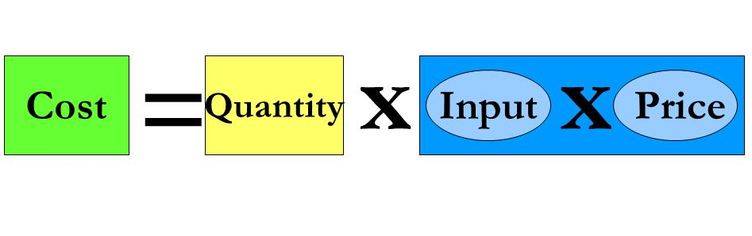
Step 4 – Build the costing formulae
Build formulae
If the structural design of your model is good, it greatly facilitates the building of costing formulae
  column and row references exactly the same
  demand data structured the same as input and price data
Apply the formula:
Work systematically, accurately and don’t rush
Apply the KISS principle
When building the formulae you will likely find that you require more demand variables, different input variables etc. Change things in a systematic way

Slide 31
Step 5 – Summarise the costing results
Summarise
In design step
  Specify where the costing results will be summarised
  What kinds of summaries you will require?
Summarise costs
  overall total costs – showing set-up, ongoing costs and capital totals by type of key inputs and other
  totals by main activity / type of institution
  totals by sphere of government, by province, by municipality
Summaries of outputs by activity
Summaries of personnel and key inputs
Explore options for unit cost and marginal cost calculations

Slide 32
Create a flow diagram of your model
Develop a flow diagram to show:
  the structure and the logic of the model
  place this in front of the model
Gives a snapshot of where the various components are

Slide 33
Step 6 – Check, check, check
Check
Use different approaches to summarise costing totals
  SUMIF and straight adding
Check for consistency across different costing summaries
  input cost totals = activity cost totals
Test if the model is robust
  do ‘back of the envelope’ type calculations to check whether costing results are of the right order of magnitude
  run extreme scenarios on key demand and input variables and check if the model behaves as expected
  run incremental scenarios (25, 50, 75%) and check if the results are consistent
    be aware of the impact of fixed costs versus variable costs
Get a new set of eyes to go through the costing model
  present the costing model to subject experts

Slide 34
Step 7 – Develop the policy choices sheet
Policy choices
What are the main policy questions?
  aim to provide answers that reflect how the question is asked
Develop a dynamic ‘policy choices’ sheet where the implications of different options can be explored
Keep the options simple and realistic
  use dropdown options, toggle buttons or simple input cells to specify different options
Illustrate the results of different options using simple graphs
Reflect options in relation to a baseline
  a current funding baseline or a baseline scenario

Slide 35
Two slides on technical excel stuff

Slide 36
Technical tips - 1
Learn how to use the following Excel functions:
  INDEX
  MATCH
  V/HLOOKUP
  IF
  SUMIF
  SUMPRODUCT
  Drop down menus (Data validation/Lists)
  Group function
  Think about the above when ideas swirl in your head
Conditional formatting has its merits, but keep it simple

Slide 37
Technical tips - 2
Keep the design structure aligned across sheets
  so you can use shortcut drag / copy and paste functions
Avoid macros
  not enough people understand how to use them
Avoid using cell names (named cells) –
  they reduce the transparency and ‘traceability’ of formulae
  they create problems when sheets are copied
  into a workbook

Slide 38
Questions or comments?

