Slide 1
Session 1
INTRODUCTION
Why am I here?
What am I going to be doing here?
and other questions….
^{Ronette Engela}

Slide 2
Welcome
  Thank you for giving us your time & attention
Spending Review Course
Notes:
To both Treasury officials and service delivery departments

Slide 3
Spending Reviews
Baseline analysis of existing expenditure programmes
  sustainability
  credible savings and re-allocation
  efficiency
Costing of new policy proposals and legislation
  costing of extensive new proposals and
  financial implications of Cabinet memorandum

Slide 4
Department | Treasury
We want our policies to be sustainable | We want policies that is affordable and therefore sustainable
 | What is the full cost of existing programmes ?
We need big policy discussions | Show us credible costing for the new policies - might help in budget negotiations
We need more money | Departments ‘have to do more with less’ stay within budget but deliver more
We need to roll policy out wider | Before we spend more money, what are we getting against performance? How efficient are you?
We have to close a programme down | What are the trade-offs?
Can we be accurate in our savings cuts? | We have a constrained fiscal environment and have to find savings
Accurate planning and proper oversight | Annual 'budget challenge' function
Why are we doing this course?
Dept reasons
Treasury reasons

Slide 5
Big data analytics - new frontier
  Career progression requires investment in broadening and deepening skills
  Concern about pipeline of staff for strategic roles
  In-depth analysis by officials not consultants
2-3 years to train a new person to do serious public finance analysis / programme analysis
Equip staff with the advanced analytical skills
Why are we doing this course?
Personal development

Slide 6
How do we do this course?
Structured way to help you think
Not a set of techniques applied mechanistically
Structured way to help you think systemically about policy or programme
Implicit knowledge
Inherently multidisciplinary
  Public economics and finance
  Cost accounting
  Policy analysis
You already know this!

Slide 7
How do we do this course?
Structured way to help you think
Not a set of techniques applied mechanistically
Structured way to help you think systemically about policy or programme
Implicit knowledge
Inherently multidisciplinary
  Public economics and finance
  Cost accounting
  Policy analysis
You already know this!

Slide 8
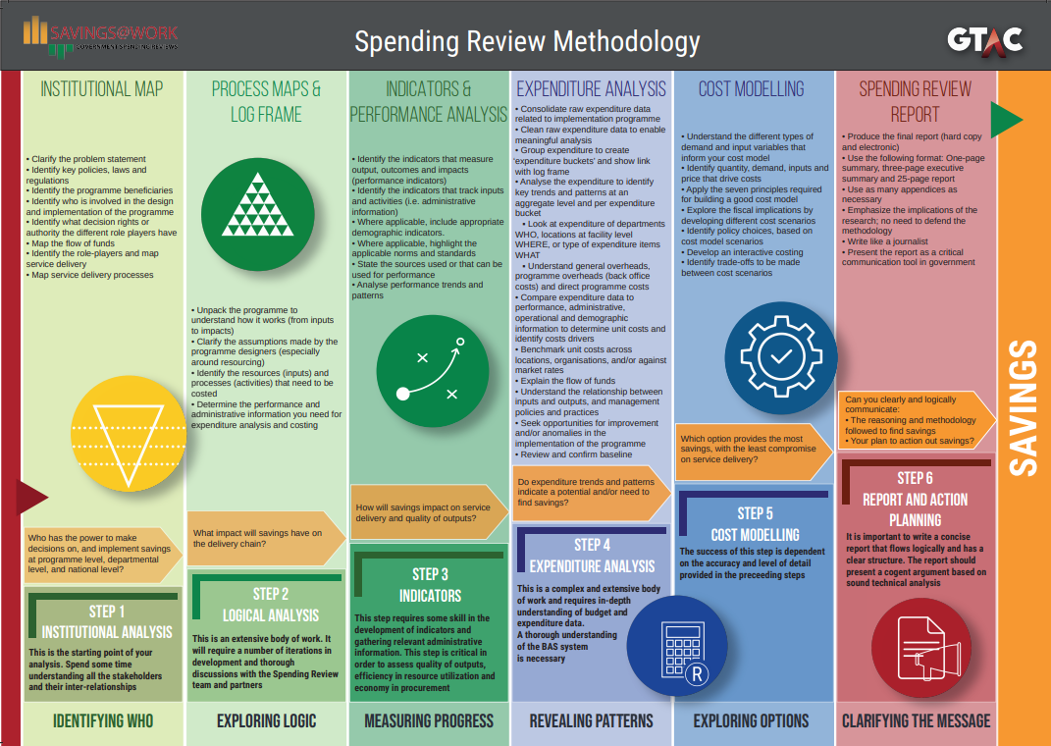
What do we do?
Teach a set of 6 steps
Customised per sector
Apply to your workspace

