Slide 1
Session 16
Savings - Technical Aspects
Identifying opportunities to
use scarce public resources better

Slide 2
Recap of Sessions 14-15
In the last session you became familiar with
The importance of understanding the programme for which you are going to build a costing model
How to approach
  the costing of different types of demand and input variables
  the development of different scenarios
  the summarising and presentation of costing results
  developing ‘policy choices’ analysis
The principles and steps to go about building a costing model

Slide 3
Learning outcomes
By the end of this module, you should be able to:
  See that the process of identifying savings, cuts and trade-offs is integral to all steps of the PER process.
  Apply the different analytical approaches for identifying savings and trade-offs
  Present your findings on savings and trade-offs

Slide 4
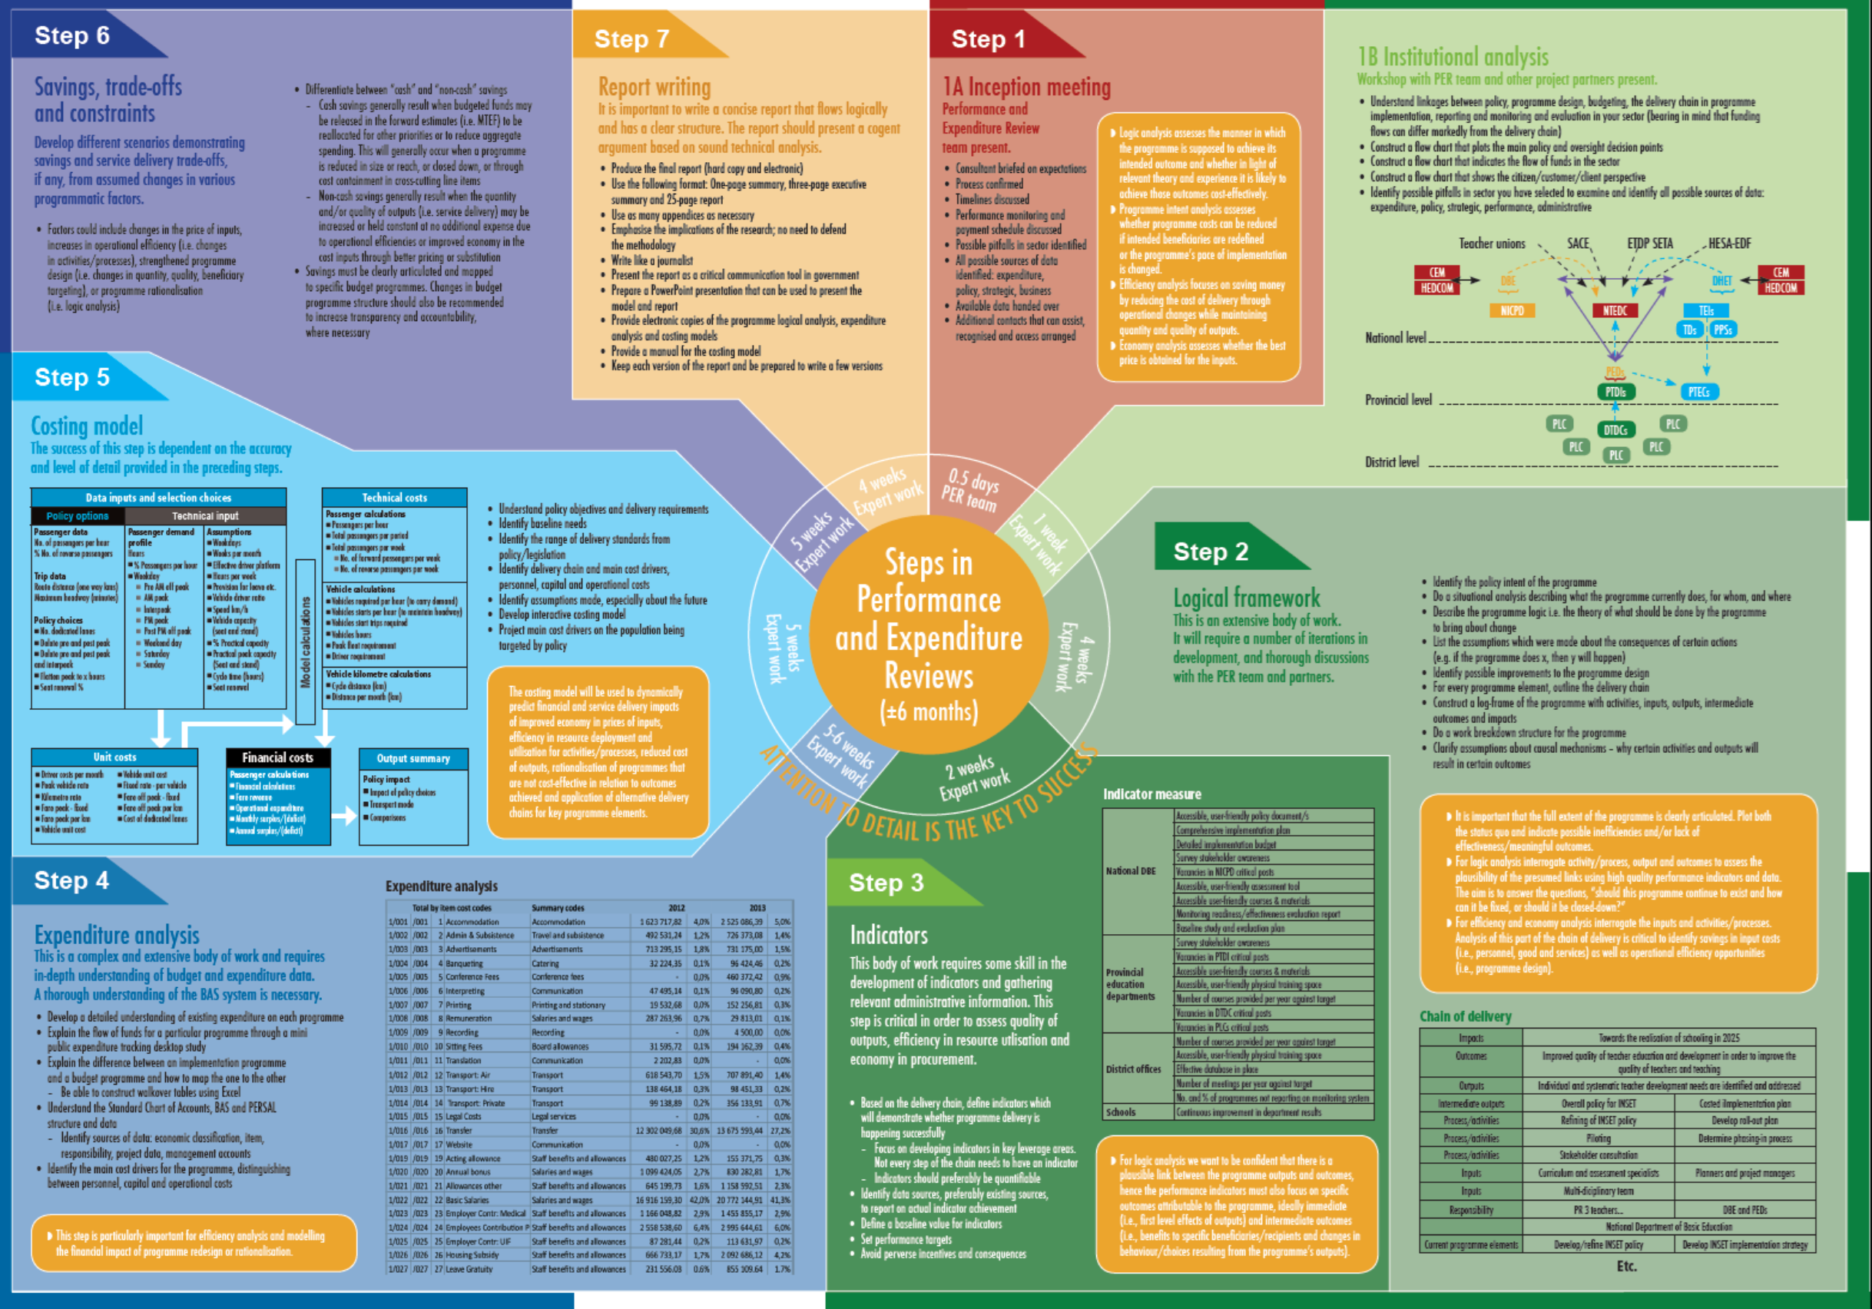

Slide 5
Key message of session
A PER should highlight where and how savings and cuts can be realised
So, researchers must ask savings and cuts focussed questions during each step of the PER
In Saving Sessions, the identified savings and cuts must be mapped to the relevant budget programme
Highlight impact on:
  the department’s total budget
  the relevant budget programmes and sub-programmes
  particular items within the sub-programme budgets
  (if possible)

Slide 6

Savings must result
from deliberate management action
and not chance

Slide 7
Savings Decisions Tree
Need to reduce the budget by R 10 million
Priority 1
Priority 2
Priority 3
Cut Waste
Are there any wasteful, non-core or ineffective:
processes
initiatives / projects
purchases
positions
that can be cut without impacting negatively on core services
Improve Efficiency
Are there any inefficient:
admin processes
initiatives / projects
programmes
that can be re-organised to realise savings in the delivery of core services
Cut least impact spending
Which core services can be cut because they have least impact on
vulnerable groups
current / future costs to government / society

Slide 8
Two track approach to look for savings

Slide 9
Track 1: Strategic perspective
Two track approach to look for savings and cuts
Considers the effectiveness, relevance and design of the programme
  Interrogating the programme logic
  Assessing the programme’s intent
Track 2: Functional or operational focus
Considers issues of efficiency and economy in how the programme is implemented
  Assessing the efficiency of the programme delivery model
  Exploring the economy of programme implementation

Slide 10
The overall aim is to improve
allocative efficiency
and
operational efficiency
so as to ensure the
cost effective use
of resources

Slide 11
Track 1: Strategic perspective – programme logic analysis
Assesses the manner in which a programme is supposed to achieve its intended outcomes
  Given relevant theory and experience is the programme likely to achieve those outcomes cost-effectively?

Slide 12
Track 1: Strategic perspective – programme logic analysis | Relevant PER steps | Key actions to ensure that questions can be answered
1. Is the programme still relevant within the current policy and macro-environmental context? | Steps 2 and 3 | 1. During step 2 assess any changes in the programme’s context/environment that may render the programme redundant
 |  | 2. During step 3, assess trends in macro-environment indicators (e.g. demographic changes) and comment on how these could affect the continued relevance of the programme or its original intent (e.g. Is a childhood nutrition programme still necessary in a ward with increasing household income)
2. Could the same results be achieved in a better way or cheaper way? | Steps 2, 3 and 5 | 1. During step 2 and 3 map out alternative programme logic or delivery mechanism by:
 |  | a. Identifying alternative programme elements in step 2 or programme elements that can be omitted
 |  | b. Identifying alternative delivery chains for key programme elements in step 3.
 |  | 2. During step 5, quantify the cost impact of implementing the alternative programme logic
3. Has the programme been achieving its objectives? | Step 3 | 1. During step 3 collect historical performance information at both an output and outcomes level
 |  | 2. Use the data to assess the presence of a plausible link between programme outputs and intended outcomes

Slide 13
Application of the programme logic analysis
Looking at processes to register partial care facilities by the provincial departments of social development

Slide 14
Track 1: Strategic perspective – programme intent analysis
Assesses whether costs can be reduced if:
  intended beneficiaries are redefined
  the pace of implementation is changed
Explore whether there is duplication with other programmes

Slide 15
Track 1: Strategic perspective – programme intent analysis | Relevant PER steps | Key actions to ensure that questions can be answered
1. Can the programme cost be reduced if the programme’s intended beneficiaries are redefined? | Step 3 and 5 | 1. During step 3, assess trends in macro-environment indicators (e.g. demographic changes) and comment on how these could affect the continued relevance of the programme or its original intent
 |  | 2. During step 5 model the cost impacts of redefining the target beneficiary groups
2. Can the programme cost be reduced if the programme’s pace of implementation is reduced | Step 2, 3 and 5 | 1. Taking note of the programme intent and performance information in step 3, during step 5 model the cost impacts of increasing or decreasing the timelines by which the programme will have achieved its objectives?
3. Is there potential duplication with other programmes? | Step 2 | 1. Assess how the programme fits in with other programmes of (i) the Department, (ii) other Departments, and/or (iii) other public and private bodies delivering on the Government’s overall policy objectives in the area in which the programme operates

Slide 16
Application of the programme intent analysis (1)
In 2013, a PER covering the following institutions was done:
  The National Language Service programme of national DAC
  Pan South African Language Board (PanSALB)
  Linguistic rights functions of the Commission for the Promotion and Protection of the Rights of Cultural, Religious and Linguistic Communities (CRL)
The key findings were:
  Unclear mandates have contributed to poor operational focus.
  There are duplications of function, both among the three entities and also with other areas of government.
  A disproportionate amount of expenditure is being allocated to administration, rather than the delivery of core services.
  There are serious management problems at PanSALB.
  CRL’s Commissioners are not contributing to the organization as envisaged.
  All three entities, but particularly PanSALB and CRL, require better-aligned and objective performance indicators.
  Not enough attention has been paid to the cost implications of the Use of Official Languages Act

Slide 17
Application of the programme intent analysis (2)
In 2013, a PER of the Micro Agriculture Finance Institutions of South Africa (MAFISA) was conducted.
Some key findings were:
  If the intention of MAFISA is to reach smallholder farmers, the issue of how write-offs are dealt with needs to be re-examined. The costing model allows for a risk sharing approach to be modelled – for instance, 50% of write-offs can be attributed to the financial intermediary and 50% to DAFF. A better approach may be that DAFF takes the first 10 or 20% and anything above that gets attributed to the financial intermediary. This approach would incentivise prudent lending by the financial intermediaries.
  National Treasury’s instruction to the Land Bank to return unutilised MAFISA funds to the national revenue fund has effectively put a cap on the MAFISA scheme. It is therefore probably advisable to close MAFISA. Will this leave a significant gap in the agricultural micro-finance market? No. There are other government grants and loan products available to small-scale farmers.

Slide 18
Track 2: Operational perspective – efficiency analysis
Focuses on saving money by reducing the cost of delivery through operational changes
  Important to maintain the quantity and quality of outputs

Slide 19
Track 2: Operational perspective – efficiency analysis | Relevant PER steps | Key actions to ensure that questions can be answered
1. How much did the outputs cost, per item and altogether? | Step 3 and 4 | 1. During step 3, collect quantitative and qualitative data on:
 |  | a. The number of outputs produced per time period
 |  | b. The time taken to produce an output
 |  | c. The quality of outputs produced in terms of completeness, customer waiting times / service standards
 |  | d. The time it takes to produce an output and the cost of the output
 |  | e. The link between the quality of the outputs and the cost of the output
 |  | 2. Use data to work out the unit costs of the outputs and the potential changes in costs if productivity (time taken to produce an output) and quality is changed
2. Could the outputs be produced at a lower cost? (e.g., Performing work during normal hours instead of on overtime; could lower grade staff or inputs be used) | Step 3 and 4 | 1. During step 3, collect quantitative and qualitative data on:
 |  | a. How the outputs were produced
 |  | b. Key management practices and policies used to determine the allocation of resources and inputs to the production process
 |  | c. Administrative data on the inputs used to produce the output? (e.g., Number and level of staff; number and type of vehicles, number of normal hours vs. overtime hours, extent that staff have been trained to complete a function, etc.)
 |  | 2. Use the data to make a judgement and/or quantify the potential to produce the outputs at a lower costs
 |  | 3. During step 4, compare the cost of producing an output across time periods, locations and if possible to an external benchmark (e.g., Private sector)

Slide 20
Application of the efficiency analysis (1)
From the PER on PanSALB:
  Of the R99.8 million allocated by government to the three entities (NLS, PanSALB and CRL) in the 2011/2012 financial year
    46% (R45.9m) was spent on activities directly related to the development and protection of languages and language diversity.
    The remaining 54% (R53.9m) was spent on administration.
  Problem is most acute at PanSALB where:
    spending has shifted increasingly towards Management and Corporate Services. In 2009 this made up 59% (R31.2m) of total expenditure, but increased to 75% (R57.2m) in 2013.
    If transfers from PanSALB to the National Language Units are taken out of the analysis then PanSALB’s expenditure on admin makes up 98% of the remaining expenditure.
    In 2012 PanSALB spent R42m on Admin. to manage R838 000 worth of language related activities and projects.

Slide 21
Application of the efficiency analysis (2)
From the PER on PanSALB
  Use of funds:

Slide 22
Application of the efficiency analysis (3)
From the INSET PER
  Model allows easy changing of policy variables to facilitate exploring the cost impact of different scenarios
  Some options relate to programme intent, others deal with efficiency

Slide 23
Track 2: Operational perspective – economy analysis
Assess whether the best price is paid for the inputs.

Slide 24
Track 2: Operational perspective – economy analysis | Relevant PER steps | Key actions to ensure that questions can be answered
1. Was the best price paid for the inputs? | Step 3 and 4 | 1. During step 3 collect quantitative and qualitative administrative data that will help to
 |  | a. Identify and quantify the inputs used
 |  | b. Identify the average unit price per input and the variations in unit price
 |  | 2. As a guide
 |  | a. Where staff are the key input, collect data on the number of staff and level of staff involved in each programme element from the department. Use this to determine the cost of the staff
 |  | b. Where goods and services are the key inputs, submit a request for information regarding input prices
 |  | 3. Obtain comparative benchmark data from the market
 |  | 4. During step 4, use the appropriate “ item level” from BAS and the administrative data from the department to evaluate the unit price for inputs and compare to the benchmark data

Slide 25
Application of the economy analysis
From PER on foreign missions

Slide 26
Consider the government Supply Chain Management system: (may need to provide a SCM doc to assist)
  Draw a high-level map of the SCM system within a department – 10 mins
  Now treating SCM as a programme (i.e. looking at the SCM policy, structures and processes) conduct a rapid cost savings analysis – 45 mins
    Interrogate the programme logic
    Assess the programme’s intent
    Assess the efficiency of the programme delivery model
    Explore the economy of programme implementation
  Still treating SCM as a programme, identify three areas that you believe offer substantial savings and should be investigated further. Substantiate your views – 30 mins
Exercise 6.2: Conduct a rapid savings analysis

Slide 27
Questions or comments?

Slide 28
Presenting information on savings and trade-offs

Slide 29
Develop different cuts / savings and trade-off scenarios that show the impact of:
  changes in the price of inputs
  increases in operational efficiency
    resulting from changes in activities/processes
  strengthened programme design
    changes in quantity, quality, beneficiary targeting
  programme rationalisation
    reducing the number of service points e.g. ports of entry
  extending programme timelines
    less ambitious rollout
Develop cost cutting and savings scenarios

Slide 30
INSET PER examples of cost saving scenarios (1)
No. of training days: Pragmatic scenario = 30 days

Slide 31
INSET PER examples of cost saving scenarios (2)
% of days allocated to short courses: Pragmatic scenario = 40%

Slide 32
Show savings and map savings to budget
Savings must be clearly articulated
  how are they realised and estimate their extent
Savings must be mapped to budget programmes, showing:
    the estimated impact on the department’s total budget
    the impact on budget programmes and sub-programmes
    the impact on specific expenditure items
Show savings linked to specific cost centres
Where necessary, suggest changes to the department’s budget programme structure to increase transparency and accountability

Slide 33

Showing savings using a waterfall chart
Select columns A through F (note that you don't select column G), and click Insert->Other Charts->Volume-Open-High-Low-Close, and delete the legend, the right hand axis and other things you don’t need
http://financephd.typepad.com/blog/2011/08/building-a-bridge-or-waterfall-chart-with-excel.html

Slide 34
Shows changes to sub-programme budgets
  needs to be shown at an even lower level
Mapping of savings to budget

Slide 35
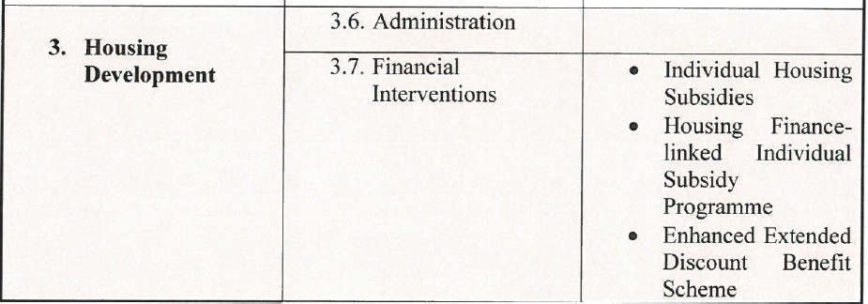
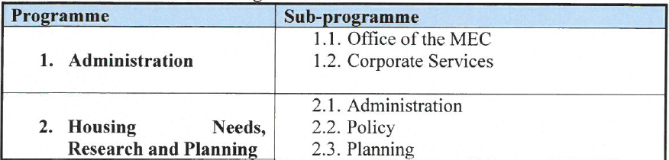
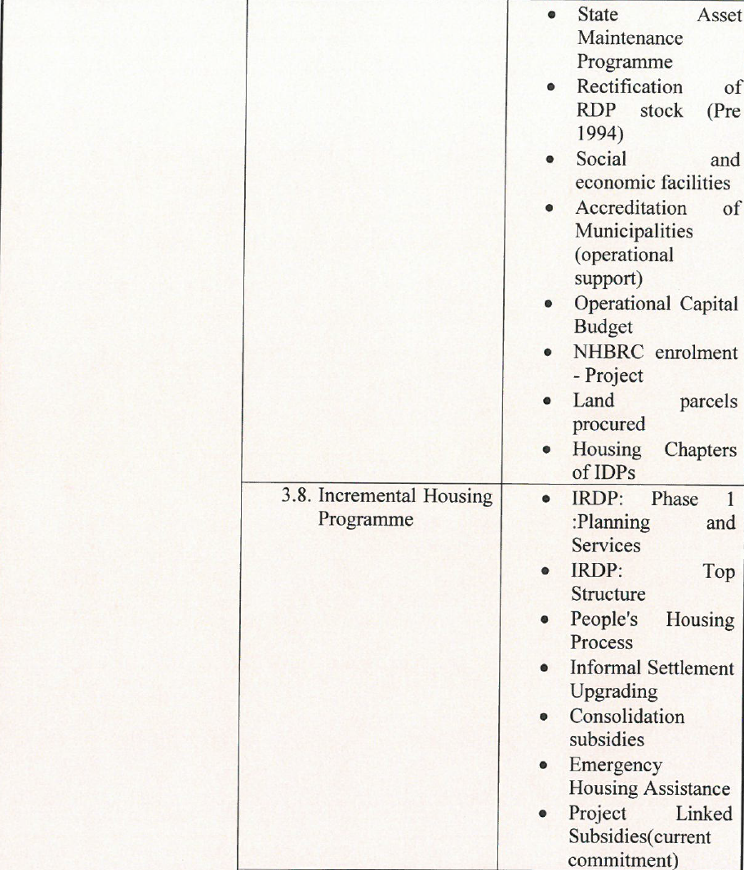
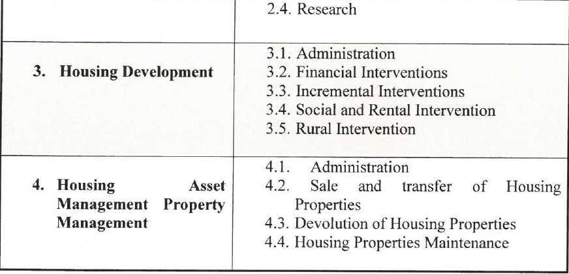
Department of Human Settlements
Alternative budget programme structure
New Structure
Old Structure

Slide 36
Ring-fencing the operations of NSFAS
  Easier to assess if the NSFAS entity is being efficient and effective in its administration
  Give assurance that funds designated for loans, grants and bursaries are not being used to fund operations
  Provide a better understanding of the actual position of the NSFAS loan scheme – an inherently complicated exercise
Example of alternative programme structure
Consolidated Financial Statements of NSFAS
These would be essentially the same as the current financial statements, though structured to reflect the different components of NSFAS better.
Financial Statements
of the
NSFAS Entity
These would cover the ring-fenced operations of the NSFAS entity, including all operational income and expenditure related to managing the financial assistance products.
Financial Statements
of the
NSFAS loan scheme
These would cover the grant income received for the loan scheme, all loan disbursements and all transactions related to the debt book: interest, recoveries, debt write-off.
It would also cover any investments linked to the scheme.
Financial Statements
of the
TVET grant scheme
These would cover the grant income received for the TVET grants any interest earned on the funds, and all disbursements to beneficiaries.
Financial Statements
of the
managed bursary funds
These would cover the transfers received in relation to each of the managed bursary funds, any interest earned on the funds and all disbursements to beneficiaries.

Slide 37
Exercise 6.3: Thinking through saving scenarios
Using the INSET Costing Model, on the Totals and Scenarios sheet:
  Using Scenario 2, develop a set of cost saving proposals that you think would ensure a cost effective delivery of INSET
  You are informed by MTEC that the budget allocation for INSET rollout will be R800m in 2014/15, increasing by R500m in both 2015/16 and 2016/17, with an additional R500m spread over the MTEF for capital. Using Scenario 1 develop a proposal as to how INSET should be rolled out given these budget constraints.

Slide 38
Questions or comments?

