Slide 1
Sessions 14-15
Costing Models
Using and developing Excel-based models to cost
government policies and programmes

Slide 2
Overview of Sessions
Session 1-3
Introduction & Savings
What to expect, how will we work?
Session 5-6
Problem statement Institutional framework
What is this delivery programme about?
Session 7-8
Develop the logical framework
How does the programme work?
Session 9
Indicators
How is it measured and how should it be measured?
Session 10-13
Analyse expenditure
What are we spending on the programme?
Session 14-15
Build a model to cost the programme
What does it actually cost to deliver the programme?
Session 16
Savings and re-allocation - technical aspects
How do we show savings?

Slide 3
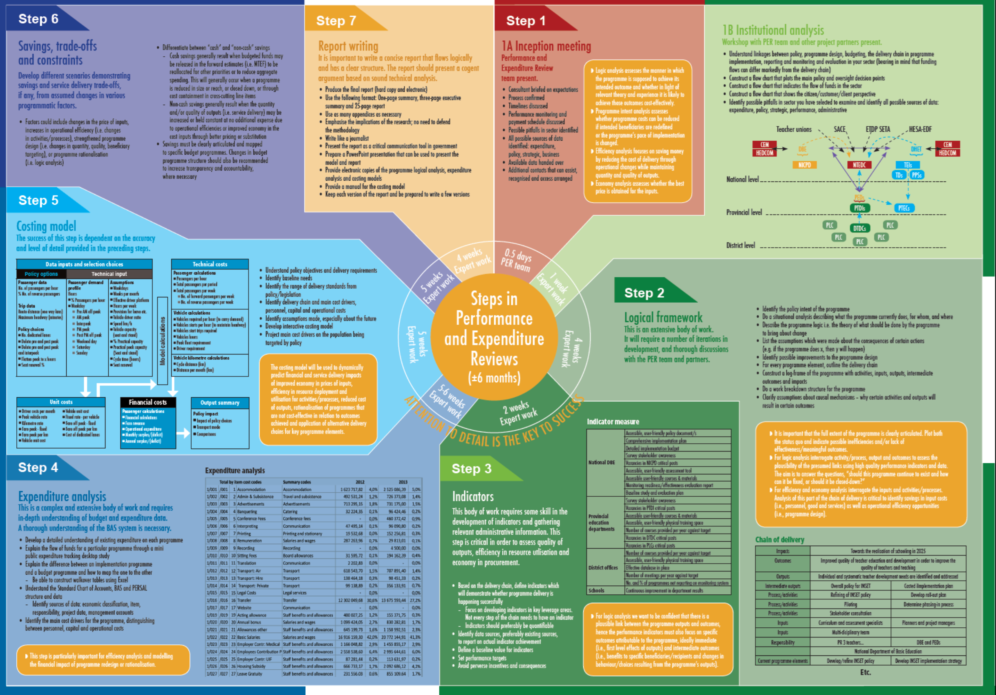

Slide 4
Exercise 5.1: What does “costing government policy” mean?
Think of building a bridge…
  list the different types of information you will require in order to work out the cost of building a bridge
  list the practical steps that are followed when working out the cost of building a bridge
Think of improving the in-service training of teachers…
  list the different types of information you will require in order to work out the cost of improving in-service teacher training
  list the practical steps that are followed when working out the cost of improving in-service teacher training
Discuss why government generally works out the cost of building a bridge before making a decision, but rarely works out the cost of a social policy before making a decision?

Slide 5
Learning outcomes
By the end of this module, you should be able to:
  Understand what is costing and how to calculate costs
  Evaluate the quality of a costing model
  Use existing costing models to support your work
  Develop your own simple costing model

Slide 6
Tuesday afternoon
  Introduction
  Prerequisites for using / building a costing model
  The core of all costing models
Wednesday
  Defining inputs and prices
  Estimating demand for services
  Presenting the costing results
  Presenting policy choices
Thursday
  Principles for building costing models
  Two slides on technical excel stuff
  Steps in building a costing model
Overview of module

Slide 7
Exercise 5.2: What is a model?
Again, think of building a bridge
  Describe what you understand by the word “model” in this context?
  What is the value of a model bridge?
Think of improving the in-service training of teachers…
  What do you understand by the word “model” now?
Does a model need to be on a spreadsheet?
What are the advantages of building a model on a spreadsheet?

Slide 8

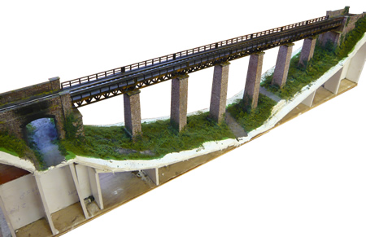
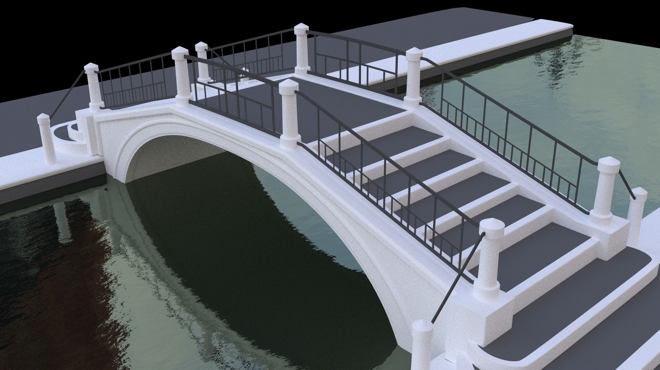

Slide 9
Prerequisites
To use / build a costing model, you will need to have…

Slide 10
Prerequisites - Institutional analysis (session 5)
Process maps or flow charts
  Can you draw a picture of how activities link together so you can present this logically in an Excel model?
    Do you understand how different processes tie role-players together?
Flow of funds
  Do you understand the intergovernmental financial relations and budgets in government with respect to the programme?
    Can you map spending to spheres of government, departments and entities … and Votes, budget programmes and sub-programmes?

Slide 11
Prerequisites – Programme logic analysis (session 7)
Logical framework - do you understand:
  the key programme elements involved in the delivery of the programme?
  the delivery chain linking inputs to activities to outputs?
  the cost-drivers?
      factors affecting demand for services, supply of inputs and how inputs becomes outputs
  how demand for the programme is measured?
The key policy questions the model needs to answer
  Do you have a good sense of the “what if” questions with regards
  to existing processes?

Slide 12
Prerequisites – Key performance indicators (session 8)
Access to information
  Do you have a good knowledge of where to find:
    census data
    administrative data for health, education etc.
    performance data
  Norms and standards that apply to the programme
    Both explicit and implicit?
    How do norms and standards describe the relationships between demand, inputs and outputs?
  Information comes from legislation, international agreements, regulations, strategic plans, management protocols…
  and from the heads of practitioners

Slide 13
Prerequisites – Expenditure analysis (sessions 9-12)
Expenditure analysis of the programmes
  Do you understand the structure of expenditure?
    What types of expenditure are significant and therefore need to be modelled explicitly?
    What are the relationships between different types of costs?
      Can some costs be modelled as proportions of others?
      What are those proportions?

Slide 14
Preparing to use / build a costing model
Costing model
Market prices
Actual service delivery
Non-government funding
Programme
logic
analysis
Norms and Standards
Processes, activities and inputs
Expenditure
analysis
Price
Govt price standards
Regulations
Govt Accounts
Institutional structure
Demand
Expenditure reports
Legislation
Institutional
analysis
Key policy questions
?
Key performance
indicators
Policy
Performance information
Powers and Functions Assigned (usually in a Constitution)
Demographic and Administrative Data

Slide 15
Questions or comments?

Slide 16
The core of all Costing Models

Slide 17
What’s in a costing model?
Costing is the process of using the following equation to estimate total programme costs
This equation is used in many different forms to estimate the cost of many layers and types of activities
Each element of this equation will be discussed in detail
x
x
=
Cost
Quantity
Input
Price

Slide 18
Costing an existing programme versus costing a new policy
Existing programme
  There is more information on:
    actual expenditures
    implementation systems, processes and procedures
    practical norms & standards
  Compare policy with the practice
  Costing involves modelling reality
    this can be a challenge since there is a baseline that the model needs to replicate
  Very often implementation does not reflect policy intent, so may need to model
    a current practice scenario
    a policy scenario
    a rollout scenario
New policy
  The policy is often thin on implementation details
    need to speak to people in the field to find out how the policy is likely to be implemented
    look at other similar programmes
  Costing involves imagining what implementation will look like
    this requires a thorough understanding of the policy intent, the implementing institutions and how government programmes are structured
  Provide for set-up costs
  Very often policy is ambitious, so may need to model
    a full policy scenario
    a pragmatic scenario
    a rollout scenario

Slide 19
Costing brings fiscal realities into policy discussions
Policy often reflects ambitious, idealistic best practice
    scope of the policy
    norms and standards
    coverage of intended beneficiaries
  objectives are laudable, but not fiscally affordable or sustainable
A costing model explores the fiscal implications of policy
  identify pragmatic options that are more affordable and sustainable.
    moderating the scope of the policy
    reducing the norms and standards from best to good practice
    restricting the eligible beneficiaries to those most in need
  construct the costing model so that the implications of these changes can be explored

Slide 20
Exercise 5.3: Application of the costing equation
Develop a costing (budget) for a party you are organising.
Reflect on the steps you followed in developing this costing, and list them in a logical order.
If your party has to be postponed by a year, how will that affect your costing?
If you are told that the budget for your party is only sufficient to cover 75% of your original costing, what are you going to do?

Slide 21
Defining inputs and prices
x
Input
Price

Slide 22
Every input has price
  However, you need to decide which inputs to count
Identify key activities and inputs - 80/20 Principle
Understand the nature of different inputs/costs
  capital versus operating inputs/costs
  set-up versus ongoing inputs/costs
  fixed versus variable inputs/costs
  direct versus indirect inputs/costs
  inputs where TIME is a variable
Because their nature determines how to cost them
Defining inputs and prices

Slide 23
Capital inputs
Things that get capitalised in accrual accounting
Buildings and facilities
  either based on detailed plans or standard building costs
  may not be taken into account if facilities exist
  usually part of the set-up costs of a programme
  how does one treat major renovations?
Major capital equipment
  a ICU unit or a mobile clinic
  vehicles
Operating inputs
Things that get expensed in accrual accounting
Personnel
  the largest input in most programmes
Transport
Programme specific inputs
  medicines
  textbooks
Transfers to NPOs
Capital
versus operating inputs/costs

Slide 24
Set-up inputs/costs
What is required to get a programme up and running?
Relevant to the costing of new services and the significant expansion of current services
Show separately because of their non-recurrent nature
Examples?
Ongoing inputs/costs
What is required to keep a programme running?
  distinguish between ongoing costs and the impact of rollout
The estimated annual budget required to run the programme
Show cost for each year of the MTEF
How do you treat price increases?
Examples?
Set-up
versus ongoing inputs/costs

Slide 25
Fixed inputs/costs
  Don’t change in the short term despite changes in volume of output
  Change only when significant increases or decreases in volume occur
  Examples
Variable inputs/costs
  There is a direct relationship with changes volume of output
  May be lumpy
    increase in a step-wise fashion as the volume of service increases
    vary according to seasonality, cycles or specific time periods for delivery
  Examples?
Fixed versus variable inputs/costs

Slide 26
Direct inputs/costs
Inputs that are required for the delivery of the programme AND that are paid for by government
  i.e. it is a direct cost to government
Apply the 80/20 principle
Certain direct inputs may be treated as ‘out-of-scope’ because of the focus of the costing model
Indirect inputs/costs
Inputs that contribute to the delivery of the programme, BUT that are not paid for by government
Examples:
  Taxi fares to the clinic
  The opportunity cost of volunteers' time
  The imputed cost of in-kind contributions or existing infrastructure
Not included – unless doing an RIA or there is a particular policy question that needs to be answered
Direct
versus indirect inputs/costs
Overhead expenses
Costs of supervision and corporate services

Slide 27
Inputs where TIME is a variable
Used to determine the required capacity of facilities and the required number of personnel
  e.g. time taken for an interview
Important for determining the quality of service
  if there is a waiting period what happens in the interim
  e.g. if adoptions take 3 months for approval what happens to the child in the interim and what other costs are incurred during that period
Responsiveness of early intervention measures
  certain actions are needed at a specific time, any delay detracts from the quality, usefulness of the service
  e.g. emergency medical services

Slide 28
Where does one find price information?
Where to obtain prices?
  Historical accounting information
  Past purchase invoices
  Suppliers and retailers
  Employee time sheets
  Employee pay roll or DPSA salary scales
Need to check that prices are ‘current prices”
May need to adjust for inflation
May need to adjust for escalation or term agreements
For certain imported inputs, the exchange rate may be important

Slide 29
Exercise 5.4: How does one model different inputs?
Go to the GenAssumptions sheet in the INSET Costing Model and analyse the Course Assumptions from line 33 down
List 10 different inputs that have been included in the costing of INSET courses
Can you think of any additional inputs related to INSET courses that should have been included?
Discuss how time has been factored into the costing of INSET courses
Identify three other instances where a time variable is costed in the INSET model, and note how it is costed
How is Infrastructure costed in the INSET Model
Why is the costing of courses placed on the GenAssumption sheet?

Slide 30
Questions or comments?

Slide 31
Estimating demand for services
Quantity

Slide 32
Who are the intended clients or beneficiaries?
  How are they identified?
  Is the programme designed to reach a specific sub-group?
Where is demand for each service located?
  What impact does the location of demand have on costing?
What is the current level of output?
What is the required/desired level of output?
What is the relationship between demand, process variables and the different kinds of inputs?
Questions to ask when estimating the demand for services

Slide 33
How does the timing of demand impact on cost?
Some services are needed immediately
  emergency removal of children from dangerous places
  emergency medical care
Some services can have a lead time
  fostering and adoptions
Some services can be delayed
  counseling, assessments or court processes
How do these differences affect the cost of services?

Slide 34
Things you need to think about when considering demand
When thinking about the demand for a service, consider:
  Number
  Volume
  Regularity/frequency
  Quality
  Time period
  One-off/continuous
Relate the demand to
  How long do processes take?
  What are the expected waiting times?
  Who is involved?
  What resources get used?

Slide 35
Factors influencing demand
Demographic factors
  Population profile, birth/mortality rates, poverty, migration
Social factors
  Crime rates, gang-related activity, family structures
Health factors
  HIV/Aids, TB
Success or failure of policy
  If prevention is unsuccessful demand is higher
  If adoption policy is successful, the demand for care decreases

Slide 36
Sometimes estimating inputs is really complicated
Can you explain what is being done on this page?

Slide 37
Exercise 5.5: Estimating demand
With reference to the INSET Costing Model
What variables are used to estimate the demand for INSET courses?
Which variables would you regard to be the key drivers of demand? Where are they set?
What happens to costs if the number of training days teachers have to complete in a three year cycle increases to 45 days?
Suggest three pragmatic approaches to changing the demand for courses that would reduce costs?
How is the demand for infrastructure worked out in the INSET model?

Slide 38
Questions or comments?

Slide 39
Presenting the Costing results

Slide 40
Summary tables should show the following
The costing results
  Start-up costs
  Operating costs
  Capital costs
  Present breakdowns by main input items
  Present breakdown by main activity
Supporting information on outputs
Supporting information on key inputs
  Breakdown of personnel numbers
  Large capital items – buildings, vehicles
  Other key inputs

Slide 41
Summary of costs by item

Slide 42
Summary of costs by main activity

Slide 43
Summary information on outputs and unit costs

Slide 44
Comparison of costing outcome to budget baseline
From the Nutrition Costing Model

Slide 45
Presenting policy choices

Slide 46
INSET Costing Model –
Using drop-down options

Slide 47
Nutrition Costing Model –
Setting values in relation to bar graph

Slide 48
NSFAS Costing Model –
Options in relation to a baseline

Slide 49
Exercise 5.10: Exploring policy choices
Open the INSET Costing Model – Totals and Scenarios
  Identify the top three cost drivers of INSET.
  Given the current budget constraints develop a scenario that you would recommend to MTEC for funding.
Open the Nutrition Costing Model – Budget Choices sheet
  Develop a scenario for the health component where expenditure equals the available budget of R1.5 billion.
  What is your view of the resultant scenario in 1?
  Develop a scenario for the health component that you would recommend to MTEC for funding.
Open the NSFAS Choices Model
  Using the model to identify interventions that would improve the financial viability of the NSFAS scheme

Slide 50
Questions or comments?

Slide 51
Read the following…
The challenge in modelling lies in the structure of the spreadsheet and which functions should be used to create an efficient and sophisticated model that is easy to use and can accommodate a wide range of eventualities.
Amateur modellers will want to solve the immediate problem. Their focus is on the problem and their challenge is how best to solve it and very often the spreadsheet becomes an impediment.
An experienced modeller is likely to approach the problem from a spread-sheeting perspective. The spreadsheet becomes a tool for representing and exploring reality, thus gaining exciting insights into the nature of the problem.
Adapted from: Grossman , T (2002). Spreadsheet Engineering: A Research Framework

Slide 52
Principles for evaluating and building costing models

Slide 53
Exercise 5.4: What is a good costing model?
Discuss what is meant by the following statements
Building a good costing model is
a blend of both art and science
Jonathan Carter, 2015
Senior Economist with Cornerstone Economic Research
No costing model is right – in the objective sense,
but a costing model can be wrong
Conrad Barberton, 2016
Senior Economist with Cornerstone Economic Research
You are asked to evaluate the PER INSET costing model:
  List the things you like about the model.
  List the weaknesses/shortcomings you can see with the model.

Slide 54
Balancing the art and science of costing
80/20 principle – too much detail is a bad thing!
Transparency – show all assumptions and calculations
Formatting principle – keep it simple and be consistent
Ordering principle – arrange the worksheets logically
Colouring-in principle – use colours to identify cells
KISS principle – keep it (all parts of the model) simple…
Apply these principles from the very beginning
it saves a lot of time!
Principles for building costing models

Slide 55
Balancing Art and Science
KISS
principle
80/20
principle
building a good Costing Model
Colouring-in principle
Transparency principle
Ordering
principle
Formatting principle
Apply these principles from the very beginning
it saves a lot of time!

Slide 56
Balancing the art and science of costing
Always keep in mind that
Building a good costing model is
a blend of both art and science
One is objective and the other subjective
  The science dimension involves data, formulas and math
    The calculations are either right or wrong
  The art dimension involves imagination, assumptions and judgement
    Does the design of the model adequately reflect reality?
    Are the key assumptions reasonable, realistic and informed?
Getting the balance right requires judgement - strengthened by experience

Slide 57
80/20 principle
Too much detail is a bad thing!
  focus on the 20% of cost components which account for 80% of the costs
  focus on getting 80% of the costs by doing 20% of the costing work
How does one avoid too much detail?
  Focus on identifying the key cost drivers -
    the main programme elements and activities
    the key groups of clients or beneficiaries of the service
    the main inputs, activities and outputs of the service
  Avoid trying to work out “How long is a piece of string?”
    simply make an informed assumption or
    identify a plausible range

Slide 58
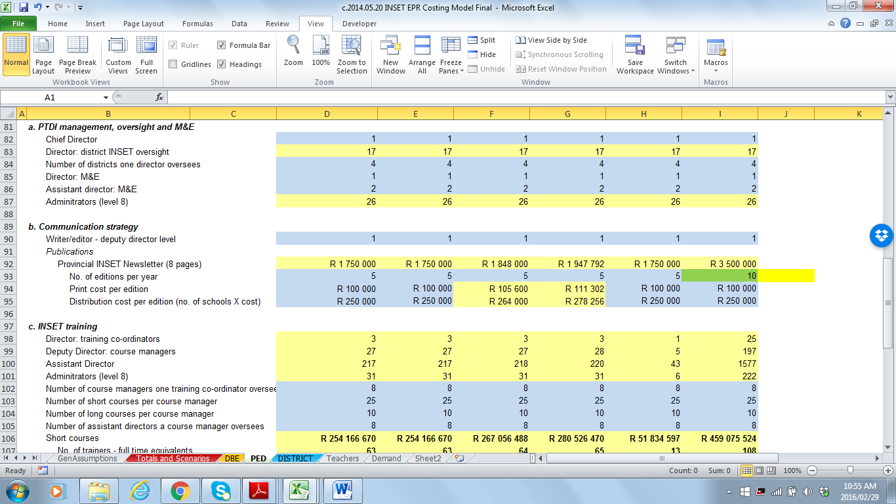
Transparency
Show all assumptions and calculations
  avoid using hidden sheets, hidden cells or hidden formulae
Avoid building assumptions into the formulae
  Wrong if: Administrators (level 8) : 26 = (D82*9)+D83
  Right if: 26 =IF($C$1=$U$14,(D82*9)+D83,D82+D83)
    Can you explain the difference?
Use the notes function to provide explanations

Slide 59
Formatting principle
Keep formatting simple and be consistent
  structure similar sheets the same way
    data sheets, working sheets, results sheets
  avoid blank columns or rows when working with series data
    makes it more difficult to drag or copy & paste formulae
  summary data should be structured in exactly the same way on each sheet - identical cell references
    this facilitates the consolidation / adding-up of information

Slide 60
Ordering principle
Arrange the worksheets logically
  contents and descriptions, result sheets, working sheets, data
  colour the sheet Tabs to distinguish different kinds of sheets

Slide 61
Colouring-in principle
Use colours to identify different types of cells
  information cells –
    descriptions of inputs or assumptions
  number input cells –
    where number assumptions are inputted
  formula cells –
    where the results of formulae are shown
clear / white
light blue
light yellow

Slide 62
KISS principle
Keep it (all parts of the model) simple…
  Show calculations in steps rather than using long formula
  Use sheets to separate different types of data/information
  Use the Group function to make it easier to navigate

Slide 63
Exercise 5.5: Applying the core principles
With reference to the Khanyile Costing:
Open the Khanyile Costing – Example 1:
  Can you explain the key question this costing model is trying to answer?
  Identify and discuss areas where the core principles have not been followed in this model
  What would you do to improve the model?
Open the Khanyile Costing – Example 2:
  Why is this model more useful?

Slide 64
Questions or comments?

Slide 65
Two slides on technical excel stuff

Slide 66
Technical tips - 1
Learn how to use the following Excel functions:
  INDEX
  MATCH
  V/HLOOKUP
  IF
  SUMIF
  SUMPRODUCT
  Drop down menus (Data validation/Lists)
  Group function
  Think about the above when ideas swirl in your head
Conditional formatting has its merits, but keep it simple

Slide 67
Technical tips - 2
Keep the design structure aligned across sheets
  so you can use shortcut drag / copy and paste functions
Avoid macros
  not enough people understand how to use them
Avoid using cell names (named cells) –
  they reduce the transparency and ‘traceability’ of formulae
  they create problems when sheets are copied
  into a workbook

Slide 68
Steps in Building A costing Model
Cost

Slide 69
Exercise 5.6: Why can’t we simply use a costing model template?
Discuss why you have not simply been given a “costing model template” (like the budget format template) for costing government programmes?
Within the context of building costing models, discuss what is meant by “form follows function”?
What do you think the advantages and disadvantages are of building a unique costing model for each new costing project?

Slide 70
Preparation
Specify
Summarise
Check
Build formulae
Design
Policy choices
Steps in building a costing model
Step 1 – Preparation
Step 2 – High level design of the costing model
Step 3 – Specify activities, demand and inputs
Step 4 – Build the costing formulae
Step 5 – Summarise the costing results
Step 6 – Check, check, check
Step 7 – Develop the policy choices sheet
The process is very often not linear, and one finds oneself having to go back to previous steps
Building a costing model is a learning process

Slide 71
Step 1 - Preparation
Preparation
Are all the prerequisites in place?
  Have you done the background research?
  Have you gathered the data you require?
Do you have a really good understanding of the programme?
  Process map / flow chart of programme (covered in Module 1)
  The logical framework (covered in Module 2)
  The norms and standards (covered in Module 3)
    If clear norms and standards do not exist, then you will need to develop your own set, which become variables in the model
  The expenditure analysis (covered in Module 4)
Do you know what policy questions you need to answer?

Slide 72
Understand the institutional context of programme delivery
Costing models need to be structured to reflect the institutional environment
So the costing model may need to calculate costs by:
  sphere of government,
  individual province or municipality,
  different national and provincial departments,
  public entities,
  non-governmental organisations,
  and sometimes even private sector entities and individuals.

Slide 73
Keep focussed on the key policy questions
Keep asking yourself:
What are the key policy questions that this model
should be able to answer?
Then design the model so that it can be used to ask and answer those questions quickly and easily
  develop short-cut methods of asking and answering
    e.g. toggling a few buttons/numbers on one sheet
  set this up in a front ‘policy choices’ sheet
  use graphs (that are simple)…to present answers
Policy-makers want answers to a limited number of questions
  the trick is to answer each question in the way it is asked

Slide 74
Example:
  In nutrition programmes you want pregnant women to take folic acid before, during pregnancy and also while they are breastfeeding.
Politicians may want to ask:
  What is the impact of increasing/decreasing expenditure on this intervention by 20%? How many more/fewer pregnant women will benefit from this intervention?
  What is the impact on the budget of expanding the intervention from all pregnant and breastfeeding women to all women in the reproductive age group?
Each of these questions requires a different model
  It helps a to know which questions politicians are likely to ask and therefore whether you need to develop one
  or two models.
Why does “the way the question is asked” matter?

Slide 75
Balance key policy questions against core information
A costing model must answer the key policy questions
  Since these differ, the design of each costing model will differ
Still, all models should show:
  capital versus operating costs
  set-up versus ongoing costs – especially for new initiatives
  personnel costs
    disaggregated by function of employee
      e.g. show nurse and doctor salaries separately
  the cost of key inputs
    different medicines in health
    textbooks vs classroom consumable in education
    transport vs food vs salary costs in a feeding scheme

Slide 76
Step 2 – High level design of the Costing Model
Design
Develop the overall structure of the workbook
  Identify what worksheets you need and name them
  Develop sensible tab ‘names’ (not numbers or letters)
  Colour the tabs for sheets with data, workings and results
  Will you require a ‘GenAssumptions sheet?
Design the overall structure of the different kinds of sheets
  Headings and sections
  Scenarios
  Costing results, and summaries of costing results
  Demand assumptions
  Activity assumptions – inputs and prices
  Start colouring-in the cells
Insert the data sets you will be using

Slide 77
Deciding on the structure of scenarios
Nature of the programme and the time parameters of the costing influence how one approaches scenarios
As a minimum, provide for costs over an MTEF period
Proposed scenarios (choosing appropriate names is important)
  ‘baseline’ or ‘current’ – existing levels of service
  ‘full cost’ – complete implementation of the policy
  ‘pragmatic’ – proposed costing saving policy options
  ‘rollout’ – different rollout options
Design model structure so that new scenarios can be added
For some programmes it is better not to include scenarios:
  it would make the model too complicated
  better to run scenarios on different copies of the model

Slide 78
Examples of scenario naming
Scenarios in the INSET Costing Model
Scenarios in the MAFISA Costing Model
Scenarios in the Nutrition Costing Model

Slide 79
Step 3 – Specify activities, demand variables and inputs
Specify
Organise the activities you are going to cost on the workings sheets
  List the demand variables and key input variables
    Personnel, time variables, price variables
  Keep variables that belong together close together
  This involves thinking through each activity
Start colouring-in the cells
Identify variables that should be placed on the GenAssumptions sheet
Keep the design structure aligned across sheets
  so you can use the drag / copy and paste functions

Slide 80
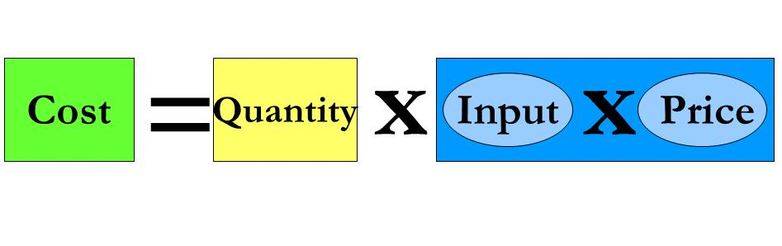
Step 4 – Build the costing formulae
Build formulae
If the structural design of your model is good, it greatly facilitates the building of costing formulae
  column and row references exactly the same
  demand data structured the same as input and price data
Apply the formula:
Work systematically, accurately and don’t rush
Apply the KISS principle
When building the formulae you will likely find that you require more demand variables, different input variables etc. Change things in a systematic way

Slide 81
Step 5 – Summarise the costing results
Summarise
In design step
  Specify where the costing results will be summarised
  What kinds of summaries you will require?
Summarise costs
  overall total costs – showing set-up, ongoing costs and capital totals by type of key inputs and other
  totals by main activity / type of institution
  totals by sphere of government, by province, by municipality
Summaries of outputs by activity
Summaries of personnel and key inputs
Explore options for unit cost and marginal cost calculations

Slide 82
Create a flow diagram of your model
Develop a flow diagram to show:
  the structure and the logic of the model
  place this in front of the model
Gives a snapshot of where the various components are

Slide 83
Step 6 – Check, check, check
Check
Use different approaches to summarise costing totals
  SUMIF and straight adding
Check for consistency across different costing summaries
  input cost totals = activity cost totals
Test if the model is robust
  do ‘back of the envelope’ type calculations to check whether costing results are of the right order of magnitude
  run extreme scenarios on key demand and input variables and check if the model behaves as expected
  run incremental scenarios (25, 50, 75%) and check if the results are consistent
    be aware of the impact of fixed costs versus variable costs
Get a new set of eyes to go through the costing model
  present the costing model to subject experts

Slide 84
Step 7 – Develop the policy choices sheet
Policy choices
What are the main policy questions?
  aim to provide answers that reflect how the question is asked
Develop a dynamic ‘policy choices’ sheet where the implications of different options can be explored
Keep the options simple and realistic
  use dropdown options, toggle buttons or simple input cells to specify different options
Illustrate the results of different options using simple graphs
Reflect options in relation to a baseline
  a current funding baseline or a baseline scenario

Slide 85
Exercise 5.7: Building a costing model
Refer to Section 9 of the Act - Right of orphaned and vulnerable children to registration:
Develop a simple process map for this provision.
Identify a list of variables that are necessary to cost this provision.
Using the information sheet given, develop a basic costing model in Excel distinguishing between set-up costs and operational costs.

Slide 86
Input | Price
Chief Social Worker per year | R200,240
Social worker per year | R164,643
Administrative clerk per year | R83,309
Food services aid worker per year | R55,858
Security guard per year | R55,858
Computer | R6,000
Printer | R1,600
Telephone | R90
Telephone line rental per month | R85
Fax machine | R1,500
Photostat machine rental per month | R350
Printing paper per ream | R40
Photocopying per page | R0.18
Files | R8
Desk | R1,200
Chair | R900
Filing cabinet | R1,200
Stationery per month | R200
Certificates | R20
Postage per month | R200
Tea | R13
Coffee | R25
Biscuits | R12
Exercise 5.9
Building a costing model:
list of inputs and prices

Slide 87
Questions or comments?

Slide 88
NEXT SESSION WILL BE:
Module 16 Saving, trade-offs and constraints

